Slide 1
The best textbook is only as good as the mind that uses it!
Oct. 5, 2019
Eli Ghazel
Eli Ghazel 2019

Slide 2


Because Learning Changes Everything

Slide 3
Part 1: Language and Literacy
Part 2: Lesson Plan for Words
Part 3: Lesson Plan for Comprehension
Part 4: Lesson Plan for Writing
Part 5: Inquiry based learning
Eli Ghazel 2019

Slide 4
Language and Literacy
What is the difference between Language and Literacy?
Eli Ghazel 2019

Slide 5
Language and Literacy
Language communicates meaning.
It can be heard.
It can be spoken.
It can be signed.
If you are a human, you have a language!
Eli Ghazel 2019

Slide 6
Language and Literacy
Literacy communicates meaning, too.
It can be read.
It can be written.
It can be coded.
Not all languages have a code form (written).
Eli Ghazel 2019

Slide 7
Language and Literacy
The problem with current problem with language learning is that we are testing LANGUAGE through LITERACY
Eli Ghazel 2019

Slide 8
What is language made up of?
Language is made up of words.
hear it
say it
read it
write it
words
pen pen pen pen
What can we do with a word?
We can modify it for different purposes.
- singular / plural
- prefix / suffix
- classification / categorization
Eli Ghazel 2019

Slide 9
What is language made up of?
Language is also made up of details. (Joining words)
What can we do with a detail? How do we form a detail?
hear it
say it
read it
write it
words
pen pen pen pen
a nice
blue pen
a nice
blue pen
a nice
blue pen
a nice
blue pen
details
One of the most important reasons for learning LANGUAGE grammar is to understand and form details.
- Adjective - noun word order
- Order of adjectives
- Position of preposition
Eli Ghazel 2019

Slide 10
What is language made up of?
Language is also made up of sentences. (Joining details)
What can we do with a sentence? How do we form a sentence?
hear it
say it
read it
write it
words
pen pen pen pen
a nice
blue pen
a nice
blue pen
a nice
blue pen
a nice
blue pen
details
sentences
I need a
nice blue
pen.
I need a
nice blue
pen.
I need a
nice blue
pen.
I need a
nice blue
pen.
Sentence grammar is different from detail grammar.
Eli Ghazel 2019

Slide 11
What is language made up of?
Language is also made up of text. (Joining sentences)
What can we do with a text? How do we form a text?
hear it
say it
read it
write it
words
pen pen pen pen
a nice
blue pen
a nice
blue pen
a nice
blue pen
a nice
blue pen
details
sentences
I need a
nice blue
pen.
I need a
nice blue
pen.
I need a
nice blue
pen.
I need a
nice blue
pen.
texts
Sorry, grammar stops at the sentence level. Texts and passages work in a different way.
Eli Ghazel 2019

Slide 12
What is language made up of?
Find the grammar mistake in the sentences.
Eli walked into the room. She sat in the empty chair in the corner.
There is no grammar mistake in each sentence. There is a reference error.
Eli Ghazel 2019

Slide 13
Language Essentials
Other than listening, speaking, what other strand can be added to language?
Another strand in language is the exchange or dialogue.
Conversation or dialogue
hear it
exchange
say it
read it
write it
words
We can have a conversation at word levels only!
pen pen pen pen
details
a nice
blue pen
a nice
blue pen
a nice
blue pen
a nice
blue pen
We can have a conversation at detail levels!
See the next slide for an example of exchange at a word level.
Eli Ghazel 2019

Slide 14
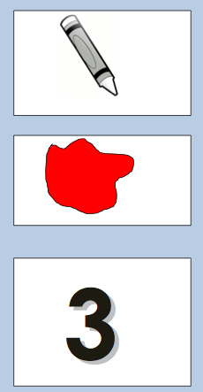
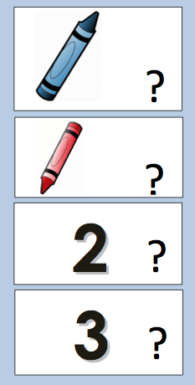


Exchange (words)
Request
Dialogue
Ibrahim?
Yes?
Crayon, please.
Blue?
No
Red?
Yes
2?
No
3?
Yes
Here
Thanks
You’re welcome
14
Eli Ghazel 2019

Slide 15
Active learning!
Designing a two to three step task
that helps every student reach
the ability of the “I CAN” statement
using the content on the pages
is the right way to go.
This is called ”de-fluency” or “scaffolding”.
Eli Ghazel 2019

Slide 16
Active learning!
Task 1/3 Look at the picture. Tell each other in pairs as many words as you can in one minute. Use your pair voice.
Details
Eli Ghazel 2019

Slide 17
Active learning!
Task 2/3 Read the article for very quickly. Find more words that could be in the picture and underline them. Now tell each other in pairs what your words are. Use your pair voice.
Eli Ghazel 2019

Slide 18
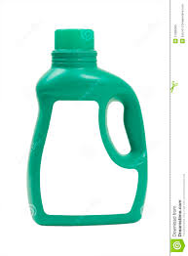


Active learning!
Task 3/3
Find these new words in the article. For each word, read the sentences before and after the word. Make a concept map for word; write words that “can go” with it (or draw quick pictures).
water
cup
cup
juice
flower
”LEVEL” is what you are able to do with the content and not the content itself.
Eli Ghazel 2019

Slide 19
Active learning!
Task 3/3
Find these new words in the article. For each word, read the sentences before and after the word. Make a concept map for word; write words or details that “can go” with it.
what
for tea or coffee
cup
where
In the kitchen
1
why
To drink
”LEVEL” is what you are able to do with the content and not the content itself.
Eli Ghazel 2019

Slide 20
Active learning!
Task 3/3
Read the text. For each word in red, find one sentence or example and write it on the line.
TEXT
It is morning. My dad and mom are in the kitchen. Dad is drinking coffee. He looks out of the kitchen window. He sees a bird.
Etc…..
cup
Dad is drinking coffee.
1.
2.
tree
He sees a bird.
”LEVEL” is what you are able to do with the content and not the content itself.
Eli Ghazel 2019

Slide 21
Language and Abilities
Instructions: Is it possible to give this text to a kindergarten student?
What do you think? Tell each other.
Eli Ghazel 2018

Slide 22
Language and Abilities
Teacher to the students: Listen to the letter I say. Find as many of those letters and underline them. (Teacher says ‘C’.)
Level is NOT
the content.
Level is the task that
a student
is able to do
with the content.
Eli Ghazel 2019

Slide 23
Everyone makes sense of language in a similar way.
Say one of these questions words when you see an image.
WHO WHAT WHEN WHERE
Eli Ghazel 2019

Slide 24
Everyone makes sense of language in a similar way.
Say one of these questions words for each word or details you see below.
WHO WHAT WHEN WHERE
Cup
What
A white cup
What
A small white cup
What
One small white cup
What
In one small white cup
Where
By adding a preposition of position “IN” to a “WHAT detail”, the detail changes its meaning to WHEN
Eli Ghazel 2019

Slide 25
Everyone makes sense of language in a similar way.
Say one of these questions words for each word or details you see below.
WHO WHAT WHEN WHERE
Heba and Ahmed
Who
Heba and her son Ahmed
Who
Kitchen
What
In the kitchen
Where
Saturday
What
On Saturday
When
Eli Ghazel 2019

Slide 26
For words to be learned and used:
They need to be used meaningfully.
They need to be conceptualized.
They need to be associated with other words and details.
They need to be used to construct meaning for other words and ideas.
Eli Ghazel 2019

Slide 27
Word task (reading)
Science connection
Find the words that do not belong in the columns, circle them and draw lines to show which columns they should belong in.
 | TOYS | COLORS | FRUIT | PEOPLE
1 | doll | red | banana | kiwi
2 | sister | blue | apple | teacher
3 | ball | green | yellow | father
4 | Lego | chess | pear | driver
5
What went on in your brain?
How did your brain process the information?
1st Compared and contrasted information in each category.
2nd Identified the item that is different
3rd Classified information.
[Critical thinking]
Eli Ghazel 2019

Slide 28
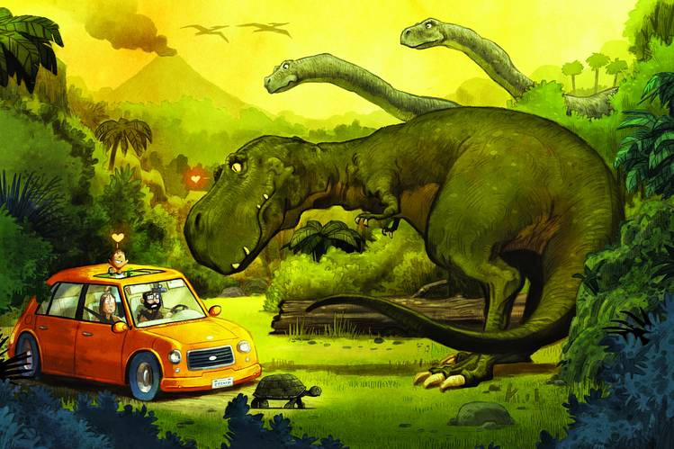

Detail task (language)
Say at least three WHAT details for this picture.
WHAT
This can also be done as a writing task. See next slide.
slow little turtle
big green dinosaur
small yellow car
Eli Ghazel 2019

Slide 29
Detail task (literacy)
Write at least three WHAT details for this picture.
WHAT
big green dinosaur
small yellow car
slow little turtle
Eli Ghazel 2019

Slide 30
Detail task (language)
Say at least three WHERE details for this picture.
WHERE
This can also be done as a writing task by just changing the instructions.
Under a slow little turtle
Next to a big green dinosaur
In a small yellow car
Eli Ghazel 2019

Slide 31
Detail task (language)
Say at least three WHAT - WHERE details for this picture.
WHAT - WHERE
This can also be done as a writing task by just changing the instructions.
A nice car next to a big green dinosaur
Green ground under a slow little turtle
Four seats in a small yellow car
Eli Ghazel 2019

Slide 32
Detail task (Literacy)
Read each detail. In pairs, tell each other if the detail is WHO WHAT WHERE WHEN.
1. My grandfather and grandmother ________________
2. A nice friend ________________
3. A big green bus ________________
Two green flowers ________________
5. Yesterday ________________
6. In the morning ________________
7. In a big green bus ________________
8. Under two green flowers ________________
9. On a big green hat ________________
Eli Ghazel 2019

Slide 33
Details at a sentence level (literacy)
Everyone makes sense of language in a similar way.
For each underlined detail in the sentences below, decide whether it’s a
WHO WHAT WHEN WHERE HOW ACTION
Who
action
What
How
We will build a new birdhouse with the basket.
Taylor and her friends watched the basket.
The basket was empty in a few days.
who
Action
What
What Action What When
Eli Ghazel 2019

Slide 34
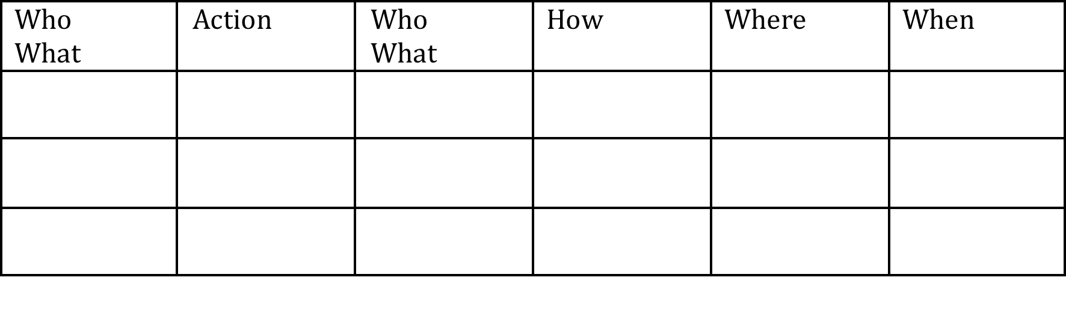
Details at a sentence level (literacy)
Read each sentence. In pairs, tell each other where the detail goes in the organizer.
The planet moves in an elliptical orbit around the sun.
He finished his homework quickly and switched on the TV.
Analyze your writing carefully before you submit your paper.
in an
elliptical
orbit
The planet
moves
around the
sun
Eli Ghazel 2019

Slide 35
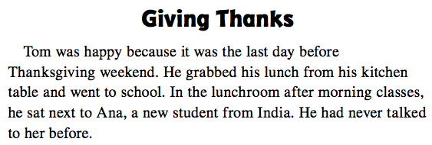
Details at a text level (literacy)
Find all the WHO details in the text below.
Eli Ghazel 2019

Slide 36
Details at a text level (literacy)
Find all the WHERE details in the text below.
HO
Eli Ghazel 2019

Slide 37
Details at a text level (literacy)
Find all the WHEN details in the text below.
HO
Eli Ghazel 2019

Slide 38
Critical thinking using details at a text level (literacy)
Read the text and tell each other (orally) how Tom and Anna are similar and different.
TOM (details that are unique to him)
Details that are the same for both
ANNA (details that are
unique to her)
boy
girl
not new student
new student
students
from India
Eli Ghazel 2019

Slide 39
Creativity in producing details (literacy)
Write a 3 to 4 word detail using only words from the text for each question word.
Q. WORD | DETAIL
WHAT
WHERE
WHEN
WHO
his Thanksgiving
lunch
next to the table
after a happy lunch
Tom and his new student
Eli Ghazel 2019

Slide 40
Creativity in producing sentences (literacy)
Use words from the text to write at least two sentences using the organizer below.
Tom and Anna
went
to India
last weekend.
Eli Ghazel 2019

Slide 41
Details in a simple sentence and how it becomes a complex sentence.
Complex Sentences
who is my brother
that he always wanted
that is opposite our hotel
Eli Ghazel 2019

Slide 42
Critical thinking at a text level (literacy)
Using only words from the text to write at least two sentences using the organizer below. The first sentence needs to be in the A position and the second sentence needs to be in the B position.
A
It
was
morning.
B
Tom
talked to
Ana.
happy to talk to Tom.
B
Ana
was
A
B
Eli Ghazel 2019

Slide 43
Everyone makes sense of language in a similar way.
On a higher level, our minds start to go beyond the details in the sentences and we start to read or hear sentences at a thought level.
We ‘piece together’ the details to make a complete THOUGHT!
This ice cream is delicious.
The sentence above is
An opinion A cause A prediction
Eli Ghazel 2019

Slide 44
Everyone makes sense of language in a similar way.
What ‘thought’ does each sentence below express? Sometimes depending on the context and the intonation, a sentence may express more than one thought.
Information
a) An opinion
b) A cause and effect
c) A sequence of events
d) A complaint
e) A prediction
f) A retell
g) A description
h) Information
_____ 1 I need three blue pens, please.
___ 2 The ship had already left.
___ 3 This is the third time I asked for a glass of water.
___ 4 Careful, you are going to fall.
___ 5 He wants to go home.
___ 6 The books on the history of the Kingdom are on the
top shelf.
___ 7 Don’t put the rug there or someone might trip on
it.
___ 8 The building is tall and wide.
A sequence of events
A complaint
A prediction
A retell
A information
A cause and effect
A description
Eli Ghazel 2019

Slide 45
Write the events in the order they happened. (Processing skill: Sequencing)
By the time Samia got to the port, the ship had already left.
1. 2. 3. 4.
We used the past perfect tense to show SEQUENCE relative to the speaker or writer.
Samia got to the port
The speaker
or writer
told you
The ship left
Eli Ghazel 2019

Slide 46
Write the events in the order they happened. (Processing skill: Sequencing)
We used the past tense to show SEQUENCE relative to the speaker or writer.
I saw the movie.
1. 2. 3. 4.
The speaker
or writer
told you
Saw the movie
Eli Ghazel 2019

Slide 47
Whole Text/Passage
On an even higher level, our minds go beyond the thought levels in the sentences and we start to read or hear texts at an idea level.
Main idea
We ‘piece together’ the thoughts to make a complete IDEA!
Author’s purpose
Author’s viewpoint
Conclusion
Summary
Eli Ghazel 2019

Slide 48
TEXT LEVEL
Instructions:
Make a story organizer then copy the correct details from the story in it.
Characters | Setting
Main event(s)
Eli Ghazel 2018

Slide 49
Take a minute to look at the picture and write details in the organizer. Then use it to tell a story that is at least 6 to 8 sentences long.
Characters | Setting
Main event(s)
Ending
Eli Ghazel 2019

Slide 50
New Comprehension Design
TEXT
TWO detail questions for (WHAT)
On Sunday, Tom gets up at 10 o'clock. Then he reads his newspaper in the kitchen. He has breakfast at 11.30 and then he telephones his mother in Scotland. In the afternoon, at 1.00, Tom plays tennis with his sister and after that, they eat dinner in a restaurant. At 6.00, Tom swims for one hour and then he goes by bike to his brother´s house. They talk and listen to music. Tom watches television in the evening and drinks a glass of mint tea. He goes to bed at 11.30.
TWO detail questions for (WHEN)
TWO detail questions for (HOW)
TWO detail questions for (WHO)
TWO cause effect questions (WHY)
Center for English Language – MoE, KSA

Slide 51
To summarize
We make sense and meaning of each by processing the information we hear and see, then respond to it.
Eli Ghazel 2018

Slide 52
Learning Vocabulary

Slide 53



Grade 3
Vocabulary
Lesson plan
Eli Ghazel

Slide 54
Grade 3 Unit 1 Week 1
Vocabulary PB page 1
LESSON PLAN
NOTE to the teacher
This is a sample generic lesson plan. Obviously each grade will have some differences.
You can do all the eight words in the same way if time allows.

Slide 55
Grade 3 Unit 1 Week 1
Vocabulary PB page 1
LESSON PLAN
1/125
Instructions:
1. Number your paper from 1 to 5. Listen to the sentences I am going to read you. Each time you hear one of words on the board, write the letter that comes before each in the order you hear them. The words are below.
a. educated e. satisfied
b. inspired f. concentrate
c. ached g. improved
d. discovery h. effort
Teacher’s list of sentences (unseen to the class)
I can’t concentrate in this noise.
My arm ached after basketball practice.
My teacher inspired me to do better.
…
…

Slide 56
Grade 3 Unit 1 Week 1
Vocabulary PB page 1
LESSON PLAN
1/125
Instructions:
1. Number your paper from 1 to 5. Listen to the words I am going to read you. Each time you hear a set of words, write the letter that comes before each in the order you hear them. The words are below.
Each child’s paper would look like this.
f
C
b
4. …
5. …

Slide 57
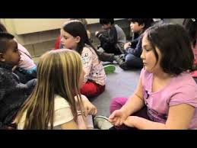
Grade 3 Unit 1 Week 1
Vocabulary PB page 1
LESSON PLAN
1/125
Instructions:
1. In pairs, read the words to each other in the order you heard them in the sentences. Remember to use only your pair voice.
a. educated e. satisfied
b. inspired f. concentrate
c. ached g. improved
d. discovery h. effort
FEEDBACK
1. Concentrate 2. ached 3. inspired

Slide 58

Grade 3 Unit 1 Week 1
Vocabulary PB page 1
LESSON PLAN
1/125
Instructions:
2. Look at the picture. Tell each other in pairs words for the things you see in the picture. Remember to use only your pair voice.

Slide 59
Grade 3 Unit 1 Week 1
Vocabulary PB page 1
LESSON PLAN
1/125
Instructions:
3. Let’s hear some of the words that you told each other about the picture. Raise your hands and I will call on you to tell the class. I will also write some of the words here next to the picture.
FEEDBACK
Teacher writes these
words as the children say them
sad
hold

Slide 60

Grade 3 Unit 1 Week 1
Vocabulary PB page 1
LESSON PLAN
1/125
Instructions:
4. Now do the same thing for the next three pictures. Remember. Look at the picture. Tell each other in pairs words for the things you see in the picture. Remember to use only your pair voice.
Teacher can show each picture separately in order to control time and feedback

Slide 61


Grade 3 Unit 1 Week 1
Vocabulary PB page 1
LESSON PLAN
1/125
Instructions:
5. Let’s hear some of the words that you told each other about the picture. Raise your hands and I will call on you to tell the class. I will also write some of the words here next to the picture.
FEEDBACK
Teacher writes these
words as the children say them
write
Read
Library
Raise your hands

Slide 62

Grade 3 Unit 1 Week 1
Vocabulary PB page 1
LESSON PLAN
1/125
Instructions:
5. Let’s hear some of the words that you told each other about the picture. Raise your hands and I will call on you to tell the class. I will also write some of the words here next to the picture.
FEEDBACK
Teacher writes these
words as the children say them
Raise your hands
dig
boys
Look for

Slide 63

Grade 3 Unit 1 Week 1
Vocabulary PB page 1
LESSON PLAN
1/125
Instructions:
5. Let’s hear some of the words that you told each other about the picture. Raise your hands and I will call on you to tell the class. I will also write some of the words here next to the picture.
FEEDBACK
Teacher writes these
words as the children say them
Raise your hands
classroom
teacher

Slide 64
Grade 3 Unit 1 Week 1
Vocabulary PB page 1
LESSON PLAN
1/125
Instructions:
6. Look at each picture I show you. Tell each other in pairs the answer to the questions you see. Remember to use only your pair voice.
1. What is the boy doing?
2. What do you think is in the bag?
3. Why do you think he is holding it to his head?

Slide 65
Grade 3 Unit 1 Week 1
Vocabulary PB page 1
LESSON PLAN
1/125
Instructions:
6. Look at each picture I show you. Tell each other in pairs the answer to the questions you see. Remember to use only your pair voice.
1. What is the boy doing?
2. Where is the boy?
3. What must the boy do to finish quickly and make no mistakes?

Slide 66
Grade 3 Unit 1 Week 1
Vocabulary PB page 1
LESSON PLAN
1/125
Instructions:
6. Look at each picture I show you. Tell each other in pairs the answer to the questions you see. Remember to use only your pair voice.
1. What are the boys doing?
2. What do you think they found?

Slide 67
Grade 3 Unit 1 Week 1
Vocabulary PB page 1
LESSON PLAN
1/125
Instructions:
7. Let’s hear some of the answers that you told each other about for the questions. Raise your hands and I will call on you to tell the class. I will also write some of the words here next to the picture.
FEEDBACK
1. What is the boy doing?
2. Why do you think is in the bag?
Raise your hands
3. Why do you think he is holding it to his?

Slide 68
Grade 3 Unit 1 Week 1
Vocabulary PB page 1
LESSON PLAN
1/125
Instructions:
7. Let’s hear some of the answers that you told each other about for the questions. Raise your hands and I will call on you to tell the class. I will also write some of the words here next to the picture.
FEEDBACK
1. What is the boy doing?
2. Where is the boy?
Raise your hands
3. What must the boy do to finish quickly and make no mistakes?

Slide 69
Grade 3 Unit 1 Week 1
Vocabulary PB page 1
LESSON PLAN
1/125
Instructions:
7. Let’s hear some of the answers that you told each other about for the questions. Raise your hands and I will call on you to tell the class. I will also write some of the words here next to the picture.
FEEDBACK
1. What are the boys doing?
2. What do you think they found?
Raise your hands

Slide 70
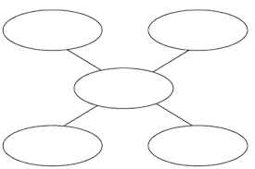
Grade 3 Unit 1 Week 1
Vocabulary PB page 1
LESSON PLAN
1/125
Instructions:
8. Make some webs like the ones below on a sheet of paper. Open your books to page 24. Find the word ached. Read 4 lines before the word ached and 4 lines after the word ached. Find words that you think are connected to ached and write them in the web.
Work alone!
ached

Slide 71
Grade 3 Unit 1 Week 1
Vocabulary PB page 1
LESSON PLAN
1/125
Instructions:
9. Do the same thing for the other words. Find the words on pages 24, 25, and 26. Read 4 lines before each word and 4 lines after the word. Find words that you think are connected to afraid and depends and write them in the web.
Work alone!
ached
concentrate
discovery

Slide 72
Grade 3 Unit 1 Week 1
Vocabulary PB page 1
LESSON PLAN
1/125
Instructions:
10. In pairs, tell each other which words you wrote in your webs. Add words to your web from the ones your partner wrote.
Remember to use only your pair voice.
FEEDBACK
ached
concentrate
discovery

Slide 73
Grade 3 Unit 1 Week 1
Vocabulary PB page 1
LESSON PLAN
1/125
Instructions:
11. Open your practice books to page 1 and and do the task alone.

Slide 74
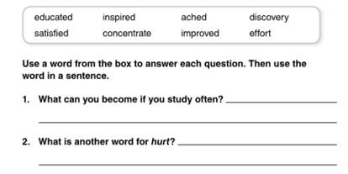
Grade 3 Unit 1 Week 1
Vocabulary PB page 1
END of PERIOD ASSESS
1/125
New Instructions:
Think of words and write them around each of the words in the bank. Then do the same thing for each of the underlined parts of the questions. Then think of what the missing blank needs and write a word from the box.
Continued
Go to school
read
study
homework
school
educated

Slide 75
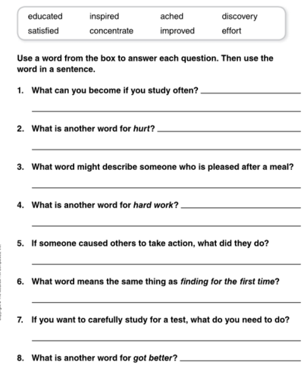
Grade 3 Unit 1 Week 1
Vocabulary PB page 1
END of PERIOD ASSESS

Slide 76
Learning to Comprehend

Slide 77
Grade 3 Reading Comprehension
Eli Ghazel

Slide 78
Grade 3 Unit 1 Week 1
Focus:
How to find the main character,
his/her want or needs,
his/her feelings, his her actions
his/her traits
in a short story.

Slide 79
Grade 3 Unit 1 Week 1
Comprehension PB page 2, 3, 4
Read the story on pages 3 and 4 in your practice book, and
Underline all the parts that answer WHO. Find the WHO that is the focus of the story and write his/her name in the CHARACTER box in the organizer.
Circle all the actions that the character likes to do all the time. That will show you his/her needs. Write the character’s needs/wants in the box.
Make a box around all the words tell about the character’s feelings. Write the feelings in the box.
Find the most important actions the character took. Copy the actions in the box.
Find which words which describe what kind of a person the character is. That will show you his/her traits. Write the character’s traits in the box.

Slide 80
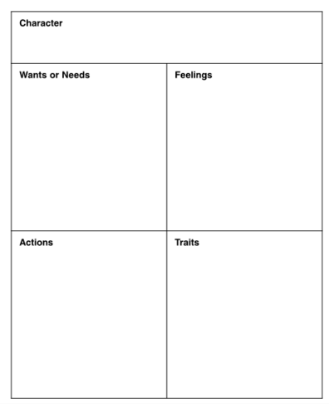
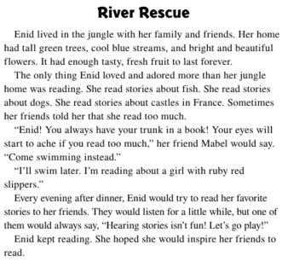
Grade 3 Unit 1 Week 1
Comprehension PB page 2, 3, 4
END of PERIOD ASSESS
who
who
Adores reading
who
To read
who
who
who
Uses her reading to take action
Helps her friend
Helpful
Inspires

Slide 81
Learning to
Write and Analysis

Slide 82
Grade 3
Write an analysis
Eli Ghazel

Slide 83
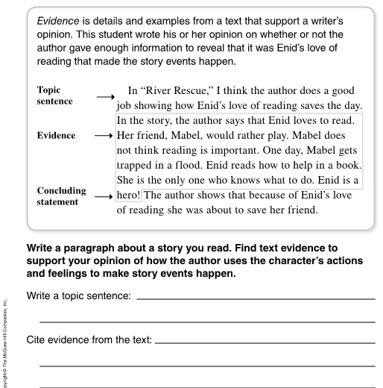
Grade 3 Unit 1 Week 1
Comprehension PB page 9
END of PERIOD ASSESS

Slide 84
Grade 3 Unit 1 Week 1
Comprehension PB page 9
END of PERIOD ASSESS

Slide 85
Grade 3 Unit 1 Week 1
Comprehension PB page 9
END of PERIOD ASSESS
x/125
New Instructions:
Read the story that I am going to give you.
Underline all the parts that answer WHO. Find the WHO that is the focus of the story and write his/her name on the side of the story.
Make a box around all the words tell about the character’s feelings. Write the feelings in the box.
Find the most important actions the character took and underline them.
Write a sentence that tells your opinion of how the author uses the character’s actions and feelings to make the story event happen. Start your sentence, “ I think the author …….” Write it on the topic sentence line.
Copy the important actions and feelings of the character on the “Cite the evidence line”.

Slide 86
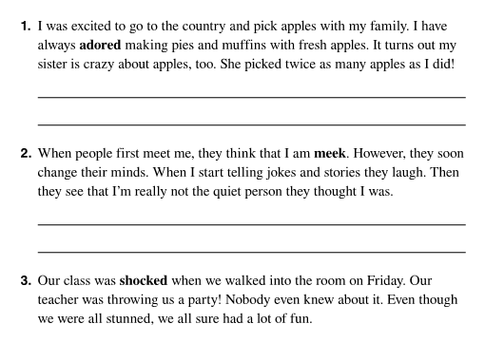
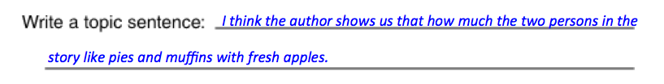
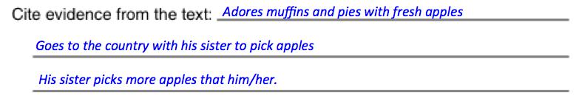
Grade 3 Unit 1 Week 1
Comprehension PB page 9
END of PERIOD ASSESS
Apply on this story
Who?
Actions
Feelings
Opinion (Topic sentence)
Cite evidence

Slide 87
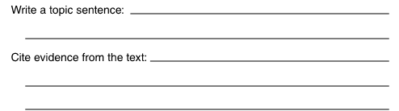
Grade 3 Unit 1 Week 1
Comprehension PB page 9
END of PERIOD ASSESS
I think the author shows us that how much the two persons in the
story like pies and muffins with fresh apples.
Adores muffins and pies with fresh apples
Goes to the country with his sister to pick apples
His sister picks more apples that him/her.

Slide 88
Grade 3 Unit 1 Week 1
Comprehension PB page 9
END of PERIOD ASSESS
Apply on this story

Slide 89
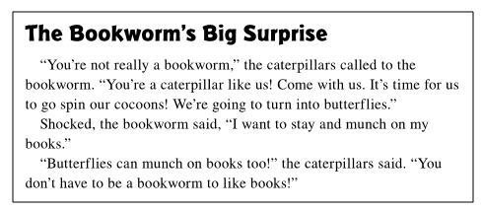
Grade 3 Unit 1 Week 1
Comprehension PB page 9
END of PERIOD ASSESS
Apply on this story

Slide 90
Using Inquiry to Learn
Eli Ghazel 2018

Slide 91
Put the big idea question on a large sheet of paper and put it up on the wall.
How do friends
and families depend on one another?

Slide 92
Put the first essential question for the week(s) up – like below.
How do friends
and families depend on one another?
Week one
How do friends depend on one another?

Slide 93
Each day, ask the children to read a certain part of the story (you tell them which page or section especially the younger children) and find an example that answers the question.
How do friends
and families depend on one another?
Week one
How do friends depend on one another?

Slide 94
Each day, ask the children the children to write the examples on note cards and put them up around the question. (You can also ask them to find examples in the PB stories or in other texts.
How do friends
and families depend on one another?
Week one
How do friends depend on one another?

Slide 95
During the week, ask the children to add examples from their own lives. Not everyone needs to do this.
How do friends
and families depend on one another?
Week one
How do friends depend on one another?

Slide 96
At the end of the week(s), ask the children to write sentences or paragraphs about How Friends Depend on One Another using the notes around the the essential question.
How do friends
and families depend on one another?
Week one
How do friends depend on one another?

Slide 97
Continue the same thing the following weeks.
Week five
How do friends
and families depend on one another?
Week four
Week three
Week one
Week two
How do friends depend on one another?
How can a pet be an important friend?
How are families around the world same and different?

Slide 98
How to convert this into a traditional test.
Put a text that has examples for the question(s)
Comprehension through reading
Instructions: Read the story and find one example for each question. Copy the example on the line.
How do friends depend on one another?
________________________________________________________________
2. How are families around the world same and different?
__________________________________________________________________
3. How can a pet be an important friend?
__________________________________________________________________

Slide 99
How to convert this into a traditional test.
Put a picture depicting an example for the question(s)
Writing
Instructions: Look at the picture(s) and write 4 to 6 sentences (Grade 1 sentences. Grade 2 and up passage or paragraph) for the question below.
How do friends depend on one another? (You can use any or all of the inquiry questions)
__________________________________________________________________
__________________________________________________________________
__________________________________________________________________
__________________________________________________________________
__________________________________________________________________

Slide 100
PYP program of Inquiry: What constitutes culture?
Children read the story to find and construct answers to the questions.
Children read the story in other books to find and construct answers to the questions.
Children ask parents/adults/ other children to find and construct answers to the questions.
Week five
How do friends
and families depend on one another?
Week four
Week three
Week one
Week two
How do friends depend on one another?
How can a pet be an important friend?
How are families around the world same and different?
Eli Ghazel 2018

Slide 101
PYP program of Inquiry: What constitutes culture?
Children ask parents/adults/ other children to find and construct answers to the questions.
How do friends and families depend on one another?
 | Name 1 | Name 2 | Name 3 | Name 4
How can a pet be an important friend?
How are families around the world same and different?
How do friends depend on one another?
Eli Ghazel 2019

Slide 102


E l i G h a z e l
Here comes the learning designer
e g h a z e l
e g h a z e l @ gmail.com
+ 971 559 221 588
e g h a z e l
www.munjez.com

