Slide 1
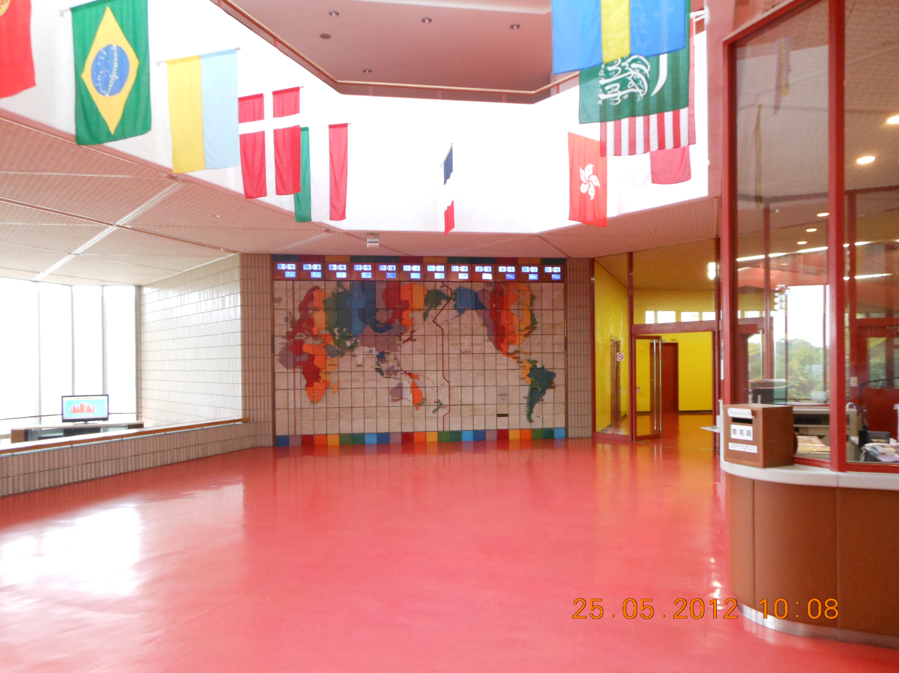
Writing the
10-minute IELTS®
Essay
Eli Ghazel Nov 16 201
Sharjah Chapter
American University of Sharjah
1332 E 22nd Ave. Denver, Colorado, U S A
Emaar Blvd., P O Box 454517, Dubai, UAE
eli@eupad.net Tel: +971 559221588 Fax: +971 44558556

Slide 2
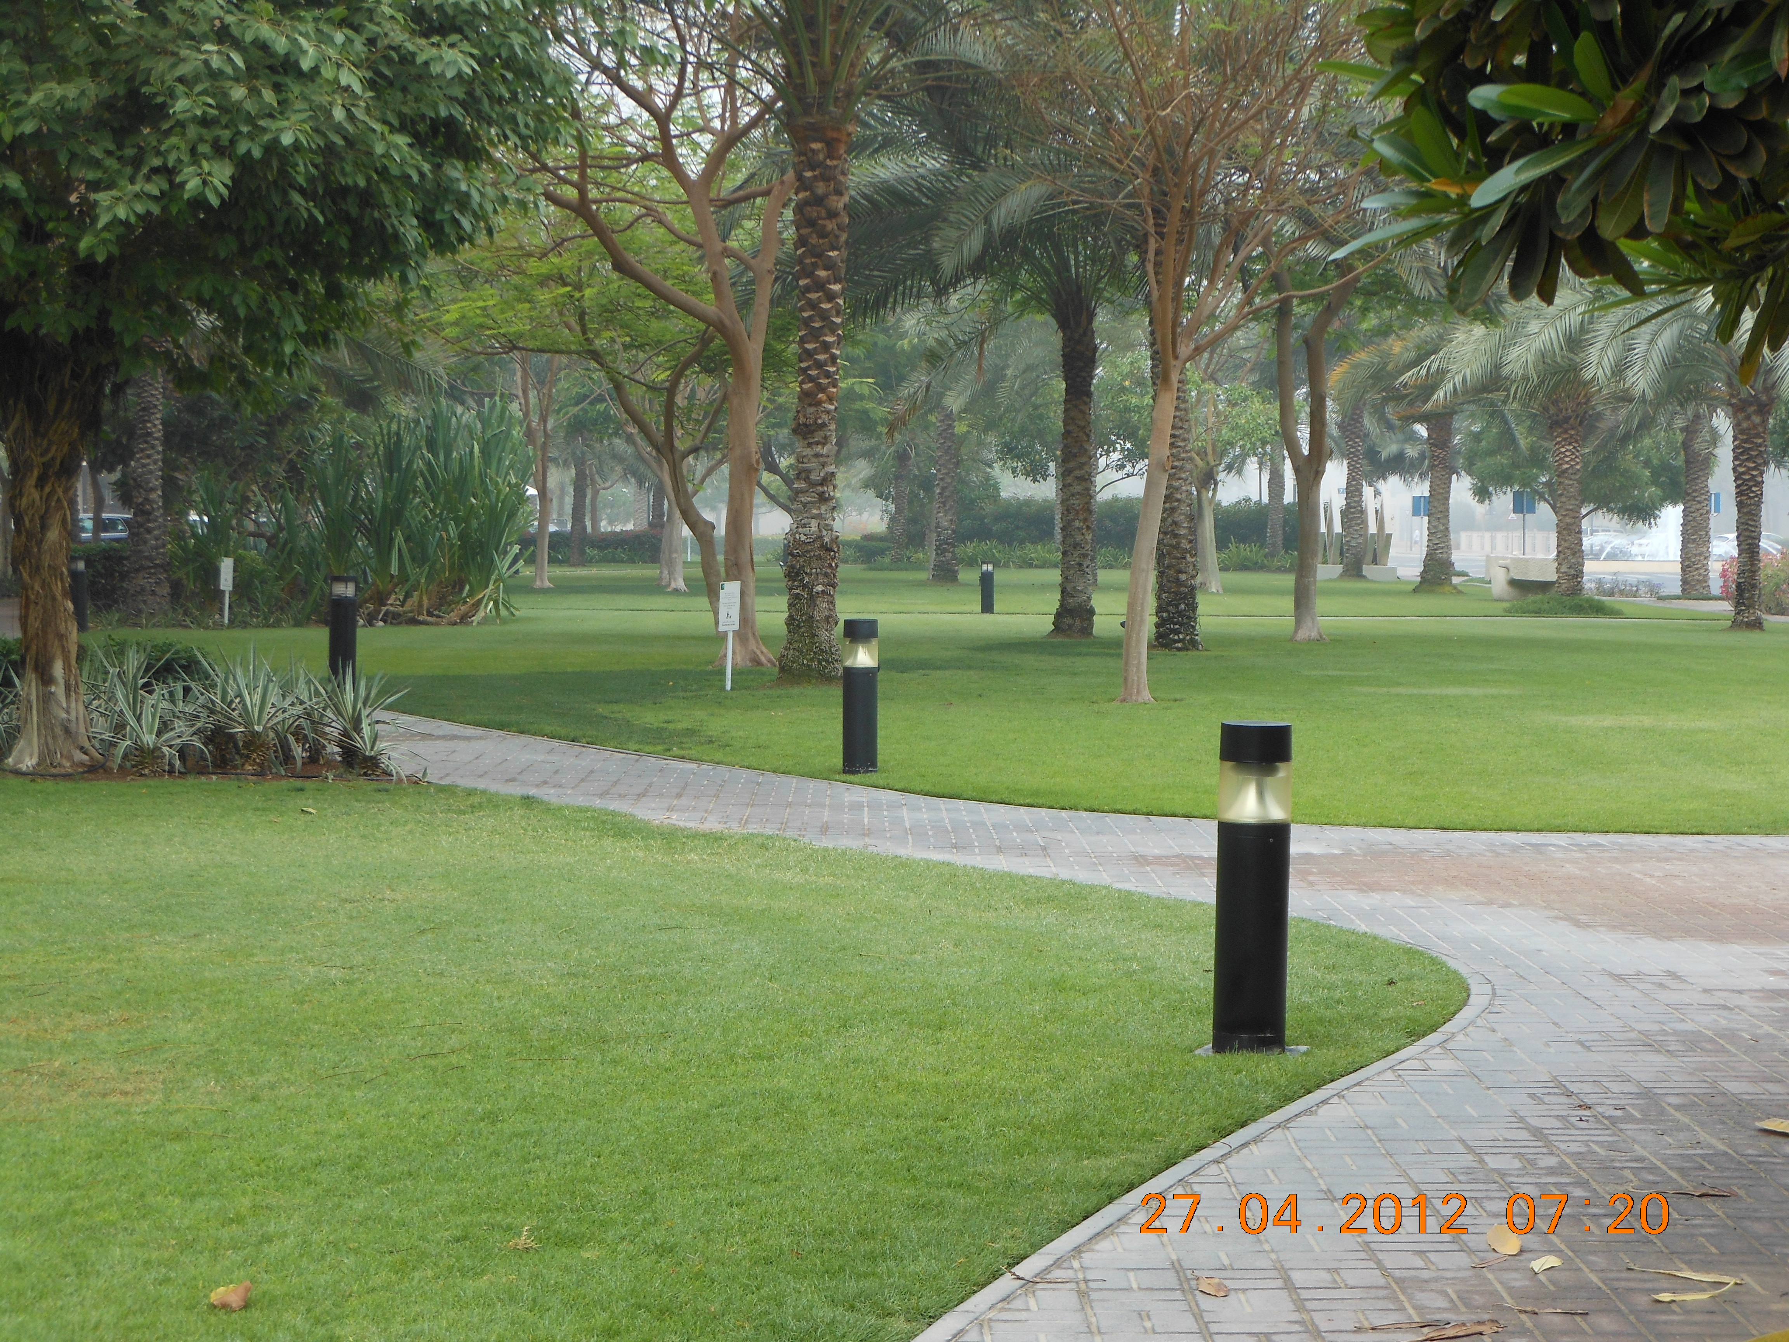
The first step in preparing to write an essay in an IELTS is to read the instructions. To develop an examinee’s ability to read the instructions, it is important to understand how a sentence works in English.
1332 E 22nd Ave. Denver, Colorado, U S A
Emaar Blvd., P O Box 454517, Dubai, UAE

Slide 3
A simple sentence in English can have up to six parts, or chunks that provide details about who, what, where, when, how and the action that occurs. Each part can be a word or a set of words. The word combination determines whether the chunk answers WHO, WHAT, WHERE and so on.
Example:
Chair = WHAT
Red wooden chair = WHAT
On the red wooden chair = WHERE

Slide 4
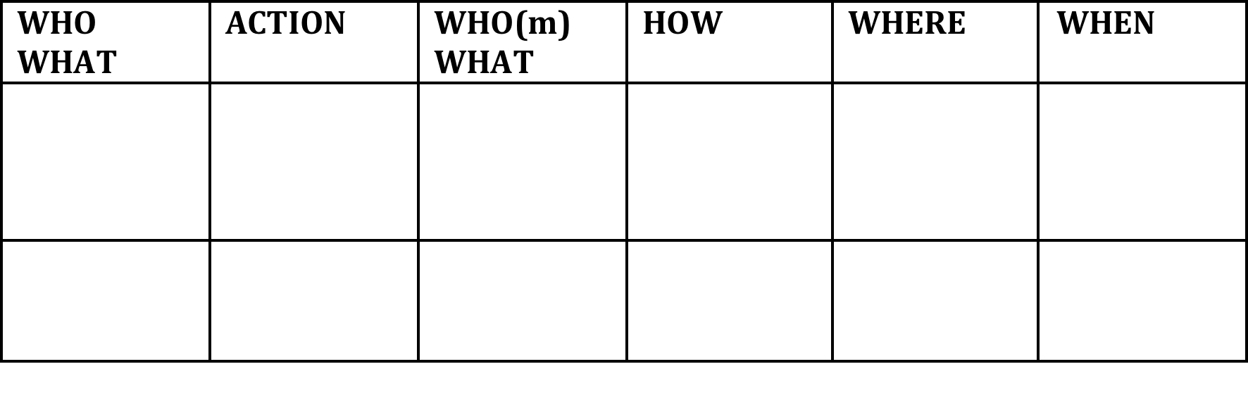

Slide 5
TASK 1 Copy the parts of the sentences below in each box in the chart above.
A big tall handsome man bought a beautiful red Ferrari at a whim from the dealer on the corniche last Saturday night.
Clean the large room at the end of the hall

Slide 7
TASK 2 Copy the parts of the sentences below in each box in the chart on the next page next to the corresponding numbers.
1 He finished his homework quickly and switched on the TV.
2 The planet moves in an elliptical orbit around the sun.
3 The question will be read aloud by a narrator.
4 Analyze your writing carefully before you submit your paper.

Slide 8
A simple sentence in English when doubled and joined by and, but, so on becomes a compound, or a double simple sentence. Each part can contain the chunks that answer WHO, WHAT, WHERE and so on.
what action where
The new smart phone fell to ground
what action how
and it broke into a million pieces.

Slide 9
Sometimes a simple sentence in English may contain parts that add meaning to one of the details. These parts that add meaning to a detail in a simple sentence are sometimes called ‘clauses’. They work like this.
The new smart phone fell to ground
and it broke into a million pieces.
that I got for my birthday

Slide 10
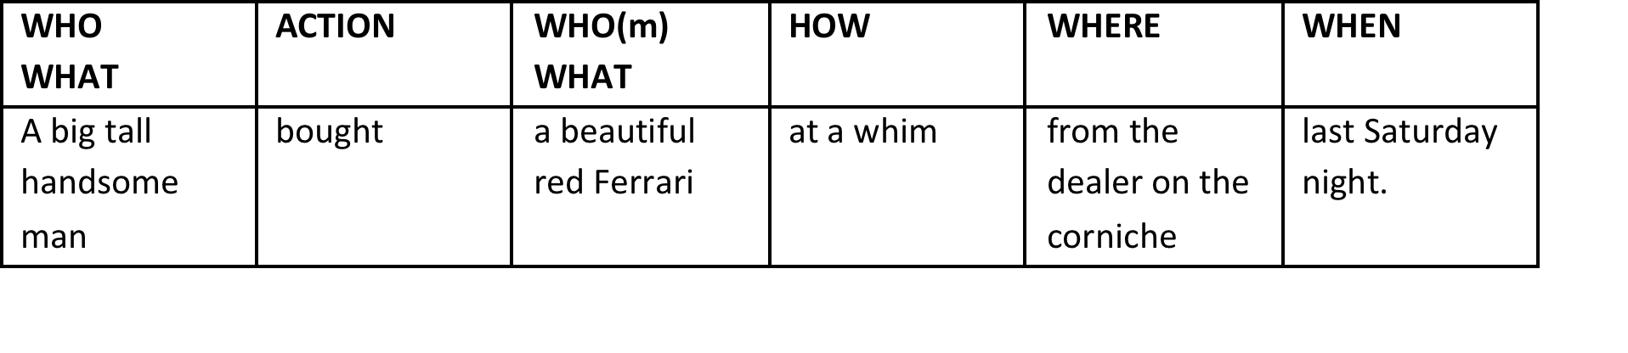
The clause is giving more information about the WHAT part of the first sentence. A clause can give more information about any part of the sentence and a simple sentence can have more than one clause.
who is my brother
that he always wanted
that is opposite

Slide 11
TASK 3 Read each sample instruction for an IELTS essay and underline the parts. Write the words who, what, how, where, and action above each part.
1 Is freedom of speech necessary in a free society? Do you agree or disagree?
Under 5 mins / 40

Slide 12
TASK 3 Read each sample instruction for an IELTS essay and underline the parts. Write the words who, what, how, where, and action above each part.
action what what
Is freedom of speech necessary
where who action
in a free society? Do you agree or disagree?

Slide 13
TASK 3 Read each sample instruction for an IELTS essay and underline the parts. Write the words who, what, how, where, and action above each part.
2 Some people think women should be allowed to join the army, the navy and the air force just like men.

Slide 14
TASK 3 Read each sample instruction for an IELTS essay and underline the parts. Write the words who, what, how, where, and action above each part.
who action
2 Some people think
what
women should be allowed to join the army, the navy and the air force just like men.

Slide 15
TASK 3 Read each sample instruction for an IELTS essay and underline the parts. Write the words who, what, how, where, and action above each part.
3 In the past, buildings often reflected the culture of a society but today all modern buildings are alike and cities throughout the world are becoming similar.

Slide 16
TASK 3 Read each sample instruction for an IELTS essay and underline the parts. Write the words who, what, how, where, and action above each part.
when what action
3 In the past, buildings often reflected
what
the culture of a society
but today all modern buildings are alike and cities throughout the world are becoming similar.

Slide 17
TASK 3 Read each sample instruction for an IELTS essay and underline the parts. Write the words who, what, how, where, and action above each part.
but
when what action what
today all modern buildings are alike
and cities throughout the world are becoming similar.

Slide 18
TASK 3 Read each sample instruction for an IELTS essay and underline the parts. Write the words who, what, how, where, and action above each part.
and
what action
cities throughout the world are becoming
what
similar.

Slide 19
TASK 3 Read each sample instruction for an IELTS essay and underline the parts. Write the words who, what, how, where, and action above each part.
What do you think is the reason for this, and is it a good thing or a bad thing?

Slide 20
TASK 3 Read each sample instruction for an IELTS essay and underline the parts. Write the words who, what, how, where, and action above each part.
The world is experiencing a dramatic increase in population. This is causing problems not only for poor, underdeveloped countries, but also for industrialized and developing nations.

Slide 21
TASK 3 Read each sample instruction for an IELTS essay and underline the parts. Write the words who, what, how, where, and action above each part.
Describe some of the problems that overpopulation causes, and suggest at least one possible solution.

Slide 22
The next step is to create a quick organizer to collect thoughts, details and ideas. One of the quickest way to do so is to use a T-Chart or a double T-Chart. See slide for examples.

Slide 23
The next step is to create a quick organizer to collect thoughts, details and ideas. One of the quickest way to do so is to use a T-Chart or a double T-Chart. See slide for examples.

Slide 24
The next step is to create a quick organizer to collect thoughts, details and ideas. One of the quickest way to do so is to use a T-Chart or a double T-Chart. See slide for examples.

Slide 25
The next step is to create a quick organizer to collect thoughts, details and ideas. One of the quickest way to do so is to use a T-Chart or a double T-Chart. See slide for examples.
Buy a house or start a new business (discuss)
Advantage disadvantage Advantage disadvantage

Slide 26
TASK 4 Choose one of the instructions Study the parts of the instructions and identify the headings for the T-chart. Then write down the headings, the details, ideas and thoughts in the appropriate columns.
under 10 mins / 40

Slide 27
TASK 5 Study your details, thoughts and ideas.
A Note which are examples, reasons, opinions, arguments
B Cross out the ones you think are irrelevant
C Number your ideas in the order importance to you
Under 5 mins / 40

Slide 28
There are several types of essays – persuasive, descriptive, informative, comparison and contrast, cause and effect and each has its own unique organizer. The time available is not enough to go into the different types.

Slide 32
For more examples, go to www.munjez.com and download the On Location Teacher Support Guides for grades 10, 11 and 12 written by Eli Ghazel and published by McGraw-Hill Education.

Slide 33
Task 6
Examine the three organizers that follow and decide which organizer would be most suitable for each of the four instructions in TASK 3. Write the number of the instruction next to the organizer. Then write the information from your T-chart in the organizer.
Under 5 mins / 40

Slide 34
TASK 7 Use the information in your organizer to write your essay.
Under 10 mins / 40

Slide 36
> 5 Study the question / instructions
> 10 Brainstorm the ideas in a T-Chart
> 5 Cross out irrelevant details and order the information
> 5 Write the information in an organizer
> 10 Write your essay
> 5 Review your essay

Slide 37
Eli Ghazel
eli@eupad.net
+971 559 221 588
www.munjez.com www.eupad.net

