Slide 1
Welcome, fellow educators
My name is Eli
Kindly:
Sit in any seat where there is a handout
Sign the presence sheet and check the spelling of your name
Help us make this workshop successful by keeping an open mind
Be punctual and timely
Keep phones on silent mode (and away from sight)

Slide 2
Designing and Managing Learning Part 1
Dubai Modern Education Schools
October 30, 2015
Dubai Office: (doing business as EU PAD) USA Home Office:
Tel: 04 455 8722 Fax: 04 455 8556 21 Apex Drive, Bozeman, MT 59718, U S A
Mobile: 0559221588 Email: info@21caf.org
Email: info@eupad.net

Slide 3
Our goals
Thinking as an EXPLORER vs FINDING the right answer
Do not hesitate to question the status quo or even the research.
Remember?
The world is flat.
The sun revolves around the earth.
Bloom’s taxonomy
The planet Pluto
The atom

Slide 4
Our goals
Differentiate between language acquisition and language literacy.
Distinguish between learning and performance. Increase every child’s learning experience
Create new assessment that help students learn, not just get grades ---assessment that show abilities that work in the real world

Slide 5
Our goals
Write a book entitled:
Designers and Managers of Learning

Slide 6




The comments I get from some people when I talk about the need for “change of expectations in schools”.
Ok, so what?
This is what we have
always done
Look at me, I was brought up in this
system and I turned out pretty good.

Slide 7
What is learning?
Everyone has a concept
near/far to city
Small
70K to 200K
Apartment in Dubai
expensive
High rise

Slide 8
What is learning?
Everyone has a concept
What is your concept of …?
Chinese food
Where is your information coming from?
1 On the sheet of paper, draw your concept of … (alone)

Slide 9
What is learning?
Everyone has a concept
What is your concept of …?
Chinese food
Where is your information coming from?
2 Work together as a table, draw your concepts as one concept on a large sheet of paper.

Slide 10
What is learning?
Everyone has a concept
What is your concept of …?
Chinese food
Where is your information coming from?
3 Read the next slide. Add information to your group concept map.

Slide 11
Garlic
Garlic has been used in China for over 5,000 years. Not only in the kitchen but also in Chinese Traditional Medicine as it is considered to have medicinal properties. You will find that Garlic is used throughout Chinese cooking, one of the most common uses is with stir-fries.
Sesame Oil
Sesame Oil is a dark, aromatic and very flavorful ingredient. There are several kinds, the one used for Chinese cooking is usually heavier and darker and it is not used for frying but rather as a marinade, sprinkled at the end just for flavor, or added to dipping sauces.

Slide 12
What is learning?
Everyone has a concept
What is your concept of …?
Chinese food
Where is your information coming from?
4 Look at the picture on the next slide. Add information to your group concept map.

Slide 13
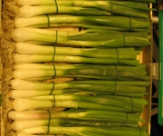




Slide 14







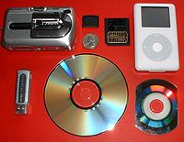
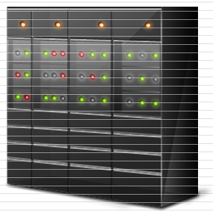


What are sources of, and that add to the concept?
5 Look at the pictures and think of more sources that can add to a concept. Tell each other and write them.

Slide 15
What are sources of, and that add to the concept?
Sources that can be read
textbook
6 Make a table like the one above. Write headings for categories of information sources and examples of them.

Slide 16
What are sources of, and that add to the concept?
pressure
temp
odor
Prior
knowledge
Heard
Read
Seen
(Existing schema)
In order for humans to learn, they need to add, delete and modify the pre-existing concept from sources.

Slide 17
What can we get from sources?
Knowledge/information

Slide 18
How do we know that a human has added to or modified his/her concept? In other words, how do humans respond?
pressure
temp
odor
Prior
knowledge
Heard
Read
Seen
(Existing schema)
7 In pairs, think of and write the ways a human can ‘respond’.

Slide 19
How do we know that a human has added to or modified his/her concept? In other words, how do humans respond?
pressure
temp
odor
Prior
knowledge
Heard
Read
Seen
(Existing schema)
Speak
Write
Act out
Imaging
7 In pairs, think of and write the ways a human can ‘respond’.

Slide 20
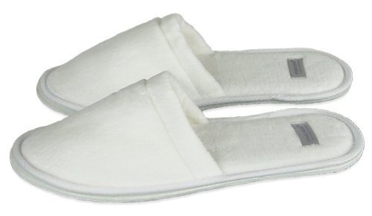
Humans don’t just copy information. The human mind does a over 250 things in order to process information. What does a mind do to process information?
A
B
C
1
2
3
8 For each task on the slides, think of what your mind is doing and write the word that represents the process.

Slide 21
Humans don’t just copy information. The human mind does a over 250 things in order to process information. What does a mind do to process information?
A
B
C
Match
There are 3 types of matching what are they?
bathrobe
1
2
3
jacket
farm
8 For each task on the slides, think of what your mind is doing and write the word that represents the process.

Slide 22

Humans don’t just copy information. The human mind does a over 250 things in order to process information. What does a mind do to process information?
Identify
Which person did you see driving the car?
8 For each task on the slides, think of what your mind is doing and write the word that represents the process.

Slide 23

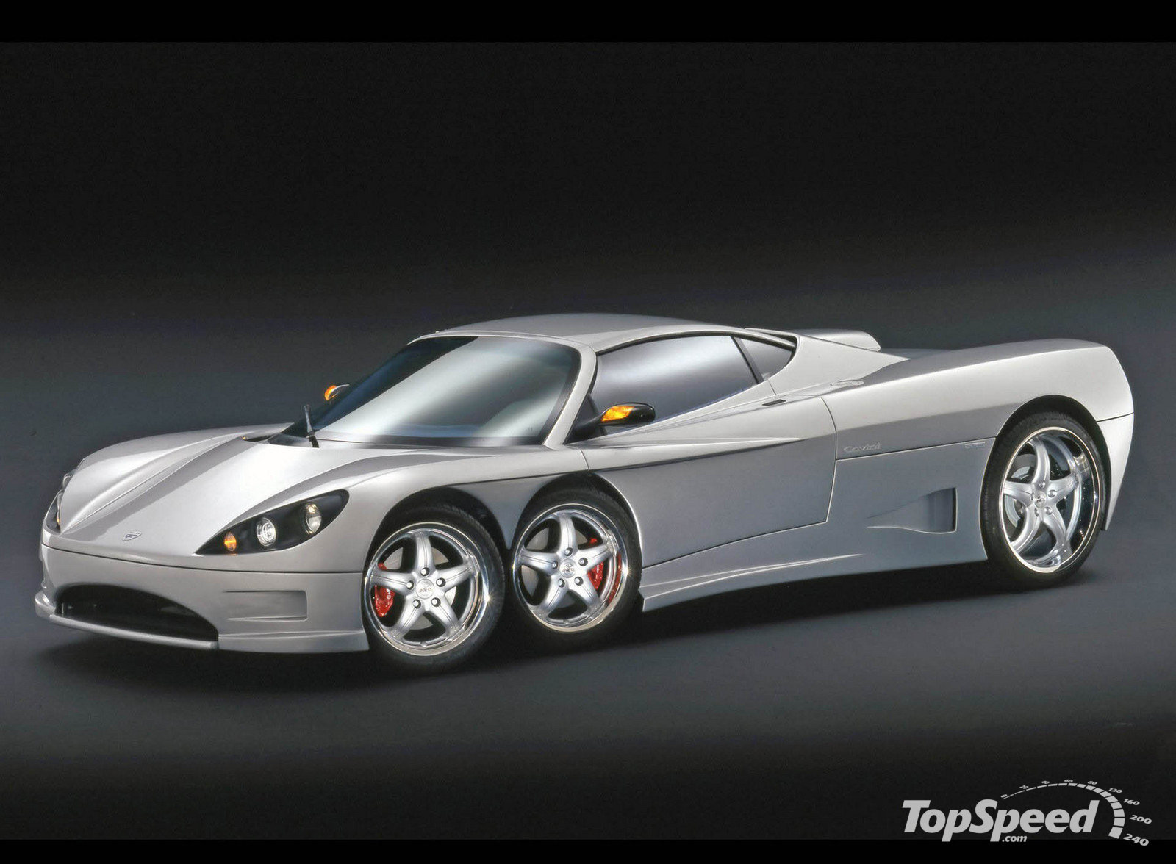
Humans don’t just copy information. The human mind does a over 250 things in order to process information. What does a mind do to process information?
Car A
Car B
Compare and contrast
Similarities and Differences
8 For each task on the slides, think of what your mind is doing and write the word that represents the process.

Slide 24
The human mind also processes in steps. What are the steps in comparison and and contrast?
Car A
Car B
Identify
Similarities and Differences
9 First, you need to decide what you are going to compare. Write what you want to compare and contrast.

Slide 25
The human mind also processes in steps. What are the steps in comparison and and contrast?
weight
Car A
Classify
Car B
10 Make a table with the headings of what you want to compare.

Slide 26
The human mind also processes in steps. What are the steps in comparison and and contrast?
weight
Car A
Identify, match and classify
Car B
11 Make a table with the headings of what you want to compare. Then write (make up) details for each heading.

Slide 27
The human mind also processes in steps. What are the steps in comparison and and contrast?
weight
Car A
Compare and contrast
Car B
12 In pairs or groups of three, tell each other how the two items are the same or different.

Slide 28
pressure
temp
odor
Prior
knowledge
Heard
Read
Seen
(Existing schema)
Processing by identifying, classifying, etc.
Speak
Write
Act out
Imaging
13 In pairs or groups of three, change the response for task number 12 in the previous slide. Write the new instructions.

Slide 29
Before we can design any learning, we need to understand what learning is.
learning
Process
Information
REVIEW

Slide 30
REVIEW
How do we process?
What is the information?
learning
Information
Process
Compare
Contrast
Classify
Find patterns
Define
Analyze
Visual information
Aural information
Printed information
Tactile information
Olfactory information
Taste information

Slide 31
pressure
temp
odor
(Existing schema)
Prior
knowledge
Heard
Read
Seen
Factors that affect your students’ ability to process information and learn
Code switch
Memory org.
Affective
Age
Lang. prof
Focused attention
Processing by identifying, classifying, etc.
Speak
Write
Act out
Imaging
14 In pairs or groups of three, think of factors that affect your students’ ability to process. Write your ideas.

Slide 32
1 garlic
2 kitchen
3 Chinese
Factors that affect your students’ ability to process information and learn
Code switch
Memory org.
Affective
Age
Lang. prof
Focused attention
15 Listen to the talk and write the numbers of the words that you see in the order you hear them.

Slide 33
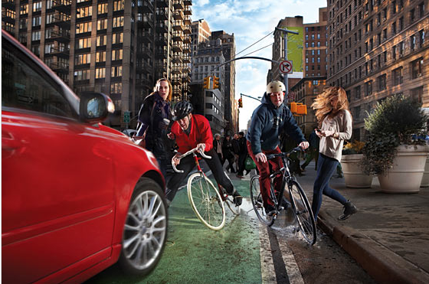
Factors that affect your students’ ability to process information and learn
Code switch
Memory org.
Affective
Age
Lang. prof
Focused attention
15 Look at the picture and write as many words as you can for what you can see in the picture. In pairs tell each other.

Slide 34

15 Look at the picture and write as many words as you can for what you can see in the picture. In pairs tell each other.

Slide 35
Levels of reading and writing: (detail level)
A simple sentence in English can have up to six parts, or chunks that provide details about
who,
what,
where,
when,
how and
the action that occurs.

Slide 36
Levels of reading and writing: (detail level)
Each part can be a word or a set of words. The word combination determines whether the chunk answers WHO, WHAT, WHERE and so on.
Example:
Chair =
Red wooden chair =
On the red wooden chair =
WHAT
WHAT
WHERE

Slide 38
He finished his homework quickly and switched on the TV.
The planet moves in an elliptical orbit around the sun.
The question will be read aloud by a narrator.
Analyze your writing carefully before you submit your paper.
16 Copy the parts of the sentences above in each box.

Slide 39
Levels of reading and writing: (idea level)
Example:
I like this. (opinion)

Slide 40
1. The building is as wide as it is tall. ___________________
2. There’s nothing I fancy on the menu. ___________________
3. The blue coat suits you better. ___________________
4. It is a fascinating subject that needs a more detailed examination. ___________________
5. One cheeseburger, a large fries and a diet soda to go, please. ___________________
6. It’s the fastest and most expensive car ever built in the United Stated. _________________
17 Read each sentence below and write next to each the whole idea it is expressing.
Choose one of the following: opinion; description; information;

Slide 41
7 He told me he was leaving. ___________________
8 This is the third time I tell you to clean up your room. ___________________
9 Waiter, this fork is dirty. ___________________
10 He’s busy and won’t be able to make it. ___________________
11 Watch out! You’re going to hit that car. ___________________
12 Rain is on its way. ___________________
18 Read each sentence below and write next to each the whole idea it is expressing.
Choose one of the following: complaint; prediction; retell;

Slide 42
19 Use the words you collected from the pictures in number 15 to make sentences for the picture. Use the chart to build your sentences.

Slide 43
Who | Where and when
Events (What happened)
End
20 Use the organizer above to put your sentences to write/tell a story.

Slide 44
Who | Where and when
Events (What happened)
End
21 Use the story tiles to tell a story. Use the learning model to name the parts.

Slide 45
Multiply by expanding
3 x 543
Represent 543 using the color blocks
100
10
1
22 Follow the lessons.

Slide 46
Multiply by expanding
3 x 543
100
10
1
100
10
3 X
1
3 X
3 X
100
10
1
100
10
100
+
+
=

Slide 47
Multiply by expanding
4 x 254
100
10
1
4 X
100
10
4 X
1
4 X
10
1
10
1
10
+
+
=

Slide 48
Multiply from memory
1 We increased the learning experience per student
2 We created focused attention
3 We included social interactions
4 We created peer assessment
A 3 x 45 =
B 4 x 16 =
C 6 x 18 =
D 2 x 32 =
22 Follow the lessons.

Slide 49
What are three basic principles that a teacher needs to adhere to when designing a learning plan to help all students?
Maximize the amount of learning experience per individual
Make the learning experiences connect to form a concept
Include social interaction as part of the learning experience
REVIEW

Slide 50
Giving the students instructions / directions
23 Read the instructions that the trainer used (from 1 to 23).
Analyze at least 5 of them. Write the parts in the chart.

Slide 51
Giving the students instructions / directions
1 Always write your instructions before you come to class.
2 Put the instructions on the screen.
3 Don’t do anything while you are giving instructions.
4 Read the instructions you put on the screen.
5 Have the students read the instructions to each other in pairs. (Avoid asking one student to read the instructions to the whole class)
6 If you can have a video or power point slides demonstrate the instructions, it would be even better.
24 Think of some ways you can help your students follow the instructions you give them for a task to do. Write them.

Slide 52
1 Always write your instructions before you come to class.
2 Put the instructions on the screen.
3 Don’t do anything else while you are giving instructions.
4 Read the instructions you put on the screen.
5 Have the students read the instructions to each other in pairs. (Avoid asking one student to read the instructions to the whole class)
6 If you can have a video or power point slides demonstrate the instructions, it would be even better.

Slide 53
Learning Tools
Scaffold / MP
Assessment
Finds /explores
Monitoring
Focuses attention
A learning tool
Help for memory
Has management
Increases experience
Has social skills
25 What should tools include and do in order to help students learn? Think about it as a group and write down your ideas in short

Slide 56
Learning Tools
Scaffold / MP
Assessment
Finds /explores
Monitoring
Focuses attention
A learning tool
Help for memory
Has management
Increases experience
Has social skills
26 Use the chart to analyze / make a tool for teaching one ‘ability’ for your students in one grade and one subject.

