Slide 1



Welcome, fellow educators
Kindly:
Sign the presence sheet and check
the spelling of your name
Be punctual and timely
Keep phones on silent mode (and away from sight)

Slide 2
www.munjez.com
The power point for the first workshop is on the website for you to download if you wish
Today’s power point will be upload in 2 days’ time.

Slide 3
Designing and Managing Learning Part 2
Dubai Modern Education Schools
November 6 and 8, 2015
Dubai Office: (doing business as EU PAD) USA Home Office:
Tel: 04 455 8722 Fax: 04 455 8556 21 Apex Drive, Bozeman, MT 59718, U S A
Mobile: 0559221588 Email: info@21caf.org
Email: info@eupad.net

Slide 4
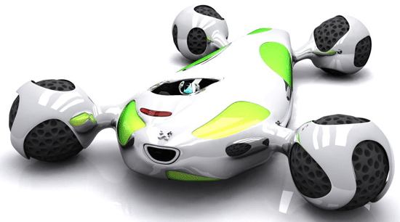
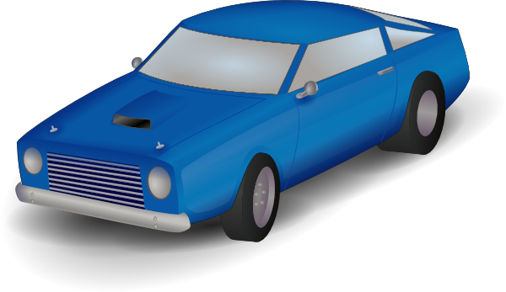
What does knowledge mean?
A car
I can design a new car.
I can make a car like it from available parts.
I can repair any car similar to it.
I can repair the car in my own backyard.
I can drive the car well in any country.
I can say car and not plane or boat.
1 How can we learn/use each item above from a lower level to a very high level? (Demonstrate)

Slide 5






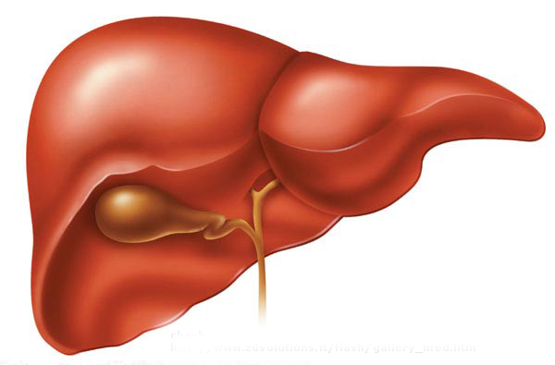

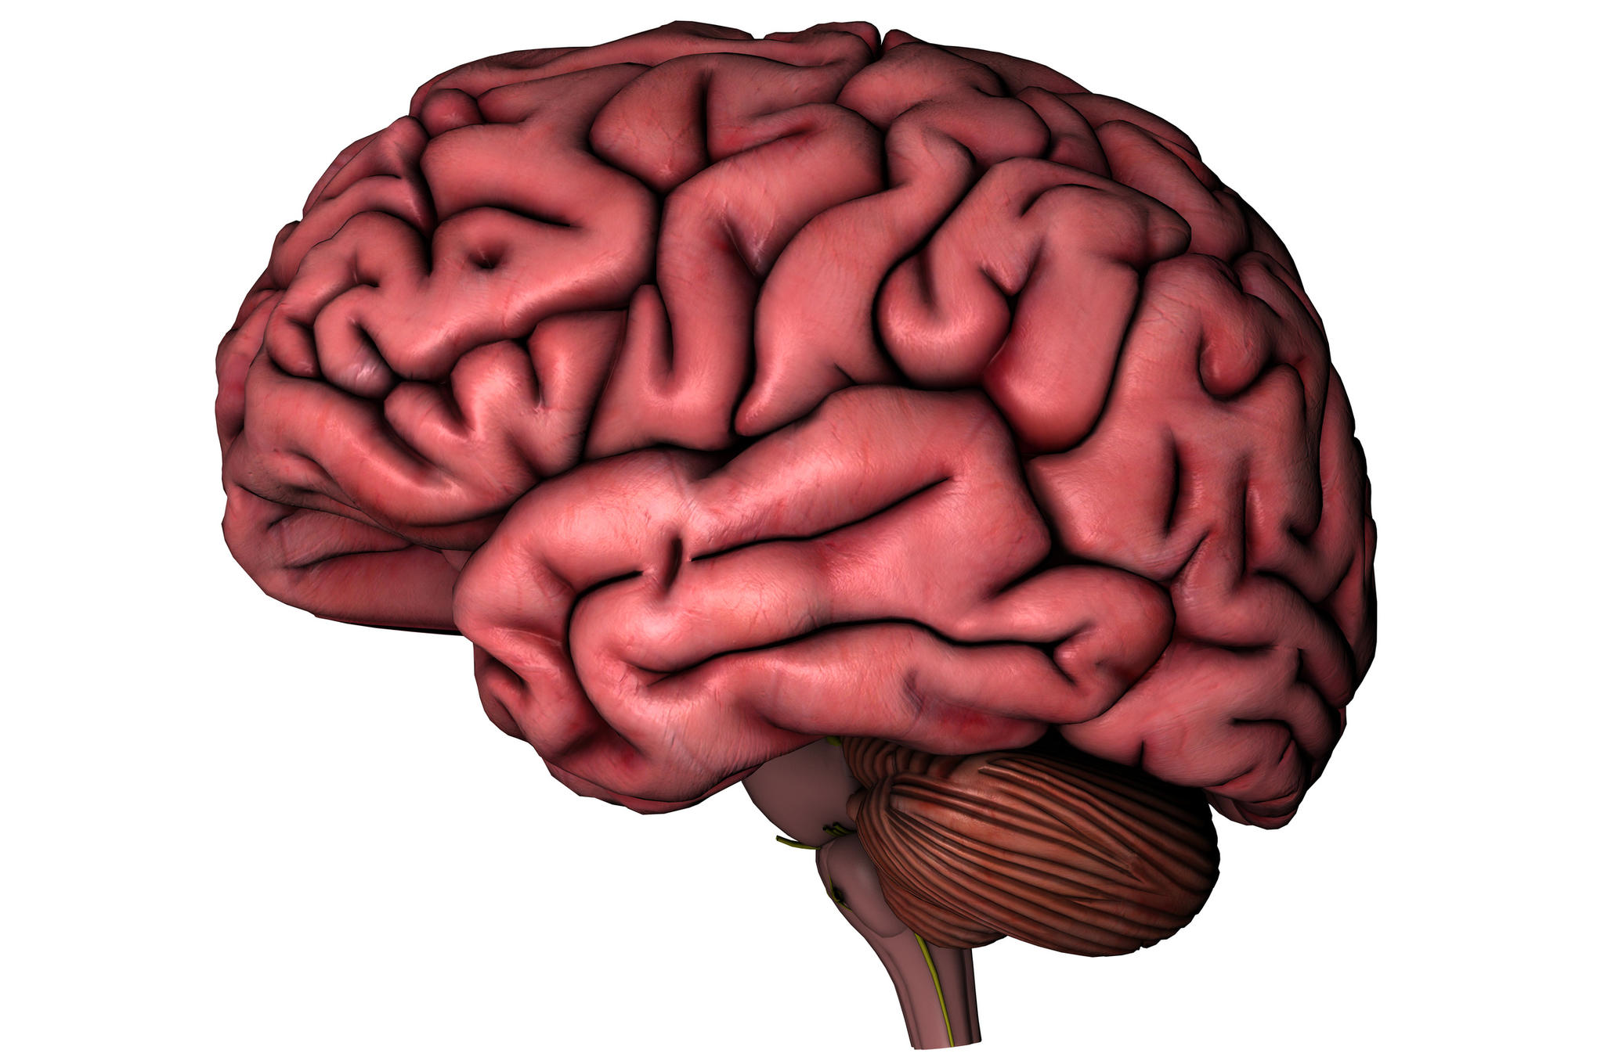
What does knowledge mean?
A dish
The Romans
A book
The plus sign
A building
Test tube
A liver
A brain
Amazing story
1 How can we learn/use each item above from a lower level to a very high level? Write notes and tell each other.

Slide 6
Categories of knowledge
? ? ?
Declarative Procedural Conceptual
A book
Cannot be learned by memorization
A liver
The plus sign
Amazing story
2 How can we classify knowledge into three basic groups? Think about it and write three headings for knowledge.

Slide 7
Your comments, feedback, and questions
Box 1
Write your comments, feedback and questions in box 1 on the last sheet of your handout.

Slide 8
Conceptualizing a unit
Central idea
Unit ?
3 Study the unit/chapter in the textbook you use for your class. Write the central idea (not word) in the middle.

Slide 9
Conceptualizing a unit
Skills
Major sections
Major sections
Sub
sections
Central idea
Unit ?
Sub
sections
Major sections
Sub
sections
Major sections
Major sections
Sub
sections
4 Draw a concept map of the unit. Write short phrases in each circle (not just words)

Slide 10
Example
Where
How - to
Assess PB ?
Assess PB ?
Details
Assess PB ?
How - to
How - to
Visualize
Action words
Time order words
What stories can teach us Unit 1
Provide vocab word for a question
Comprehension
sequence
Vocabulary
Story elements
Character/setting
Assess PB ?
How - to

Slide 11
Your comments, feedback, and questions
Box 2
Write your comments, feedback and questions in box 2 on the last sheet of your handout.

Slide 12
What kind of knowledge?
Skills
Major sections
Major sections
Sub
sections
Central idea
Unit ?
Sub
sections
Major sections
Sub
sections
Major sections
Major sections
Sub
sections
5 Study each part of your map and decide which parts are:
Declarative, Procedural, and/or Conceptual

Slide 13
What will the students learn every class period?
Skills
Major sections
Major sections
Sub
sections
Central idea
Unit ?
Sub
sections
Major sections
Sub
sections
Major sections
Major sections
1
Sub
sections
6 Make square boxes around the parts that you will help students learn every 50 minute period. Then number the boxes in the order the students will learn them.

Slide 14
What will students know and be able to do?
Skills
Major sections
Major sections
Sub
sections
Central idea
Unit ?
Sub
sections
Major sections
Sub
sections
Major sections
Major sections
1
Sub
sections
7 For each box, write sentence(s) that will let everyone know what the students’ abilities will be. Avoid vague sentences.

Slide 15
Example
The students will be able to use 4 time order words to put the events in a story in the correct order
The students will be able to add two digit numbers to another two digit number (numbers are from 1 - 4)
44 32
+12 +32
The students will be able to conclude that color dye dissolves faster in hot water

Slide 16
Your comments, feedback, and questions
Box 3
Write your comments, feedback and questions in box 3 on the last sheet of your handout.

Slide 17
Assessing at the end of the period
What is the purpose?
To draw students’ attention?
To help students learn?
To find out if students have learned?
Major sections
Sub
sections
1
Sub
sections
A What are the knowledge and abilities the students learn in this class period? Write them down.
8 For box number 1, design a short task that takes 5 to 15 minutes of the class time and will assess students’ learning.

Slide 18
Assessing at the end of the period
Major sections
Sub
sections
1
Sub
sections
(Existing schema)
Heard
Read
Seen
pressure
temp
odor
Prior
knowledge
B What are the sources that the students will use in the assessment? Write the sources and where you will get them from.
8 For box number 1, design a short task that takes 5 to 15 minutes of the class time and will assess students’ learning.

Slide 19
Assessing at the end of the period
Major sections
Sub
sections
1
Sub
sections
Speak
Write
Act out
Imaging
C What are the expected responses from the students? How will you manage the responses? Write them down.
8 For box number 1, design a short task that takes 5 to 15 minutes of the class time and will assess students’ learning.

Slide 20
Assessing at the end of the period
Major sections
Sub
sections
1
Sub
sections
Who What | Action | Who what | How | Where | When | Why
D What instructions will the students read and/or hear to carry out the assessment. Use the chart above to write them down.
8 For box number 1, design a short task that takes 5 to 15 minutes of the class time and will assess students’ learning.

Slide 21
Your comments, feedback, and questions
Box 4
Write your comments, feedback and questions in box 4 on the last sheet of your handout.

Slide 22
Planning and managing class time for learning
5 to 10 minutes
Opening task(s)
Code switching (quickly changing to target language)
Focus attention
Orient (lets students know which direction the learning is going)
20 to 40 minutes
5 to 15 minutes
Assessment task:
Sources
Response
Criteria (for the next workshop)
Total: 50 minutes

Slide 23
Planning and managing class time for learning
5 to 10 minutes
Opening task(s)
Code switching (quickly changing to target language)
Tasks for learning:
Focused attention
High learning experiences for all
Scaffolded/ Multiple perspectives
20 to 40 minutes
Assessment task:
Resources
Response
Criteria (for the next workshop)
5 to 15 minutes

Slide 24
What are three basic principles that a teacher needs to adhere to when designing a learning plan to help all students?
Maximize the amount of learning experience per individual
Make the learning experiences connect to form a concept
Include social interaction as part of the learning experience
REVIEW

Slide 25
Opening task(s) at the beginning of the period
Major sections
Sub
sections
1
Sub
sections
A What are the knowledge and abilities the students learn in this class period? What task(s) will help all the students do so?
9 For box number 1, design a short task that takes 5 to 10 minutes of the class time and will orient the students.

Slide 26
Opening task(s) at the beginning of the period
Checklist
Do the sources maximize the experience for all the students?
Do the sources connect to existing/prior learning?
Do the sources promote social interaction?
Major sections
Sub
sections
1
Sub
sections
(Existing schema)
Heard
Read
Seen
pressure
temp
odor
Prior
knowledge
B What are the sources that the students will use in the task? Write the sources and where you will get them from.
9 For box number 1, design a short task that takes 5 to 10 minutes of the class time and will orient the students.

Slide 27
Opening task(s) at the beginning of the period
Checklist
Do the sources maximize the experience for all the students?
Do the sources connect to existing/prior learning?
Do the sources promote social interaction?
Major sections
Sub
sections
1
Sub
sections
Speak
Write
Act out
Imaging
C What are the expected responses from the students? How will you manage the responses? Write them down.
9 For box number 1, design a short task that takes 5 to 10 minutes of the class time and will orient the students.

Slide 28
Opening task(s) at the beginning of the period
Checklist
Do the sources maximize the experience for all the students?
Do the sources connect to existing/prior learning?
Do the sources promote social interaction?
Major sections
Sub
sections
1
Sub
sections
Who What | Action | Who what | How | Where | When | Why
D What instructions will the students read and/or hear to carry out the opening task(s). Use the chart above to write them down.
9 For box number 1, design a short task that takes 5 to 10 minutes of the class time and will orient the students.

Slide 29
Your comments, feedback, and questions
Box 5
Write your comments, feedback and questions in box 5 on the last sheet of your handout.

Slide 30
What will the students learn every class period?
2
Skills
Major sections
Major sections
Sub
sections
Central idea
Sub
sections
Major sections
Sub
sections
3
Major sections
Major sections
Sub
sections
10 For boxes number 2, 3, 4 etc, design a short task that takes 5 to 15 minutes of the class time and will assess students’ learning.

Slide 31
Assessing at the end of the period
Remember
Sources
Response
Instructions
Major sections
Sub
sections
2
Sub
sections
A What are the knowledge and abilities the students learn in this class period? Write them down.
10 For boxes number 2, 3, 4 etc, design a short task that takes 5 to 15 minutes of the class time and will assess students’ learning.

Slide 32
Opening task(s) at the beginning of the period
Remember
Sources
Response
Instructions
Major sections
Sub
sections
1
Sub
sections
A What are the knowledge and abilities the students learn in this class period? What task(s) will help all the students do so?
11 For boxes number 2, 3, 4 etc, design a short task that takes 5 to 10 minutes of the class time and will orient the students.

Slide 33
Your comments, feedback, and questions
Box 6
Write your comments, feedback and questions in box 6 on the last sheet of your handout.

Slide 34
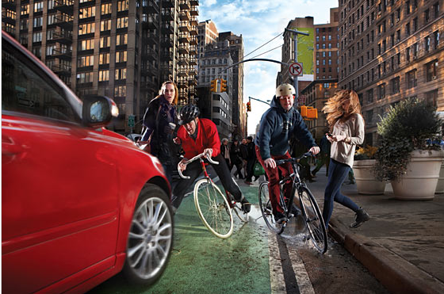
Factors that affect your students’ ability to process information and learn
Code switch
Memory org.
Affective
Age
Lang. prof
Focused attention
15 Look at the picture and write as many words as you can for what you can see in the picture. In pairs tell each other.

Slide 37
Learning Tools
Scaffold / MP
Assessment
Finds /explores
Monitoring
Focuses attention
A learning tool
Help for memory
Has management
Increases experience
Has social skills
26 Use the chart to analyze / make a tool for teaching one ‘ability’ for your students in one grade and one subject.

