Slide 1
Developing an assessment booklet for each subject in each grade level (part1)
Dubai Modern Education Schools WS 8
January 15 & 17, 2015
Dubai Office: (doing business as EU PAD) USA Home Office:
Tel: 04 455 8722 Fax: 04 455 8556 21 Apex Drive, Bozeman, MT 59718, U S A
Mobile: 0559221588 Email: info@21caf.org
Email: info@eupad.net

Slide 2



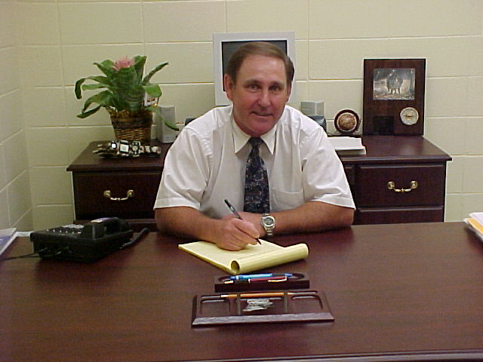
What are their thoughts?
What am I expected to be able to do by the end of the school year?
Student
What is each of my students expected to be able to do by the end of the school year?
Teacher
What is our child expected to be able to do by the end of the school year?
Parents
What is each child in my school expected to be able to do by the end of the school year?
Principal

Slide 3
The importance of assessment
Assessment should test process, strategies, in addition to getting the correct answer.
Assessment should help students learn
Assessment should help students know to what they learned and what they still need to learn
More than one assessment tool should be used.

Slide 4
Earth’s Systems
Earth’s Place in the Universe
Earth & Human Activity
Matter & its interactions
Earth & Space
Science
Motion & stability: Forces & interactions
Biological Evolution: Unity and diversity
Next Generation
Science
Physical
Science
Heredity: Inheritance and variation of traits
Life
Science
Energy
Grade 1
standards
Waves & their applications in technologies for information transfer
Ecosystems: Interactions, energy, & dynamics
Grade 2
standards
From Molecules to Organisms
Grade 3
standards
Grade ……
standards
Grade 12
standards

Slide 5
Matter & its interactions
Motion & stability: Forces & interactions
Next Generation
Science
Physical
Science
Develop a model of waves to describe patterns in terms of amplitude and wavelength and that waves can cause objects to move.
Energy
Grade 1
standards
Waves & their applications in technologies for information transfer
Develop a model to describe that light reflecting from objects and entering the eye allows objects to be seen.
Grade 2
standards
Generate and compare multiple solutions that use patterns to transfer information
Grade 3
standards
Grade ……
standards
Grade 12
standards

Slide 6
B What are the advantages if these expectations are clear?
For the student: If it is clear about what is expected of them,
they will concentrate more about how to do it.
It will help them organize and enhance their memories.
It will also lower tension during exams.
Assignments and homework will make more sense to them.
It will remove the guesswork out of learning and it will help them understand their achievement.

Slide 7
B What are the advantages if these expectations are clear?
For the teachers:
It will easier to synchronize and coordinate their work with other teachers.
They will have a clearer long-term expectation plan and how things are connected.
It will take them less time to prepare exams and tests.
They will be able to collaborate better and share their workload.
It will show progress and attainment in a more transparent way.
New teachers can be assimilated into the school system much faster.
It improves communication between departments. Teachers can also become more innovative and create interdisciplinary learning.

Slide 8
B What are the advantages if these expectations are clear?
For the parents: It is clearer about what is expected of their children.
It will give some parents a better idea of how to help their children and
if they need to hire a private a tutor, the tutor will know the where the child needs help.
It eases the tension of exam time and improves communication between parents and teachers.
Parents can also better see their children’s progress and attainment rather than just relying on grades.

Slide 9
B What are the advantages if these expectations are clear?
For the administration: It is clearer about where the school is heading.
They can explain the goals in the vision and mission more effectively to parents, visitors, and accreditation organization.
Accountability becomes more objective and transparent.
Administration support for students and teachers becomes more focused.
Evidence of progress and attainment becomes clearer and communication between administration and faculty will improve.
Administration’s decision to allocate time for the different subjects will become more based on evidence.

Slide 10
C There are two approaches for using end of the year expectations.
Top down
We can take the expectations from already existing ones and break them down to use with our textbooks.
(from MoE, CCSS, UK, American States etc.)
Bottom up
We can take the take the textbooks and materials we already use in our classrooms to construct grade level expectations.

Slide 11
C There are two approaches for using end of the year expectations.
Advantages of Top Down approach
It takes less time because they are available and have been designed experts who spent up to ten years developing them.
They plan them so that they are applicable for many years to come.
International tests such as SAT, MAP, TIMMS, PIRLS, TOEFL, IELTS, PISA are aligned with the expectations (standards). see (http://timssandpirls.bc.edu)
The expectations are linked so that they develop students’ concepts.
The principles of the expectations are similar although the design may change.

Slide 12
D Concept map of expectations
Nowadays, school subjects have become more complex and branch out into many areas.
We no longer just teach English, Math, Science, IT and Social Studies.
Each one has several branches and each branch is divided into more parts.
These parts have had many names: Domain; Area; Strand; Field;

Slide 13
D Concept map of expectations (Domain; Area; Strand)
Earth’s Systems
Earth’s Place in the Universe
Earth & Human Activity
Matter & its interactions
Earth & Space
Science
Motion & stability: Forces & interactions
Biological Evolution: Unity and diversity
Next Generation
Science
Physical
Science
Heredity: Inheritance and variation of traits
Life
Science
Energy
Grade 1
standards
Waves & their applications in technologies for information transfer
Ecosystems: Interactions, energy, & dynamics
Grade 2
standards
From Molecules to Organisms
Grade 3
standards
Grade ……
standards
Grade 12
standards

Slide 14
1 Search in your book and find the domains and strands. Write them in the boxes below.
Measurement and data
Convert like measurement units within a given measurement system.
1. Convert among different-sized standard measurement units within a given measurement system (e.g., convert 5 cm to 0.05 m), and use these conversions in solving multi-step, real world problems.
Vocabulary acquisition and Use
Determine or clarify the meaning of unknown and multiple-meaning words and phrases based on grade 6 reading and content, choosing flexibly from a range of strategies.
  Use context (e.g., the overall meaning of a sentence or paragraph; a word’s position or function in a sentence) as a clue to the meaning of a word or phrase.
  Use common, grade-appropriate Greek or Latin affixes and roots as clues to the meaning of a word (e.g., audience, auditory, audible).

Slide 15
2 Search in the standards document and find the grade level expectations for each domain/strand. Write them in the standard/ expectation boxes.

Slide 16
3 Choose a standard/expectation and analyze it using the organizer below.

Slide 17
3 Choose a standard/expectation and analyze it using the organizer below.

Slide 18
3 Choose a standard/expectation and analyze it using the organizer below.

Slide 19
E Traditional tools that help collect evidence of progress and attainment of standard/expectation
1 Think of all tools that can collect evidence of learning and make a list of them below. An example has been provided.

Slide 20
E Traditional tools that help collect evidence of progress and attainment of standard/expectation
2 Think of and write the advantages and disadvantages of each tool. An example has been provided.

Slide 21
E Traditional tools that help collect evidence of progress and attainment of standard/expectation
3 Study the tools and find the parts that are common to all of them. An example has been provided.

Slide 22
4 Use more than one tool and design a template test for one standard. An example has been provided.
instructions
Specification of sources
Skill and knowledge
Skill and knowledge
Skill and knowledge

Slide 23
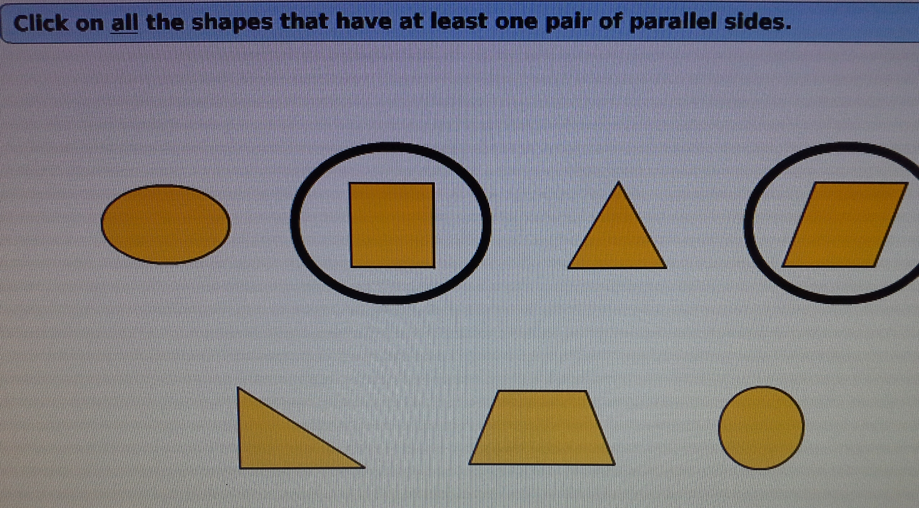
4 Use more than one tool and design a template test for one standard. An example has been provided.

Slide 24
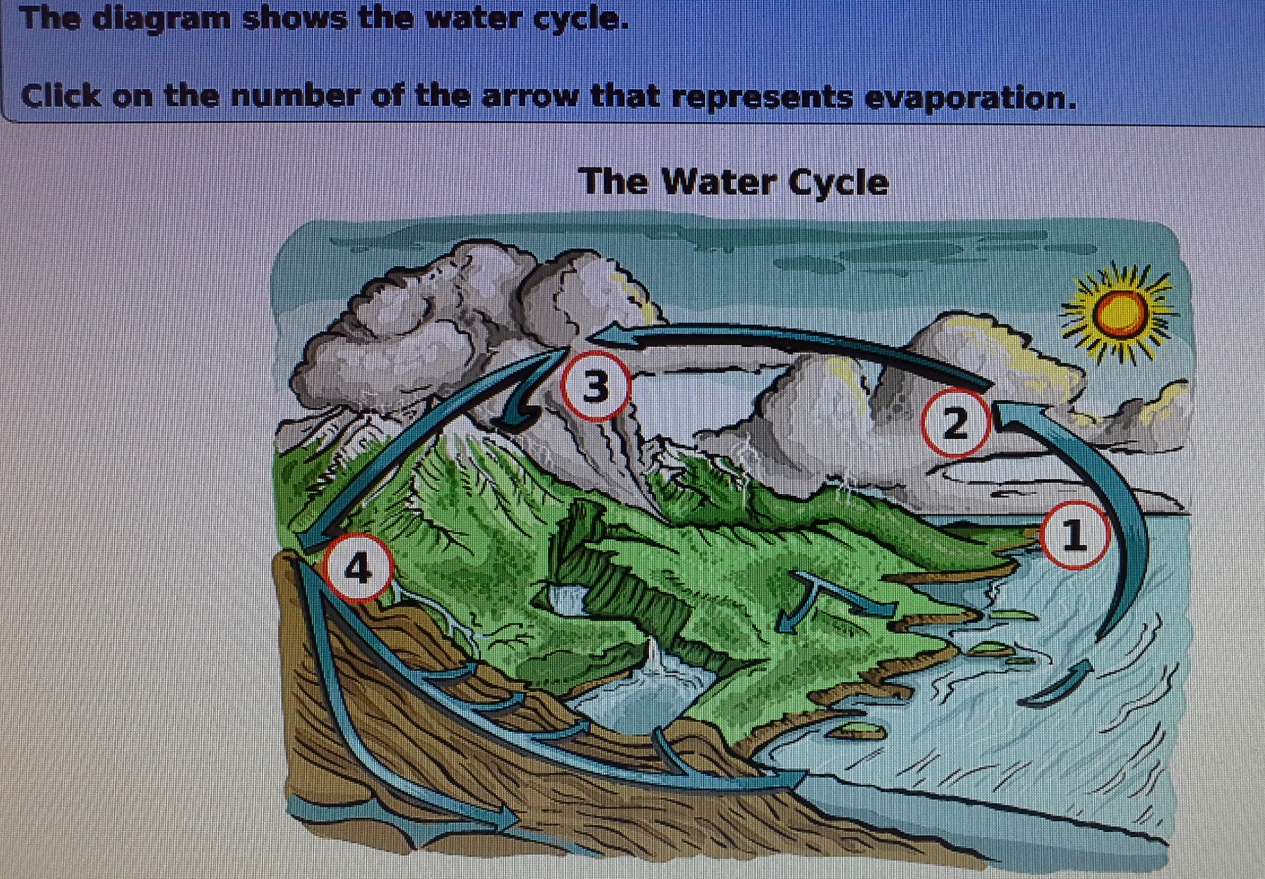
4 Use more than one tool and design a template test for one standard. An example has been provided.

Slide 25
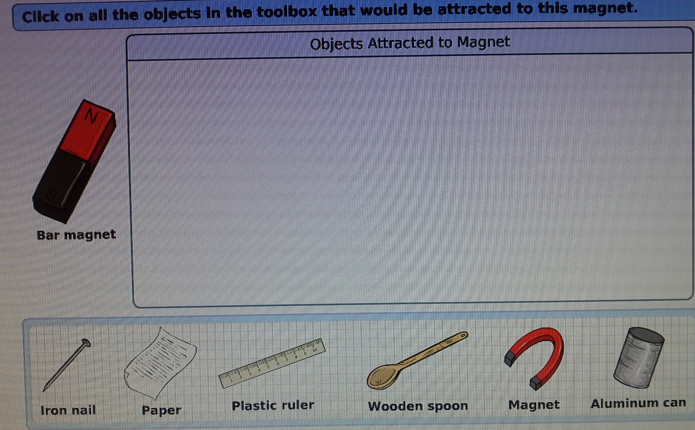
4 Use more than one tool and design a template test for one standard. An example has been provided.

Slide 26
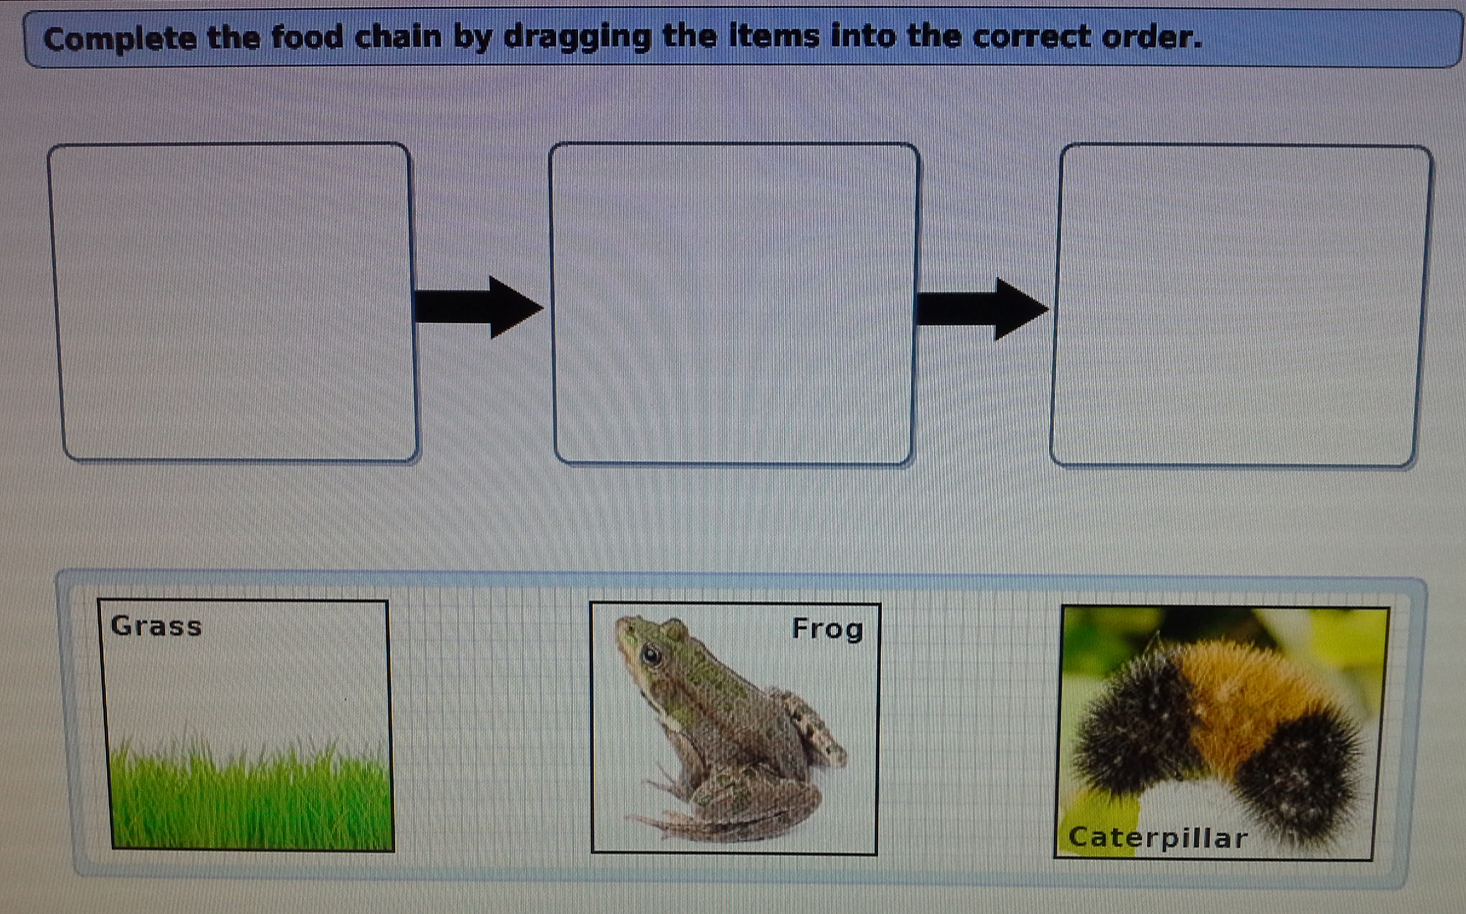
4 Use more than one tool and design a template test for one standard. An example has been provided.

Slide 27
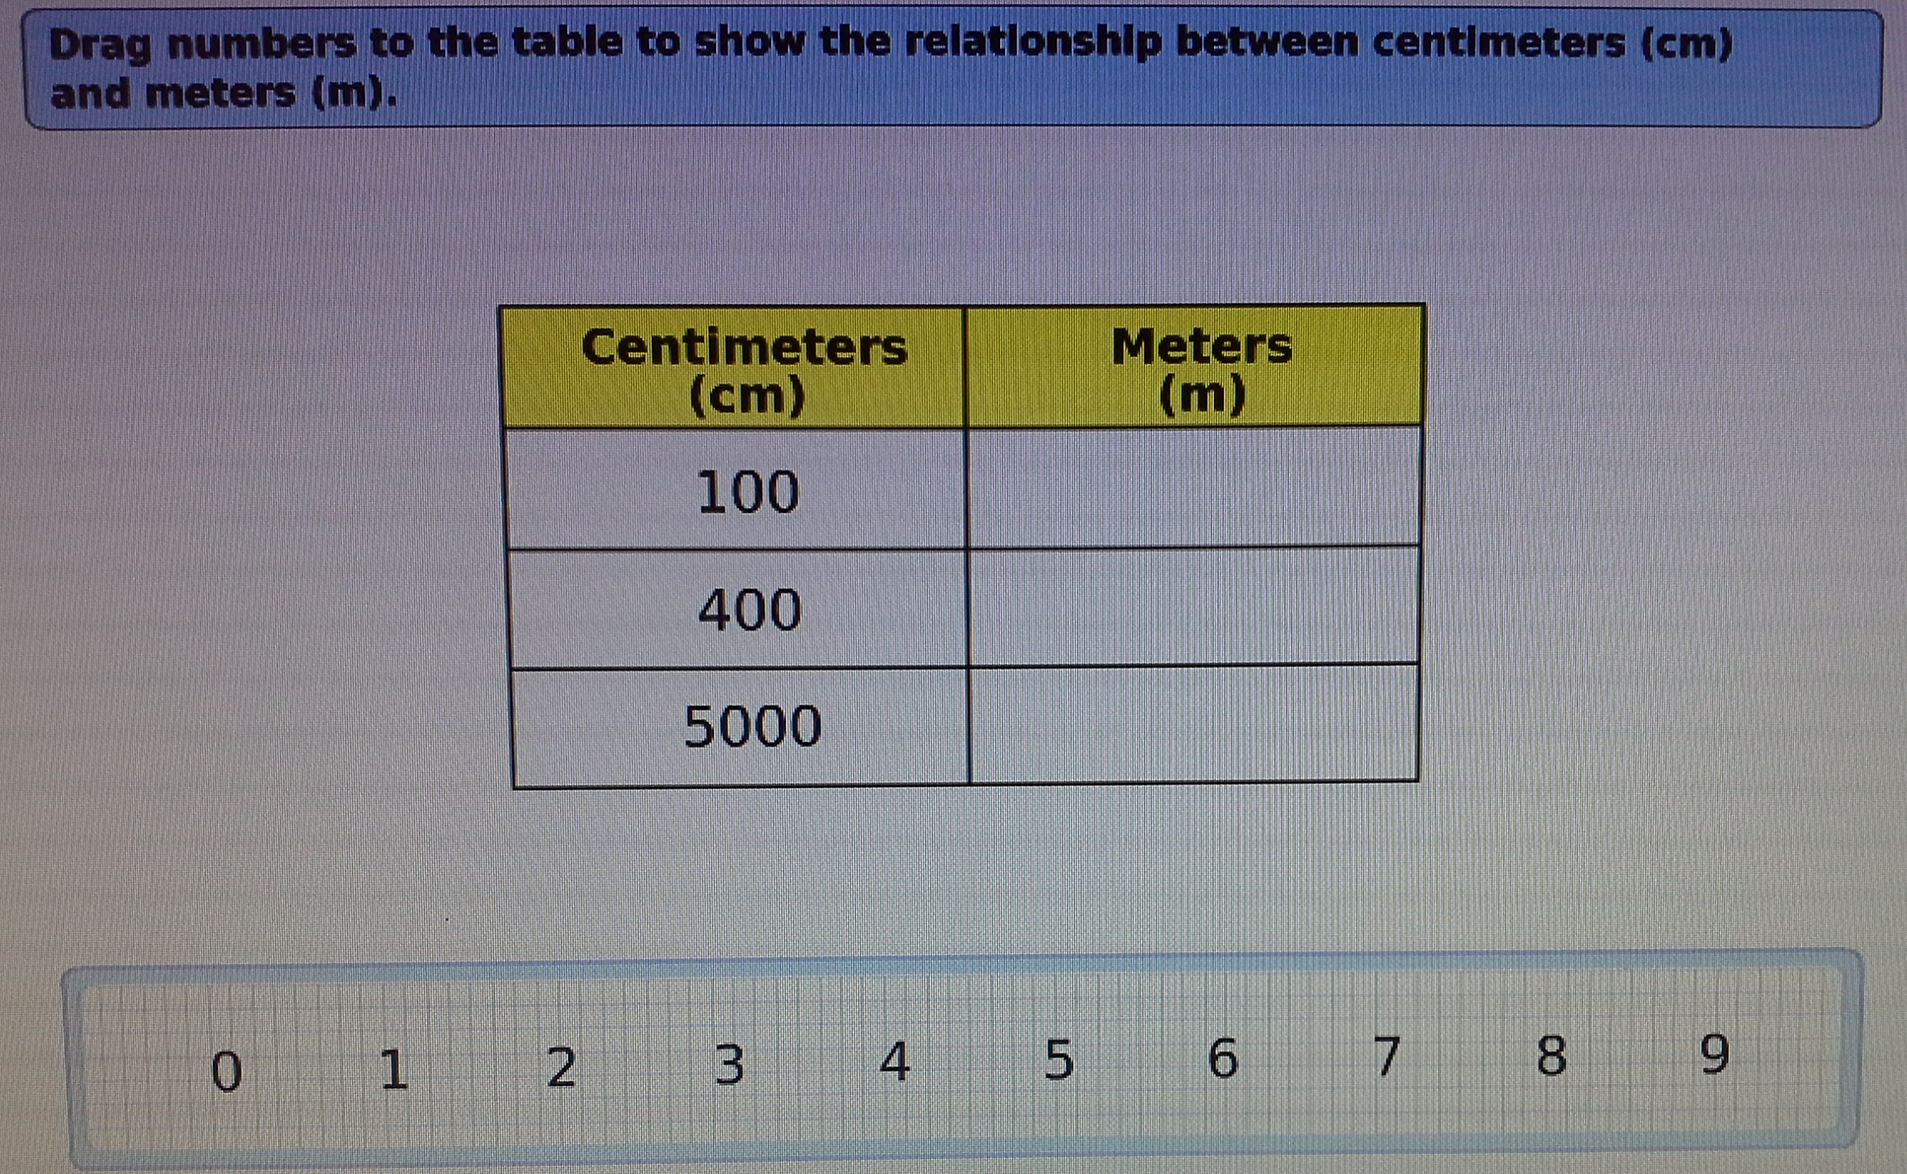
4 Use more than one tool and design a template test for one standard. An example has been provided.

Slide 28
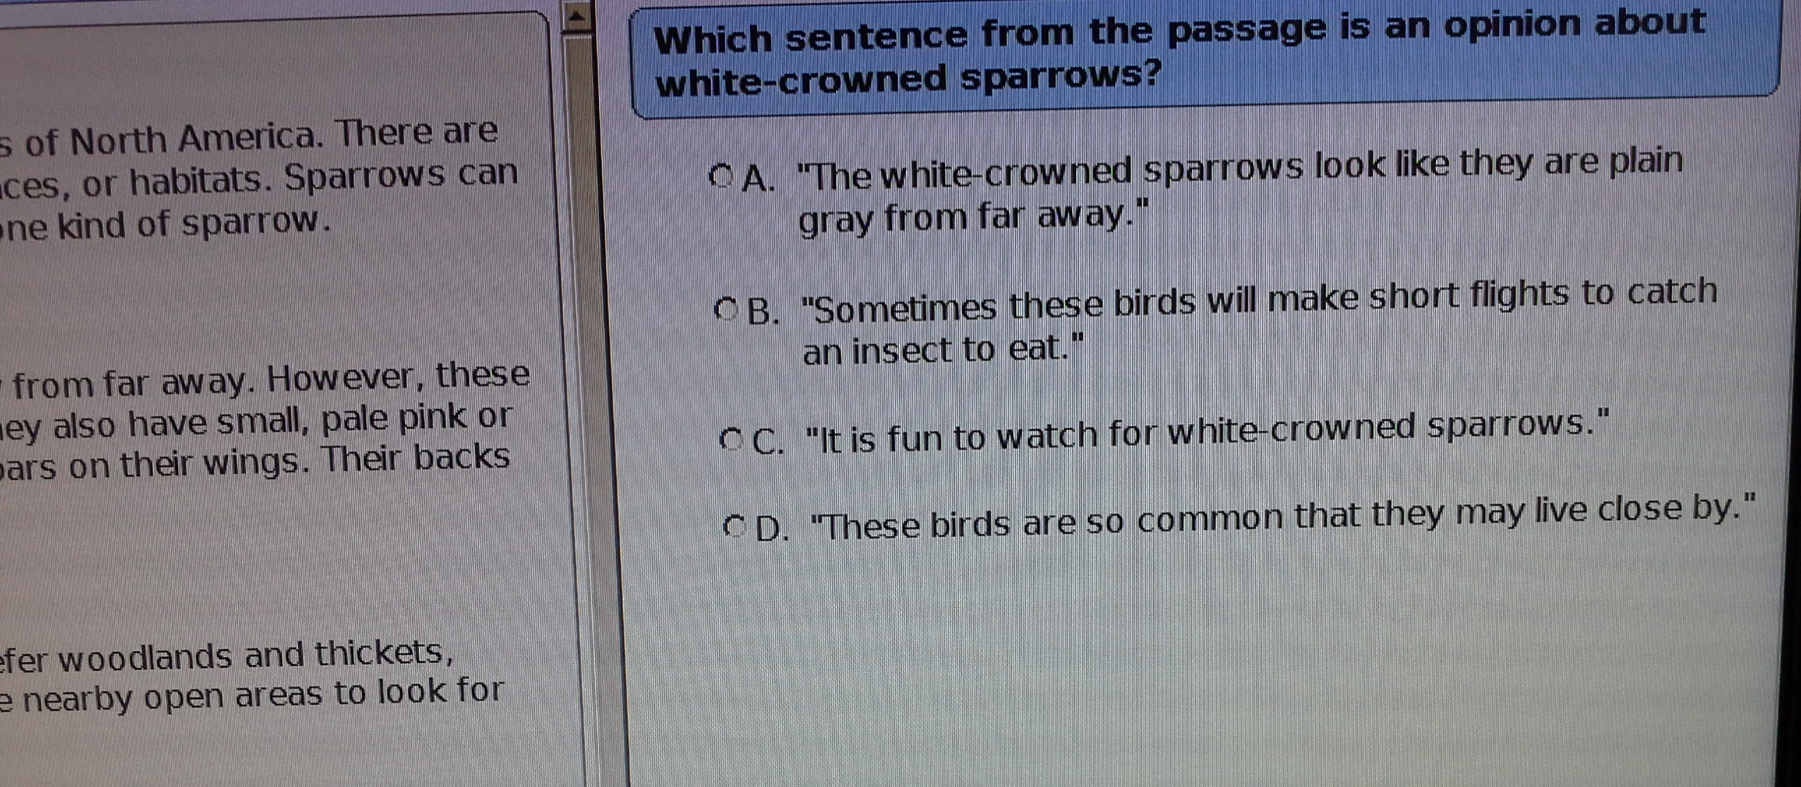
4 Use more than one tool and design a template test for one standard. An example has been provided.

