Slide 1


&
Good Morning, Lebanon

Slide 2

www.eupad.net
www.munjez.com
www.21caf.org
Eli Ghazel
eli@eupad.net +971559221588

Slide 3
In the next 20 years,
9 out 10 of the jobs we know today
will become obsolete!

Slide 4
In the next 6 years, (by 2020),
a 3rd grader will enter high school
a 6th grader will go into university
a 12th grader will enter the job
market

Slide 5
How is your educational institute preparing today’s children for the future?

Slide 6
There are three major questions that need to be asked and continuously seek answers for:

Slide 7
What do we want our children to learn?
What are the best ways to help them learn?
How do we know that they have learned?

Slide 8


Content of textbooks and websites can only give us
data & information
Data
Information
What is this?
95

Slide 9
What is KNOWLEDGE?
Knowledge cannot be stored anywhere except in the brain.

Slide 10




When someone’s knowledge is written or told to others, it becomes information for the audience.

Slide 11
What is LEARNING?
a series of planned or ‘accidental’ experiences that help persons
convert information and data from multiple sources into knowledge that
can be applied in new situations.

Slide 12
Who are WE?
What do we do and what are the consequences of our actions in the classroom?

Slide 13
Who are WE?
If we talk, show, explain, and provide examples, then we are only exposing our children to information.

Slide 14

Who are WE?
Information is everywhere
and readily accessible.
It is no longer the prerogative of a few ‘teachers’.

Slide 15
What is our role?
We are no longer ‘teachers’.
We are
LEARNING DESIGNERS.

Slide 16

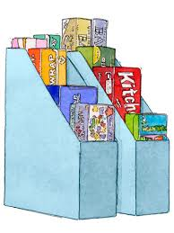
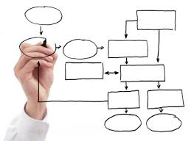
New learning
Collect
Organize
Make sense of
and apply

Slide 17
Principles of effective learning
Maximize the amount of learning experience per individual
Make the learning experiences connect to form a concept
Include social interaction as part of the learning experience

Slide 18
Challenges and
Problems
in Learning

Slide 19
Challenges and Problems in Learning
The student is bombarded with too much information from multiple subjects every day.

Slide 20
Challenges and Problems in Learning
The student is not helped to develop mental models of organization in order to start making sense of information. (develop knowledge)

Slide 21
Challenges and Problems in Learning
The students’ responses are usually
Test type exercises
Answers to questions
Essays

Slide 22
Challenges and Problems in Learning
The need to develop an experience or a set of experiences in the classroom and at home that help our children learn.

Slide 23
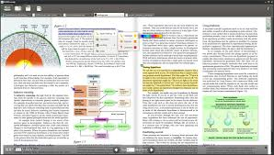



A Learning Experience Needs
Sources of information
Information that can be read
Information that can be heard
Information that can be seen
Information that can be seen and heard

Slide 24

A Learning Experience Needs
Mental (cognitive) processing of information
Comparing information
Recognizing information
Identifying information
Classifying information

Slide 25


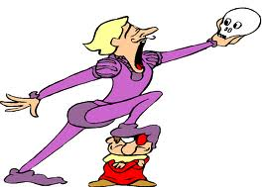

A Learning Experience Needs
Response from the students
Speaking response
Writing response
Act out / demonstrating response
Drawing / providing an image response

Slide 26
A Learning Experience Needs
Response from the students
creates meaning focused attention
is managed for maximum experience for all
includes social interaction
Speaking response
Drawing / providing an image response
Writing response
Act out / demonstrating response

Slide 27
What are the best ways to help our children learn?

Slide 28
Printed
Audio
Video
Pictures
Sources/information
Tasks for learning:
Collect
Organize
Make sense of
Processing
Response
Using images
Acting out
Speaking
Writing
Respond

Slide 29
A writer is only as good as his mastery of reading skills and strategies

Slide 30
Study the sentences below and underline the parts that answer the following words WHO WHAT ACTION (verb) HOW WHERE WHEN. Write the appropriate word above each underlined part.
Who
action
What
How
We will build a new birdhouse with the basket.
Dog hair was on the list.
Taylor and her friends watched the basket.
The basket was empty in a few days.
Yarn poked out from the sticks and mud.
What
Action
Where
Who Action What
What Action What When
What Action Where

Slide 31
Study the sentences below and underline the parts that answer the following words WHO WHAT ACTION (verb) HOW WHERE WHEN. Write the appropriate word above each underlined part.
Who Action What
The tall handsome man
bought
a beautiful red Mercedes
How Where When
at a whim
from the dealer in Beirut
last weekend

Slide 32
Which question word WHO WHAT HOW WHERE WHEN does each box below answer?
table
big round red table
on the big round red table

Slide 33
A complex sentence is one simple sentence where one of the parts is modified by a clause. A clause may start with a relative adverb such as WHO, WHAT, THAT, WHERE etc. Study the diagram of a complex sentence below and write three complex sentences using words from unit one.
Who/ what | Action | Who/ what | How | Where | When
The big tree | fell |  |  | on the old house | during the storm.
where I was born
which was in the front garden

Slide 34
At a lower level, we put words together to form the details and actions of a sentence. At a higher level, the details are no longer the parts of the sentence but the whole sentence becomes one idea.

Slide 35
Read the sentences and write the letter of the idea each one expresses. Sometimes depending on the context and the intonation, a sentence may express more than one idea. That’s why we have jokes and puns.
_____ 1 I need three blue pens, please.
___ 2 The ship had already left.
___ 3 This is the third time I asked for a glass of water.
___ 4 Careful, you are going to fall.
___ 5 He wants to go home.
___ 6 The books on the history of the Egypt are on the
top shelf.
___ 7 This ice cream is delicious.
___ 8 Don’t put the rug there or someone might trip on
it.
___ 9 The building is tall and wide.
a) An opinion
b) A cause and effect
c) A sequence of events
d) A complaint
e) A prediction
f) A retell
g) A description
h) Information

Slide 36
At an even higher level, the sentences come together to present a narrative, a description, an informative text and so forth.

Slide 37
Read/Write a story. Use the organizer to make notes of your ideas then use it to write your story.
Who?
Where? When?
What happened?
How did the story end?

Slide 38
Read/Write a story. Use the organizer to make notes of your ideas then use it to write your story.
Who?
Where? When?
How can we use sources to write a story?
What happened?
How did the story end?

Slide 39
Grab the readers’ interest
Sentence fluency
Ideas
Strong words
Create clear picture in the readers’ minds
Word choice
Cause and effect
Writing Traits
More specific to less specific
Voice
Organization
Informal / informal
Tone
More important to less important
Serious
Suspenseful
Humorous

Slide 40
What do we want our children to learn?

Slide 41
Source: Reading;
Read to Write
Write about the similarities and differences between two texts
Write a sentence that fits seamlessly into a text
Write a sentence using words from the text
Write a prediction using the information in the text
Write to change/add information in the text
Write a summary of the text
Write a script using a text
Write to merge 2+ texts into one
Write to comment, to critique, to give opinion, to point out flaws, inconsistencies, fallacies, to question, to explain, and to suggest alternatives to ‘what if’.

Slide 42
Source: Reading;
Read to Speak
Read to write
Read to draw
Read to act out
Talk about the similarities and differences between two texts
Talk to insert a sentence that fits seamlessly into a text
Talk to make a sentence using words from the text
Talk to make a prediction using the information in the text
Talk to change/add information in the text
Talk to summarize the text
Talk to merge 2+ texts into one
Talk to comment, to critique, to give opinion, to point out flaws, inconsistencies, fallacies, to question, to explain, and to suggest alternatives to ‘what if’.
Write about the similarities and differences between two texts
Write a sentence that fits seamlessly into a text
Write a sentence using words from the text
Write a prediction using the information in the text
Write to change/add information in the text
Write a summary of the text
Write a script using a text
Write to merge 2+ texts into one
Write to comment, to critique, to give opinion, to point out flaws, inconsistencies, fallacies, to question, to explain, and to suggest alternatives to ‘what if’.
Draw depictions of people, places, things, time, actions, positions, and proximity in texts read
Draw to make diagrams, charts, tables, flow charts and non-print signs to represent information and concepts in texts read
Create models of people, places, things, time, actions, positions, and proximity in texts read
Act out / demonstrate words, phrases, sentences, texts read silently

Slide 43
Let’s remember…
Writing is just a response
to a source of information

Slide 44
Example
Helping our students learn to compare and contrast in reading

Slide 45
Performance task expected of the students:
Read the two texts and answer the question.
How are Bob’s and Sally’s bedrooms alike and different? Write four sentences.

Slide 46
1 Teacher’s analysis: The students need to decide what information (details) should be compared.
In her lesson plan, the teacher gives the students an activity such as the one below:

Slide 47
a Teacher’s instructions to the students: Find words, short phrases that tell
about the bedrooms in the two texts and underline them.

Slide 48
2 Teacher’s analysis: The students need to group (classify) the information details in order to be able to compare and contrast.
In her lesson plan, the teacher gives the students an activity such as the one below:

Slide 49
b Teacher’s instructions to the students:
Look at the details you underlined and group them according to the questions that follow. Then write them in the chart.
Which details (information) talk about size?
Which details (information) talk about position?
Which details (information) talk about use?
Which details (information) talk about color?

Slide 50
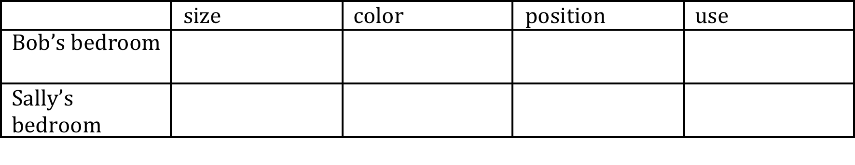

Slide 51
3 Teacher’s analysis: The students now have organized information in the chart and can produce sentences to compare and contrast Bob’s and Sally’s bedrooms.

Slide 52
c Teacher’s instructions to the students: Write four sentences to show how Bob’s and Sally’s bedrooms are similar and different.

Slide 53
4 Teacher’s analysis: The teacher knows that the students need to be able to apply their knowledge to new situations

Slide 54
d Teacher’s instructions to the students:
In groups of three, tell each other the
steps that you took in order to compare Sally’s and Bob’s bedrooms and what you should do when I give you two new texts to read and compare.
When you finish, write your steps on the large sheet and put it up on the wall.

Slide 55
How do we know that our children have learned?

Slide 56
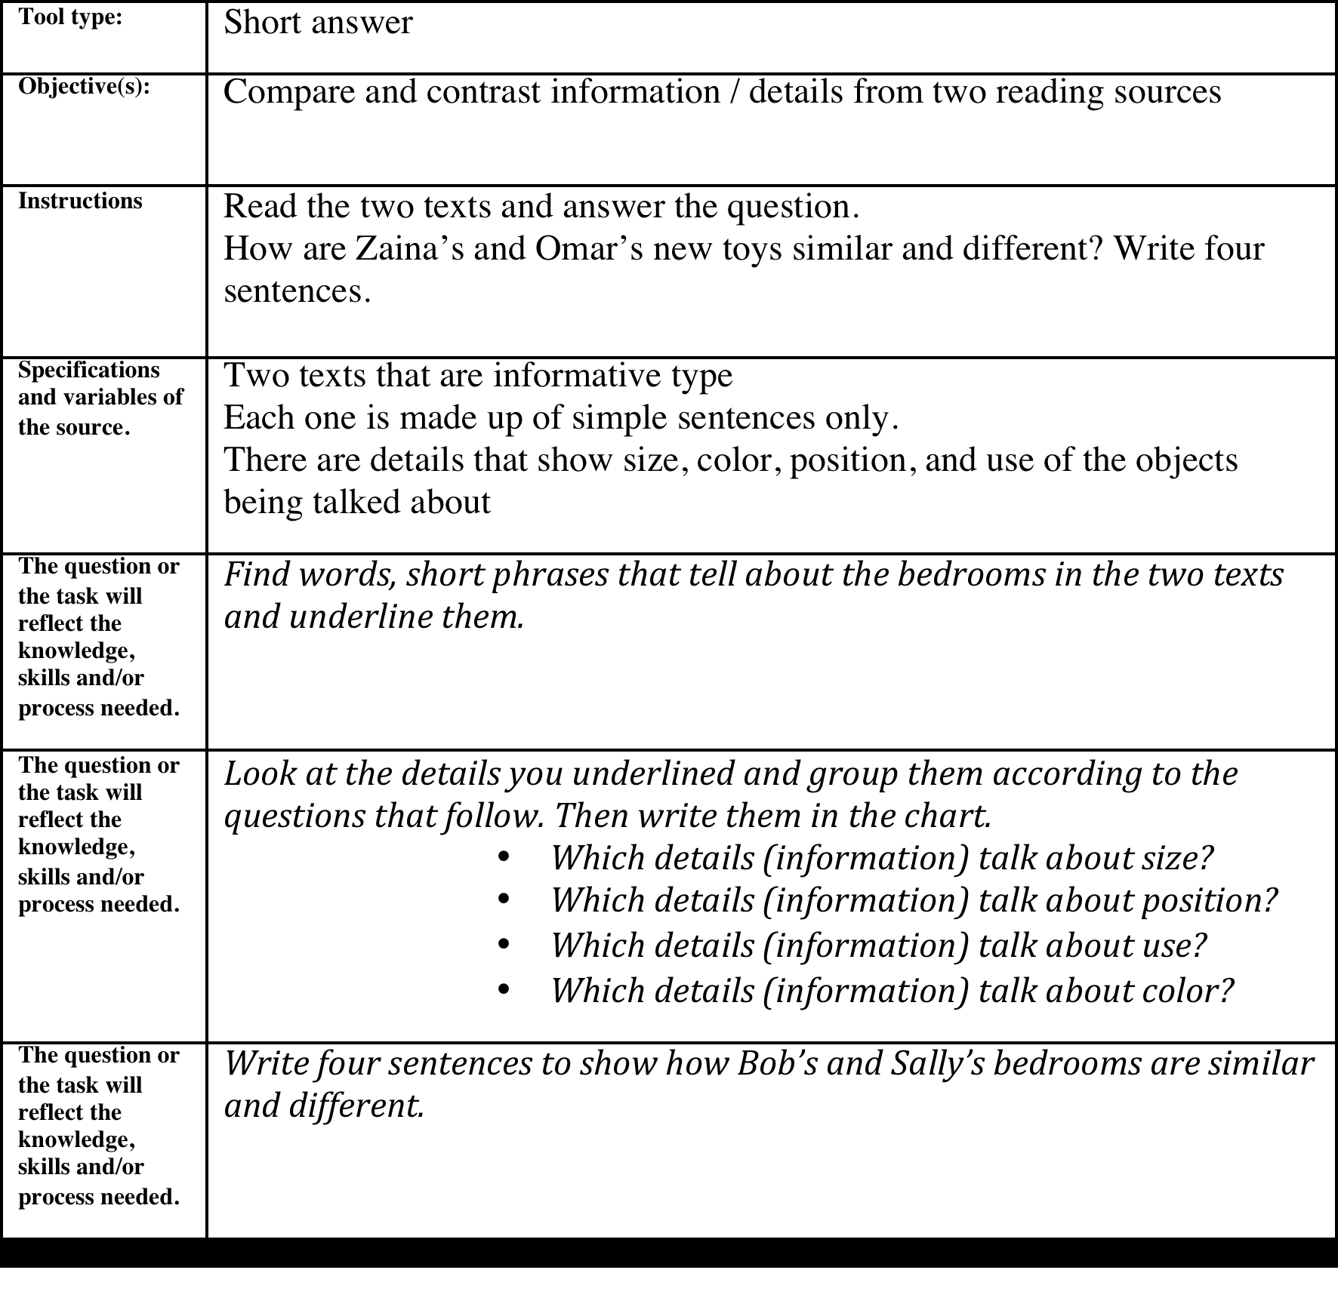

Slide 57
Read each sample instruction from an IELTS essay and underline the parts. Write the words who, what, how, where, and action above each part.
1 Is freedom of speech necessary in a free society? Do you agree or disagree?
Under 5 mins / 40

Slide 58
Read each sample instruction for an IELTS essay and underline the parts. Write the words who, what, how, where, and action above each part.
action what what
Is freedom of speech necessary
where who action
in a free society? Do you agree or disagree?

Slide 59
Read each sample instruction for an IELTS essay and underline the parts. Write the words who, what, how, where, and action above each part.
2 Some people think women should be allowed to join the army, the navy and the air force just like men.

Slide 60
Read each sample instruction for an IELTS essay and underline the parts. Write the words who, what, how, where, and action above each part.
who action
2 Some people think
what
women should be allowed to join the army, the navy and the air force just like men.

Slide 61
Read each sample instruction for an IELTS essay and underline the parts. Write the words who, what, how, where, and action above each part.
3 In the past, buildings often reflected the culture of a society but today all modern buildings are alike and cities throughout the world are becoming similar.

Slide 62
Read each sample instruction for an IELTS essay and underline the parts. Write the words who, what, how, where, and action above each part.
when what action
3 In the past, buildings often reflected
what
the culture of a society
but today all modern buildings are alike and cities throughout the world are becoming similar.

Slide 63
Read each sample instruction for an IELTS essay and underline the parts. Write the words who, what, how, where, and action above each part.
but
when what action what
today all modern buildings are alike
and cities throughout the world are becoming similar.

Slide 64
Read each sample instruction for an IELTS essay and underline the parts. Write the words who, what, how, where, and action above each part.
and
what action
cities throughout the world are becoming
what
similar.

Slide 65
Read each sample instruction for an IELTS essay and underline the parts. Write the words who, what, how, where, and action above each part.
What do you think is the reason for this, and is it a good thing or a bad thing?

Slide 66
Read each sample instruction for an IELTS essay and underline the parts. Write the words who, what, how, where, and action above each part.
The world is experiencing a dramatic increase in population. This is causing problems not only for poor, underdeveloped countries, but also for industrialized and developing nations.

Slide 67
Read each sample instruction for an IELTS essay and underline the parts. Write the words who, what, how, where, and action above each part.
Describe some of the problems that overpopulation causes, and suggest at least one possible solution.

Slide 68
The next step is to create a quick organizer to collect thoughts, details and ideas.
One of the quickest way to do so is to use a T-Chart or a double T-Chart.
See slide for examples.

Slide 69
The next step is to create a quick organizer to collect thoughts, details and ideas. One of the quickest way to do so is to use a T-Chart or a double T-Chart. See slide for examples.

Slide 70
The next step is to create a quick organizer to collect thoughts, details and ideas. One of the quickest way to do so is to use a T-Chart or a double T-Chart. See slide for examples.

Slide 71
The next step is to create a quick organizer to collect thoughts, details and ideas. One of the quickest way to do so is to use a T-Chart or a double T-Chart. See slide for examples.
Buy a house or start a new business (discuss)
Advantage disadvantage Advantage disadvantage

Slide 72
Choose one of the instructions Study the parts of the instructions and identify the headings for the T-chart. Then write down the headings, the details, ideas and thoughts in the appropriate columns.
under 10 mins / 40

Slide 73
Study your details, thoughts and ideas.
A Note which are examples, reasons, opinions, arguments
B Cross out the ones you think are irrelevant
C Number your ideas in the order importance to you
Under 5 mins / 40

Slide 74
There are several types of essays – persuasive, descriptive, informative, comparison and contrast, cause and effect and each has its own unique organizer. The time available is not enough to go into the different types.

Slide 78
For more examples, go to www.munjez.com and download the On Location Teacher Support Guides for grades 10, 11 and 12 written by Eli Ghazel and published by McGraw-Hill Education.

Slide 79
Examine the three organizers that follow and decide which organizer would be most suitable for each of the four instructions in you saw in the previous slides.
Write the number of the instruction next to the organizer. Then write the information from your T-chart in the organizer.
Under 5 mins / 40

Slide 80
Use the information in your organizer to write your essay.
Under 10 mins / 40

Slide 81
How do we know that our children have learned?

Slide 83
> 5 Study the question / instructions
> 10 Brainstorm the ideas in a T-Chart
> 5 Cross out irrelevant details and order the information
> 5 Write the information in an organizer
> 10 Write your essay
> 5 Review your essay

Slide 84
www.eupad.net
www.munjez.com
www.21caf.org
Eli Ghazel
eli@eupad.net +971559221588

