Slide 1


Slide 2
Reading Wonders
Preparing Students for the Future

Slide 3
Eli Ghazel

Slide 4
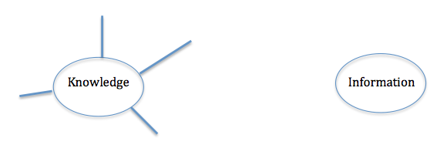
Introduction
What comes to your mind when you think of each of these words? Write/note your words and ideas around each.

Slide 5

2. Information
I read 100 books on medicine…
Who would trust me to perform surgery on them?

Slide 6
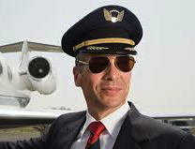
2. Information
I read 150 books on flying a Boeing 777 …
Who would trust me to pilot the plane?

Slide 7

2. Information
I will read recipes on cooking Koshary, Lasagna and Mossaka.
Who would hire me as a chef in their restaurant?

Slide 8
2. Information
Why won’t anyone here trust me in any of these jobs?
Information is not KNOWLEDGE

Slide 9
2. Information vs. Knowledge
Information can be stored outside the mind.
Knowledge can only be stored inside the mind.

Slide 10
2. Information vs. Knowledge
Information can be forgotten.
Knowledge is forever.

Slide 11
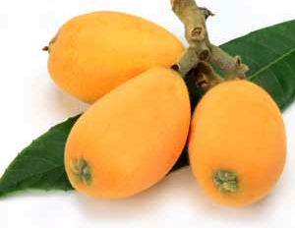
2. Information vs. Knowledge
The pyramids are in Egypt.
I am going home.
My friend doesn’t like loquats.

Slide 12
2. Information
The Reading Wonders teacher’s guide
has information that needs to be approached with knowledge

Slide 13
3. Learning vs. Have Learned
Learning is simply HOW to convert information into knowledge
Have Learned is simply the ABILITY to convert information into knowledge

Slide 14
3. Learning vs. Have Learned
What is the role of the teacher?

Slide 15
3. Learning vs. Have Learned
Help children learn HOW to convert information into knowledge
Check children’s ABILITY to convert information into knowledge

Slide 16
4. Managing and using time efficiently and effectively
How many ‘NEW learning’ classroom periods do you have in a school?

Slide 17
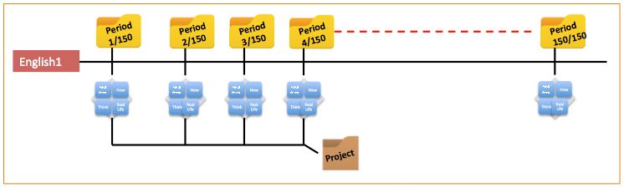
4. Managing and using time efficiently and effectively
a. Take the number of periods for the subject
b. Multiply it by 25 weeks
c. And number your planning folder accordingly

Slide 18
5. Determine what each child will learn and be able to do by the end of each classroom period.
Study the
practice book,
the reading writing workshop book
the grammar book/materials
the weekly assessment

Slide 19
5. Determine what each child will learn and be able to do by the end of each classroom period.
From the practice book handouts you have, determine …
What each child should learn and be able to do.
How each page is different from the other even though they are all about
- vocabulary.
- comprehension.

Slide 20
6. Study HOW the answer could be found by the child.
Look for text evidence that needs to be found (information)
Identify how the child should process the information (knowledge) to get the answer.
Determine how the child will make the answer visible (response)

Slide 21
6. Study HOW the answer could be found by the child.
Information ➔ Process ➔ Respond

Slide 22
Wonders

Slide 23
Integrate
Assess
Differentiate
Wonders
Introduce
Apply
Teach
Wonders Reading is a recently developed program that includes and integrates all the components of a learning model.

Slide 24
Use any BOOKS and e-materials
Use weekly/ unit and benchmark assessment BOOKS
Integrate
Assess
Wonders
Introduce
Use Reading / Writing BOOK
Differentiate
Use Leveled Readers
BOOKS
Apply
Teach
Use Reading / Writing,
Grammar, practice BOOKS
Use Literature / Anthology
BOOKS

Slide 25
Wonders
Introduce
Use Reading / Writing BOOK

Slide 26
Wonders
Introduce
Use Reading / Writing BOOK
Support with:
- Videos
- Photographs
- Organizers
To
build concept

Slide 27
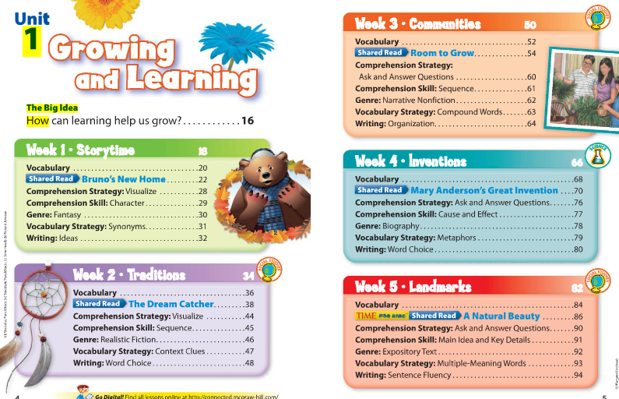

Slide 28
The big idea:
How can learning help us grow?
Essential questions
What can stories teach you?

Slide 29


Slide 30
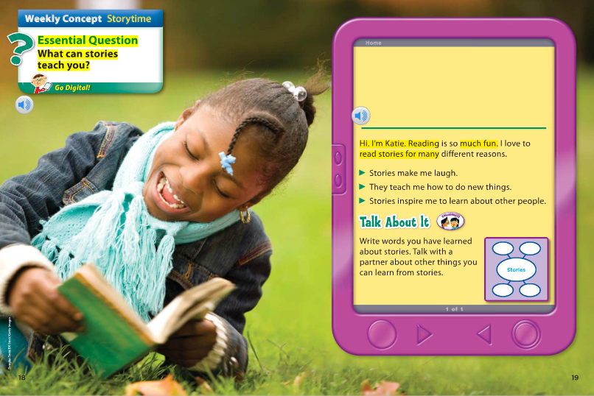

Slide 31
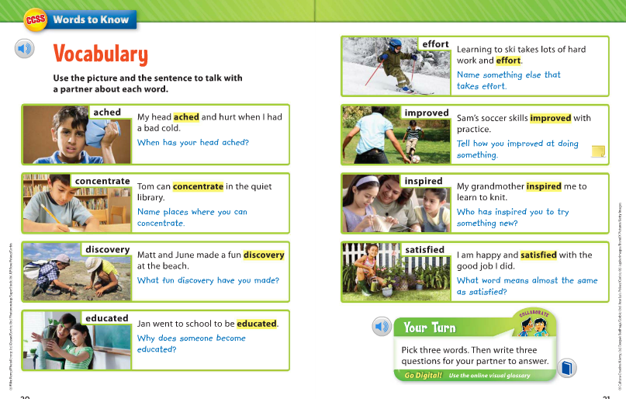

Slide 32
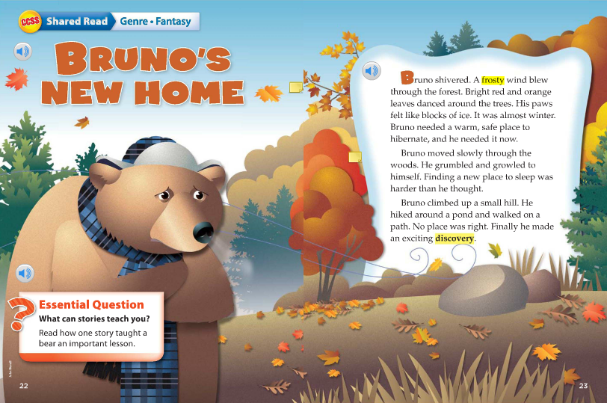

Slide 33
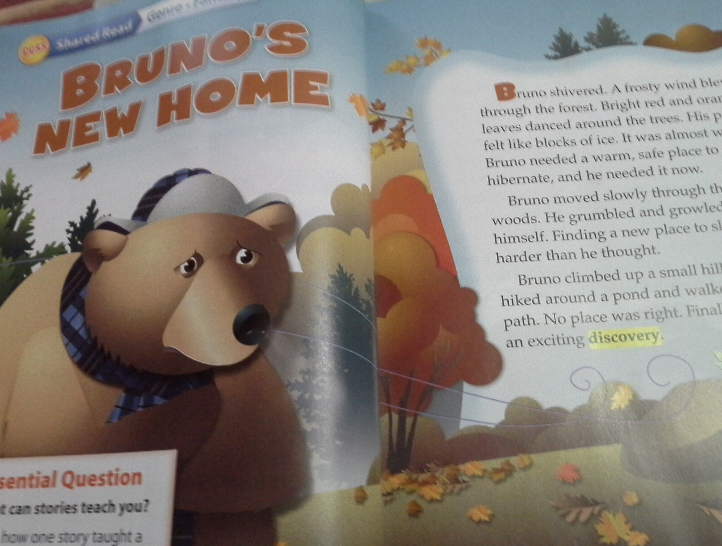
Why are we using this story?

Slide 34
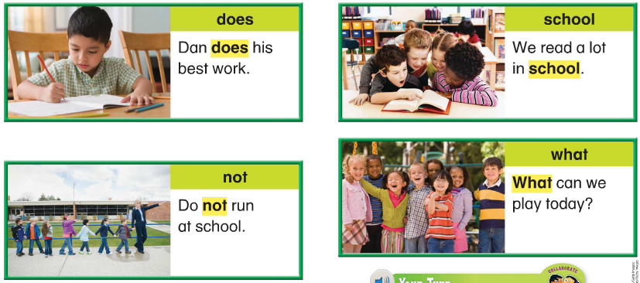
Build vocabulary

Slide 35
Learn ‘how-to’ …

Slide 36
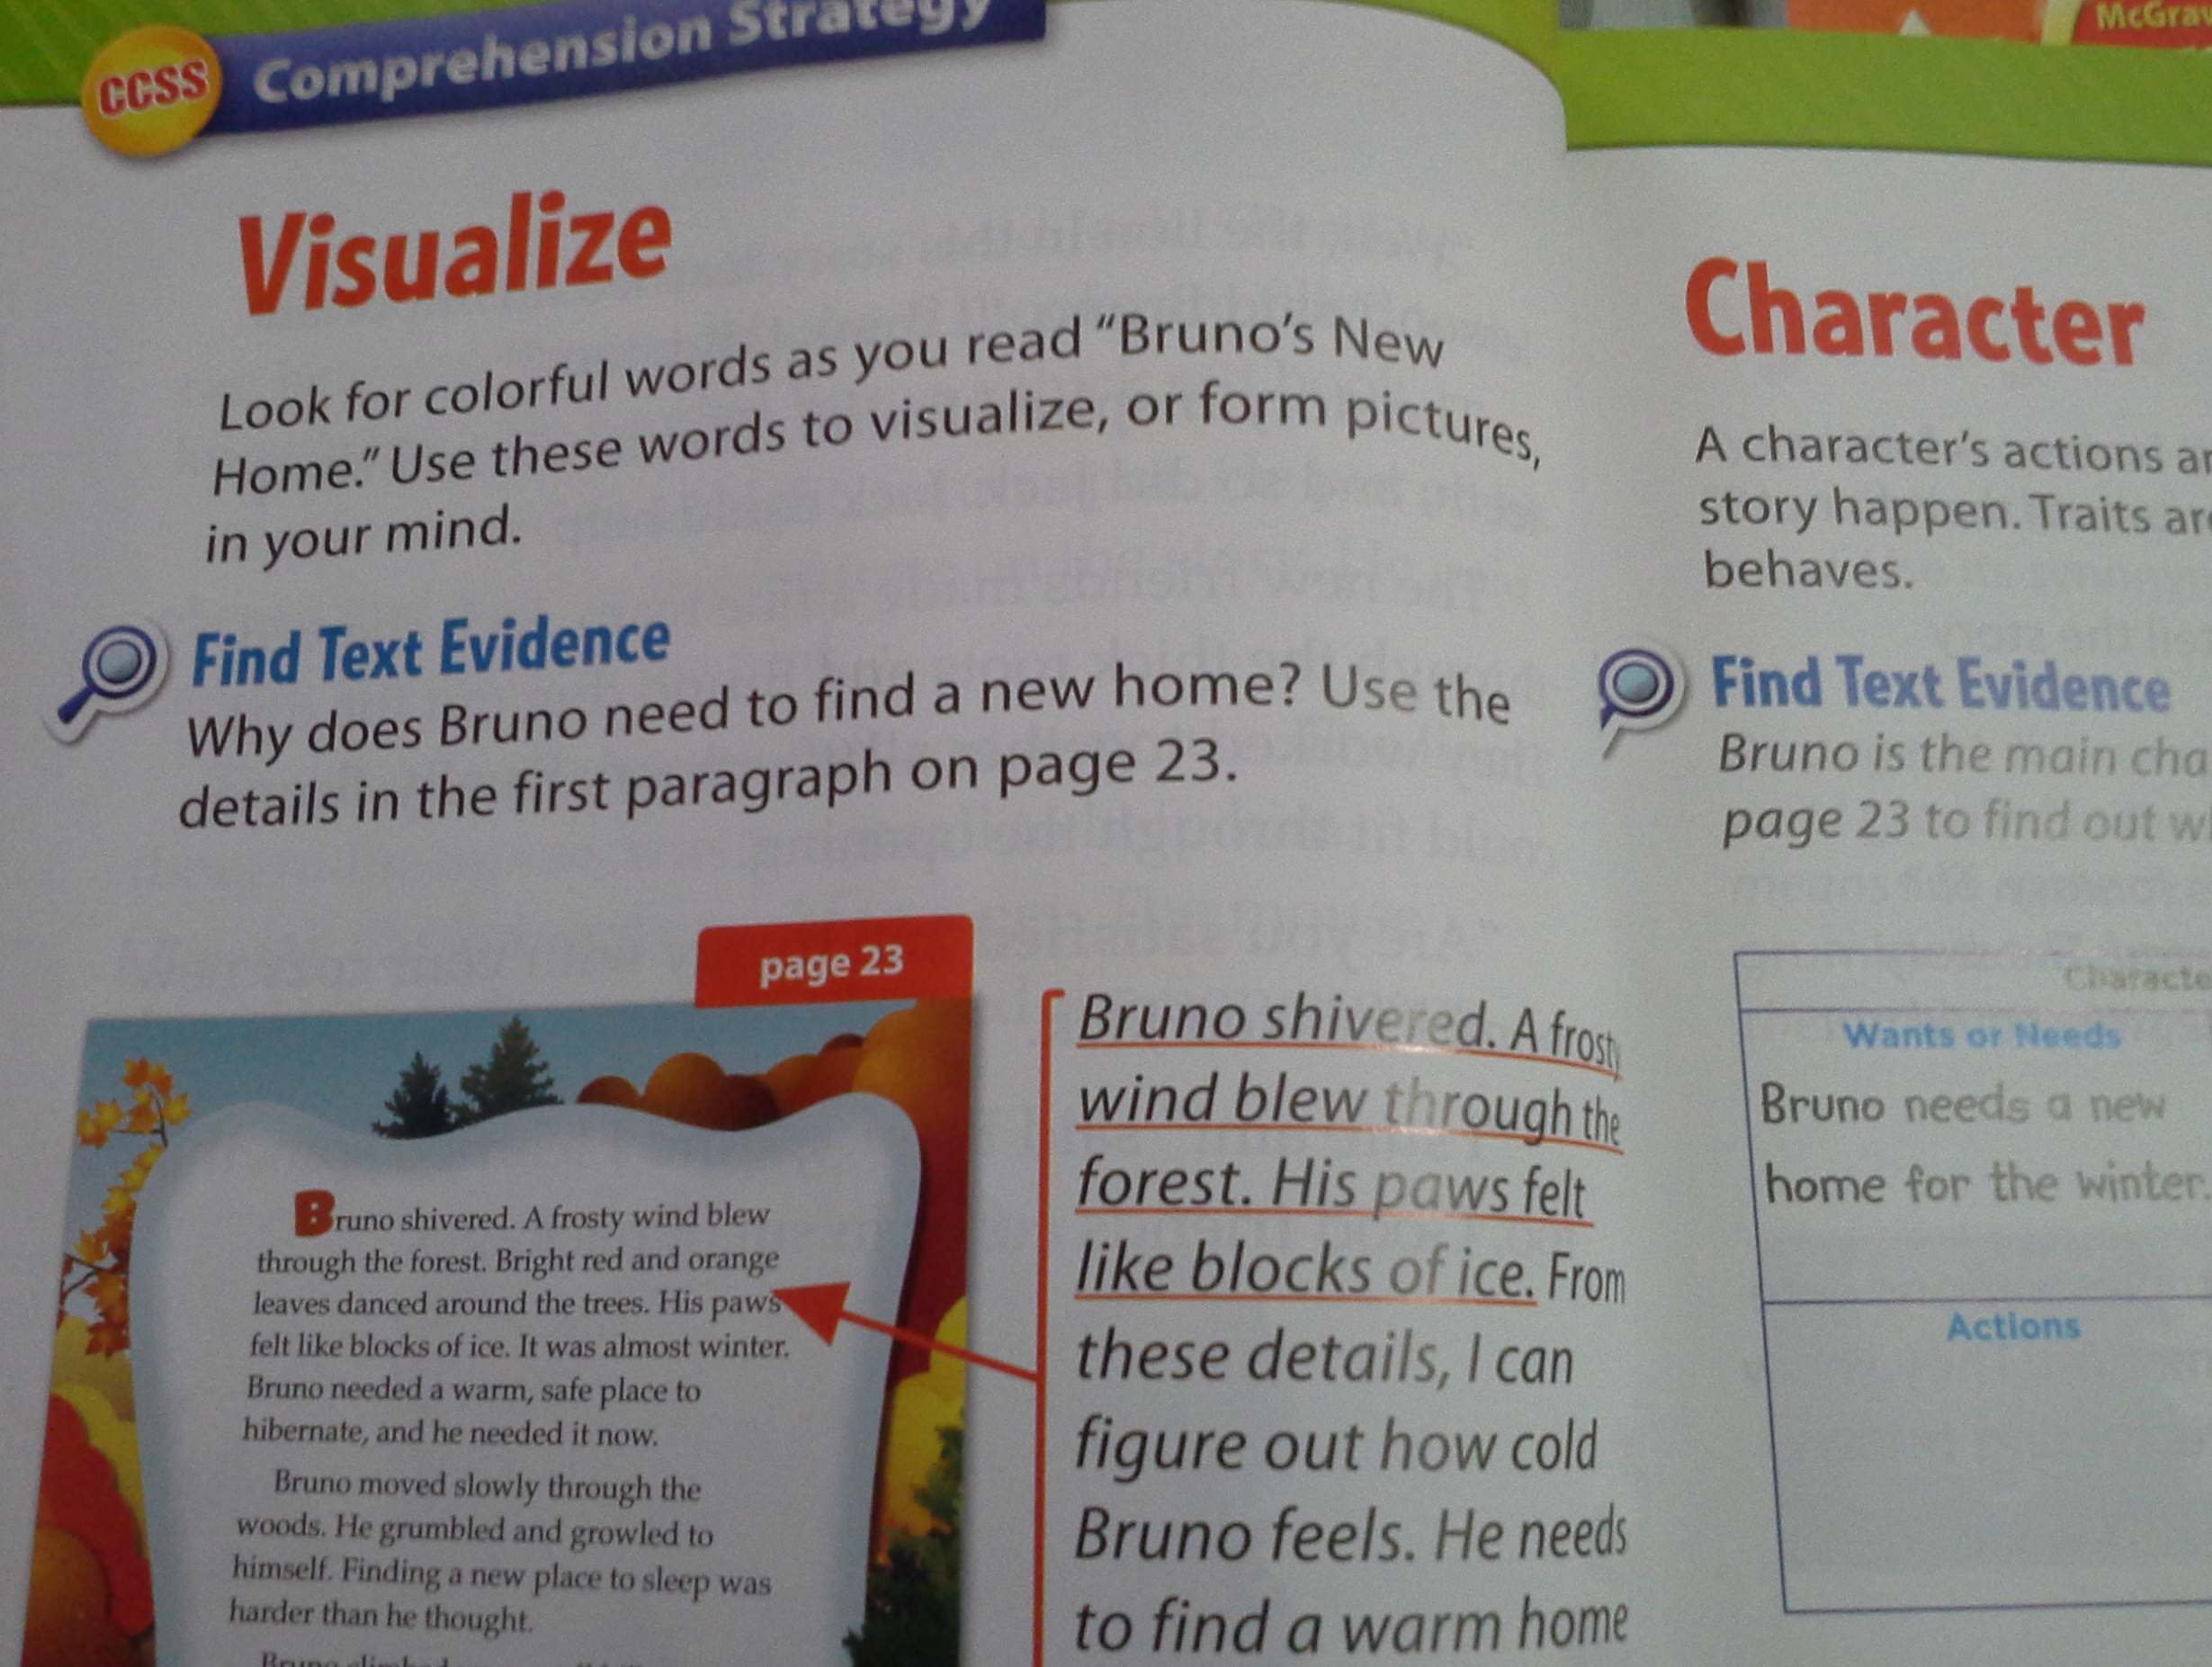
Learn ‘how-to’ …
Learn ‘how-to’ find ‘character’

Slide 37
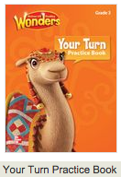
Wonders
Introduce
Use Reading / Writing BOOK
Teach
Use Reading / Writing,
Grammar, practice BOOKS

Slide 38
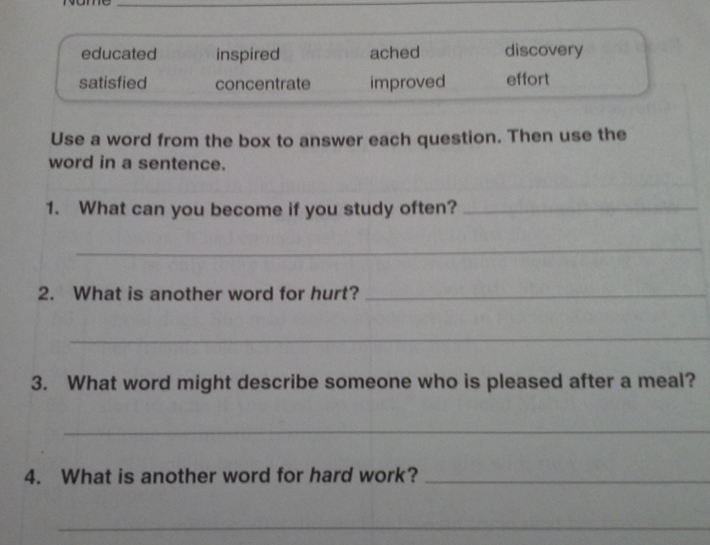
By the end of each period…
Use the practice book for either practice, or assessment

Slide 39

Wonders
Introduce
Use Reading / Writing BOOK
Apply
Teach
Use Reading / Writing,
Grammar, practice BOOKS
Use Literature / Anthology
BOOKS

Slide 40
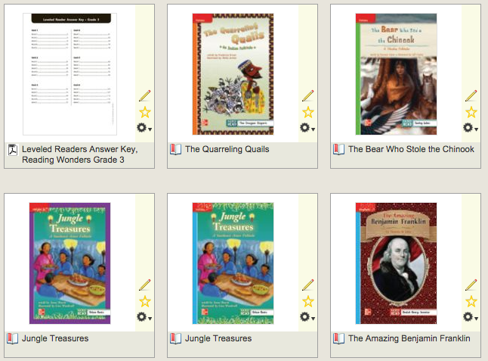
Wonders
Introduce
Use Reading / Writing BOOK
Differentiate
Use Leveled Readers
BOOKS
Apply
Teach
Use Reading / Writing,
Grammar, practice BOOKS
Use Literature / Anthology
BOOKS

Slide 41
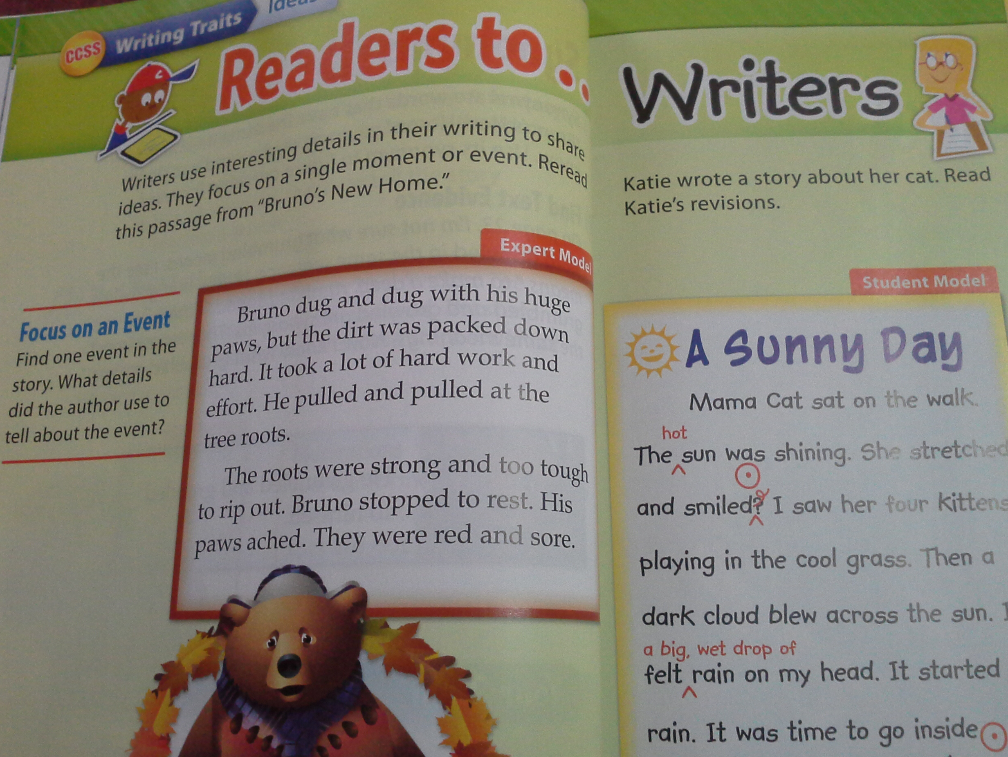
Use any BOOKS and e-materials
Integrate
Wonders
Introduce
Use Reading / Writing BOOK
Differentiate
Use Leveled Readers
BOOKS
Apply
Teach
Use Reading / Writing,
Grammar, practice BOOKS
Use Literature / Anthology
BOOKS

Slide 42
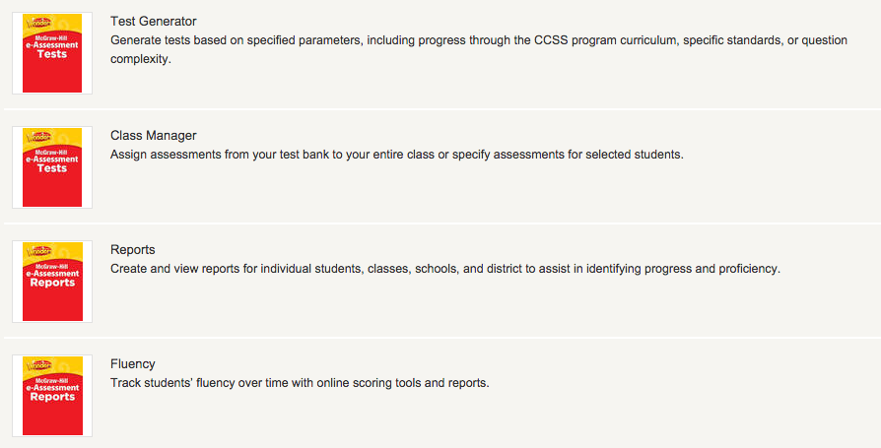
Use weekly/ unit and benchmark assessment BOOKS
Wonders
Assess

Slide 43
Big Idea and essential question
Why is this part important?
How do we design Learning for this part?

Slide 44
Children read the story in the reading / writing workshop book to find and construct answers to the questions.
Children read the story in other books to find and construct answers to the questions.
Children ask parents/adults/ other children to find and construct answers to the questions.
How do friends
and families depend on one another?
How do friends depend on one another?
How can a pet be an important friend?
How are families around the world same and different?

Slide 45
Vocabulary
Why is this part important?
How do we design Learning for this part?

Slide 46
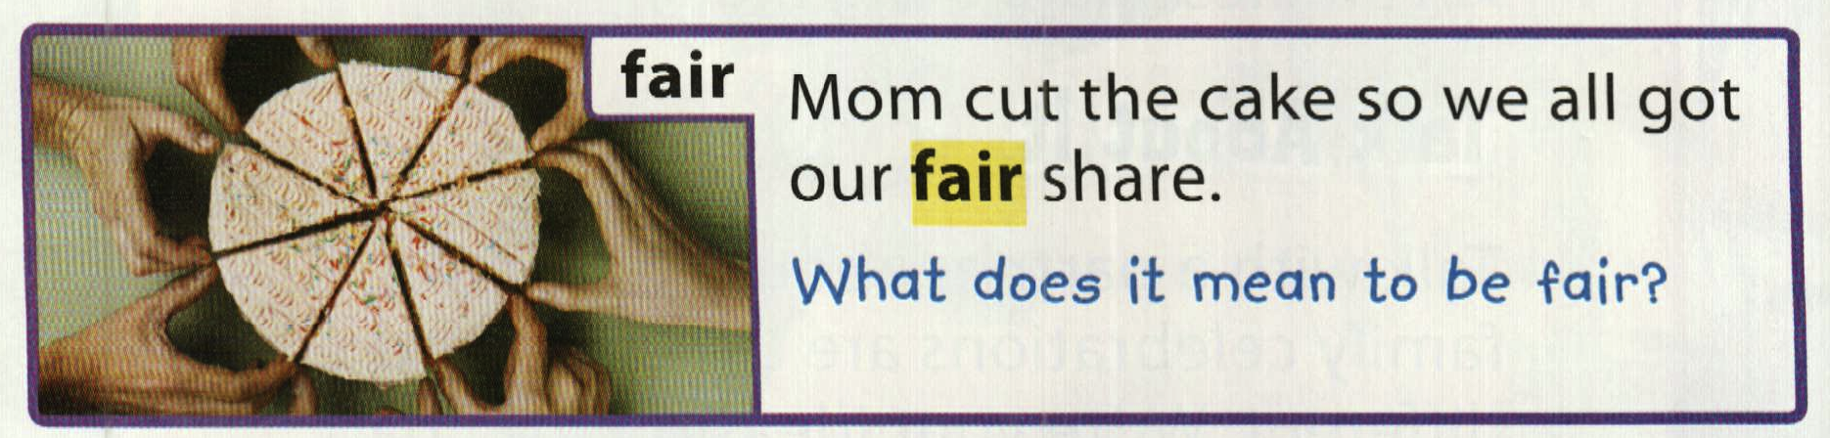
Should we plow through the selection or zoom in to the learning parts and going over the rest very quickly
VOCABULARY (Suggestions for teaching)

Slide 47
Read the word, the sentence, the task and study the picture.
Write words for the things you see in the picture.
Write answers for the questions
  What size is each piece of the cake?
  How many people are taking a piece of the cake?
  Who gets a bigger piece or a smaller piece of the cake?

Slide 48
Write words you listed under the following headings:
Thing words | People words | Action words | Descriptive words

Slide 49
Write words you listed under the following headings:
what | who | where | when

Slide 50
Read the vocabulary word, examples, questions. Circle any similarities to the words you listed.

Slide 51
Open your books to pages 12 to 14 and find the vocabulary word(s). Read the sentences before and after the sentence that contains the vocabulary word. Find words that are related or go with the vocabulary word you are learning.
Write the word in a circle on your paper. Write the words that “go with” it in a web around the circle.
fair
Same for all
equal

Slide 52
Go to the practice book and do the task alone.
* Write a sentence for each word
fair
Same for all
equal

Slide 53
Task A: Look at the picture. Write words for what you can see in the picture.
In pairs/groups of three, tell each other the words you wrote.
Add words to your list from each other’s list.
(activating prior knowledge)
(oral social interaction among students)
(expanding learning through oral social interaction)
A Viewing
B Activating prior knowledge
C Oral interaction

Slide 54


Slide 55
TASK B: Read the text about the picture.
Look for words that are the same or similar to the words you wrote before.
Find and copy on your list more new words that are for what you can see in the picture.
(exposure to language through reading)
(comparing prior knowledge to text being read)
(expanding learning through reading)
A Reading exposure
B Comparing skills
C Learning from others

Slide 56
TASK C: From the words you collected in your lists, write words or short phrases that answer the following question words.
Then, in pairs/groups of three, tell each other what you wrote.
(organizing and making sense of what was collected)
(expanding learning through oral social interaction)
A Producing to make sense
B Learning from others
C Speaking

Slide 57
TASK D: Using phrases you wrote next to the question words, write sentences for the picture using the organizer below.
(Using and applying the learning)
A Producing to make sense by applying prior learning

Slide 58
TASK E: Using the sentences you wrote in the table above, make written questions about the picture.
(Using inquiry for learning)
A Developing inquiry

Slide 59
TASK F: In pairs/groups of three, ask and answer each other using the questions about the picture.
(Using inquiry for learning through social interaction)
A Inquiring
B Speaking

Slide 60
Overview and theme
Why is this part important?
How do we design Learning for this part?

Slide 61
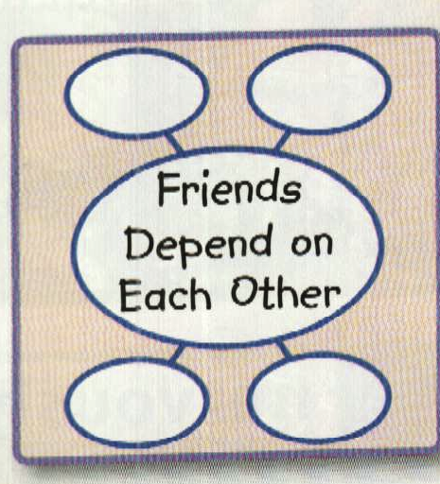
Follow the tasks on the slides.
Should we plow through the selection or zoom in to the learning parts and going over the rest very quickly
Before the learning
Setting the context and drawing on background knowledge
Pre-learn vocabulary

Slide 62
Follow the lesson plan on the slides
How do your friends help you and how do you help them?
Friends depend on each other
How the child receive instructions telling her what to do? What tool will she use to to do it? Is the tool simple enough and appropriate for her age and can I recycle the tool for another task in the future?

Slide 63
Follow the tasks on the slides.
How can we change the activity to better suit our children?
Turn the idea into a question they can relate to
How do your friends help you and how do you help them?
Friends depend on each other

Slide 64
How can we change the activity to better suit our children?
Ask them to look at a picture and tell each other who they can see helping each other and how.
Read a very short story and ask them to tell each other what they heard about someone helping another.
Ask them to remember a time they helped someone else and what they did and tell each other.

Slide 65
Comprehension
Why is this part important?
How do we design Learning for this part?

Slide 66
Visualizing
What is the text evidence that will help your students visualize without needing your help in a new and unfamiliar text?
What are the steps that he/she will take in order to collect the evidence that will help him/her visualize without needing your help in a new and unfamiliar text?

Slide 67
Details
What is the text evidence that will help your students find details without needing your help in a new and unfamiliar text?
What are the steps that he/she will take in order to collect the evidence that will help him/her find details without needing your help in a new and unfamiliar text?

Slide 68
Study the sentences below and underline the parts that answer the following words WHO WHAT ACTION (verb) HOW WHERE WHEN. Write the appropriate word above each underlined part.
Who
action
What
How
We will build a new birdhouse with the basket.
Dog hair was on the list.
Taylor and her friends watched the basket.
The basket was empty in a few days.
Yarn poked out from the sticks and mud.
What
Action
Where
Who Action What
What Action What When
What Action Where

Slide 69
4Study the sentences below and write above each part the the following words WHO WHAT ACTION (verb) HOW WHERE WHEN
Who Action What
The tall handsome man
bought
a beautiful red Mercedes
How Where When
at a whim
from the dealer in Cairo
last weekend

Slide 70
Make your own sentences using only words from the stories or practice book.
Who Action What
How Where When

Slide 71
Characters
What is the text evidence that will help your students find the characters without needing your help in a new and unfamiliar text?
What are the steps that he/she will take in order to collect the evidence that will help him/her find the characters without needing your help in a new and unfamiliar text?

Slide 72
Sequencing
What is the text evidence that will help your students sequence events without needing your help in a new and unfamiliar text?
What are the steps that he/she will take in order to collect the evidence that will help him/her sequence events without needing your help in a new and unfamiliar text?

Slide 73
Read/Write a story. Use the organizer to make notes of your ideas then use it to write your story.
Who?
Where? When?
What happened?
How did the story end?

Slide 74
Read the sentences and write the letter of the idea each one expresses. Sometimes depending on the context and the intonation, a sentence may express more than one idea. That’s why we have jokes and puns.
_____ 1 I need three blue pens, please.
___ 2 The ship had already left.
___ 3 This is the third time I asked for a glass of water.
___ 4 Careful, you are going to fall.
___ 5 He wants to go home.
___ 6 The books on the history of the Egypt are on the
top shelf.
___ 7 This ice cream is delicious.
___ 8 Don’t put the rug there or someone might trip on
it.
___ 9 The building is tall and wide.
a) An opinion
b) A cause and effect
c) A sequence of events
d) A complaint
e) A prediction
f) A retell
g) A description
h) Information

Slide 75
REMEMBER
Meaningful focused attention in listening will lead to better speaking. You cannot teach speaking!
Meaningful focused attention in reading will lead to better writing. You cannot teach writing!

Slide 76
Grab the readers’ interest
Sentence fluency
Ideas
Strong words
Create clear picture in the readers’ minds
Word choice
Cause and effect
Writing Traits
More specific to less specific
Voice
Organization
Informal / formal
Tone
More important to less important
Serious
Suspenseful
Humorous

Slide 77
How do these relate to the CCSS (Common Core State Standards)?
Reading Wonders is the first US textbook that was designed around CCSS from ground up.

Slide 79
The Reading/Writing workshop book is the heartbeat of the program.
Provides short reads of complex text
Provides scaffolding to access complex text
Teaches/models close reading using text evidence
Provides collaborative conversation opportunities
Provides clear path to CCSS

Slide 80
Teaches/models close reading using text evidence
LANGUAGE: Why did the writer choose certain words?What is emphasized? What is constantly being repeated?
NARRATIVE: Who is telling the story? How is it being told?
SYNTAX: Examining the order in which words appear?
CONTEXT: The text doesn’t exist in a vacuum. What is the historical context and the author’s background?

Slide 81
Anthology.
Provides authentic literature 50/50
Provides extended text
Close reading application
Write about reading
Builds stamina

Slide 82
Anthology: Developing analytical readers

Slide 83
WONDERS RESOURCES ARE CONFIGURED SO THAT
Teachers know exactly what to teach and how
Students are supported in everything they read!
Time is used more efficiently
Every lesson/component was designed to meet
today’s classroom challenges

Slide 84

Clear pathway to the new Standards

Slide 85

The entire pathway can be delivered digitally

Slide 86
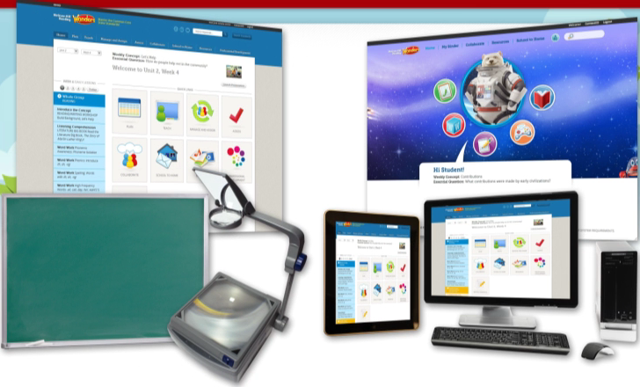
Recognizes that everyone has different skills and
comfort levels using digital material

Slide 87
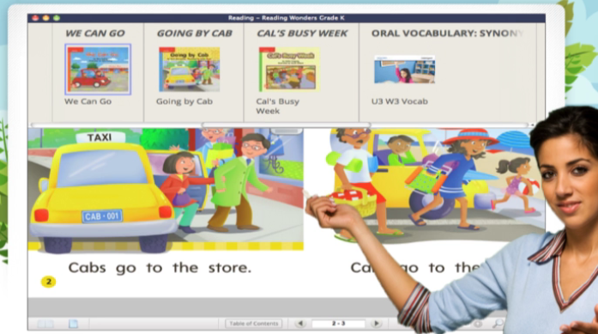
Woven seamlessly into a digital system
to help you teach every day

Slide 88
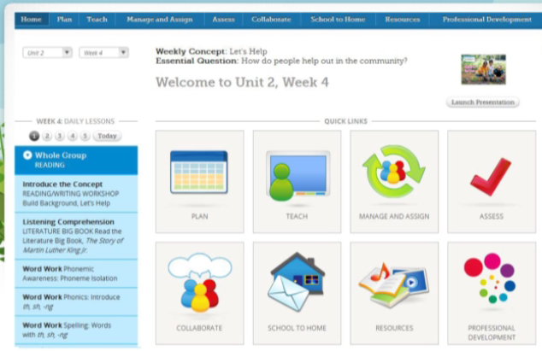
Includes a teacher workspace that is so much more than a
collection of resources

Slide 89


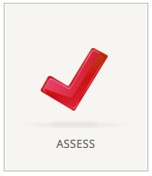







Slide 90
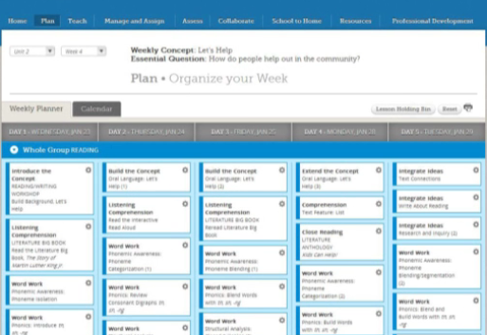
Follows you through the school year and knows what you need for today’s lesson

Slide 91
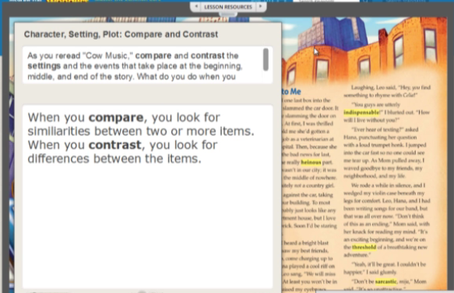
Offers lesson in interactive whiteboard format already pre-sequenced yet easily customizable

Slide 92
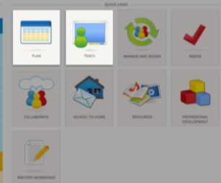
Teacher’s workspace is for place to plan, teach, assign, and assess. Also provides a great way for collaboration and communication.

Slide 93

Connected to the teacher’s workspace is the student’s workplace. Simple icon-based dashboard available on
any device, anywhere, any time

Slide 94
WONDERS online resources
https://connected.mcgraw-hill.com
Username: RWonders2014
Password: demo2014
eli@eupad.net
www.munjez.com

Slide 95
DEPENDING ON TODAY’S TOOLS
FOR TODAY’S DEMANDS

