Slide 1

You Can’t Teach Grammar
TESOL Nile
Eli Ghazel
AUC Jan 27, 2016

Slide 2
You Can’t Teach Grammar

Slide 3
But I didn’t say you can’t help someone learn it.

Slide 4
What is grammar?
It is limited to one sentence.
It has parts with names such as nouns, verbs, infinitives, prepositions, etc.

Slide 5
What is grammar?
Two sentences that follow each other are independent grammatically.

Slide 6
Sarah entered the room.
He sat on the couch.
The second is correct grammatically.

Slide 7
The word ‘grammar’ is limited to only
one sentence
at a time

Slide 8
What is the main purpose of a sentence?
To convey
information and meaning

Slide 9
In order to convey
information and meaning, sentences are
heard,
read
spoken, and
written
stress, intonation,
mechanics, punctuation
stress, intonation,
mechanics, punctuation

Slide 10
I FAIL TO SEE THE LOGIC…
that grammar in schools is still mainly carried out and checked through writing only.

Slide 11
Name the parts.
The brang thrang up the hill.
article

Slide 12
In the beginning ….
there was meaning….
and meaning became language.

Slide 13
Then someone made rules for the language and called it
grammar.

Slide 14
A sentence is a group of words that expresses
a complete thought.

Slide 15
All humans share the same ability to ‘construct’ meaning.

Slide 16
All languages have...
who...
what...
what...
action...
more than one...

Slide 17
Before a sentence can express a complete thought,
it must have chunks
that convey
universal human meaning.

Slide 18
Who/what
action
Where
The brang thrang up the hill.

Slide 19
The human mind creates a sentence model made up of meaningful chunks, not words.

Slide 20
What meaning does each convey?
Table: Who? What? or Where?
On the table: Who? What? or Where?
Kitchen: Who? What? or Where?
In the kitchen:Who? What? or Where?

Slide 21
The basic sentence model in English
Who Who
What Action What How Where When

Slide 22
Who
The man (simple chunk that conveys who)
The man in the brown shirt (more complex
chunk that
conveys who)
The tall rugged-looking man in the brown shirt (even more complex)

Slide 23
A conclusion worth thinking about
Learners need experiences that help them ‘construct’ models of chunks that relate to innate human meaning.

Slide 24
A scope and sequence design
More complex chunks
More chunks including clauses
More advanced
adult learners:
Beginners and
young
learners:
Smaller and simpler chunks
Fewer chunks in a sentence

Slide 25
A scope and sequence design
The tall, rugged-looking man in the brown shirt (who)
More advanced
adult learners:
Beginners and
young
learners:
Stay. (action)
Stay here. (action) (where)

Slide 26
Two levels of sentences
Chunk details in each sentence
One idea in each sentence

Slide 27
One idea in each sentence
This ice cream is delicious.
opinion
The building is tall and wide.
description
Careful, you are going to fall.
prediction
I need three blue pens, please.
request
opinion prediction request description

Slide 28
Teaching grammar involves
explaining how it works.
giving rules.
having learners do lots of exercises.
Learners still mistakes when communicating in actual situations.

Slide 29
Language is a mental model.
A model …
is meaningful
gives it user faster reaction time
can develop and grow

Slide 30
pronouns
Sub / verb agreement
Sub / verb agreement
possessive
Plural
singular
pronouns
Plural
singular
possessive
sequence
detail
Who
What
Who
What
tense
Where
When
naming
detail
action
detail
naming
detail
place
detail
time
detail
The tall handsome man bought a new red car from the showroom this morning
articles
Verb forms
prepositions
articles
prepositions
demonstratives
modals
demonstratives
articles
Time order
words
capitalization
contractions
capitalization
capitalization
adjectives
contractions
Auxiliaries
adjectives
adjectives
demonstratives
adjectives
Countables/
uncountables
Countables/
uncountables

Slide 31
Examples
to the kitchen
where
to see the kitchen
why
to do
what

Slide 32
Meaningful focused attention with active response
in order to help learners ‘construct’ mental models

Slide 33
Designing Learning

Slide 34
Understanding and using
AM, IS, ARE
in listening, speaking, reading & writing

Slide 35
Verb 'to be' in the forms of AM, IS and ARE serves three different purposes.
1. It makes the words that come before AM, IS or ARE agree with them in structure according to the convention of standard English.
2. It gives the details that come before and after AM, IS or ARE.
3. It shows the sequence relative to the person who said or wrote the sentence.
Notes:
You will learn 1, 2, and 3,

Slide 36
Part 1
Correct structural convention using (be) AM, IS, ARE
In English, the words that come at the beginning of a sentence usually determine whether you should use AM, IS or ARE after them. This is called in grammar 'agreement'. We need to be able to say or write the correct structural agreement between the beginning words and the AM, IS and ARE
The next five slides will help you learn how.

Slide 37
1/1
Instructions:
1 Read the passage and highlight in blue all words that are
AM IS ARE
Roger is a teacher. He is in school now. The students are in the classroom. They are happy. They like English. “I am your teacher,” Roger says. ”I am here to teach you.” Fayez is a student. He is in class. Rachel is a student. She is in class, too. “We are happy to learn English,” Fayez and Rachel say.

Slide 38
1/2
Instructions:
2 Read the passage and highlight in gray all words that come before
AM IS ARE
Roger is a teacher. He is in school now. The students are in the classroom. They are happy. They like English. “I am your teacher,” Roger says. ”I am here to teach you.” Fayez is a student. He is in class. Rachel is a student. She is in class, too. “We are happy to learn English,” Fayez and Rachel say.

Slide 39
1/3
Instructions:
3 Write the words you highlighted under
AM IS ARE
AM | IS | ARE
I
Roger
they
he
we
she
students
Fayez

Slide 40
1/4
Instructions:
4 Write your answer for each question below:
AM | IS | ARE
What are the words that can come before AM? What are the similarities? ____________________ | What are the words that can come before IS? What are the similarities? ____________________ | What are the words that can come before ARE? What are the similarities? ____________________

Slide 41
1/5
Instructions
5 Read the first parts of the sentences below and make ✔ if it correct and ✗ if it is not.
1 I am ☐ 2 We are ☐
3 They are ☐ 4 John is ☐
5 Paul and Ahmed is ☐ 6 Alice am ☐
7 Ibrahim and I is ☐ 8 She is ☐

Slide 42
Part 2
Details that come before and after (be)
In English, it is not enough to know the correct agreement between the first part of a sentence and AM, IS or ARE.
Understanding or making others understand is essential in communication. The parts that come before and after the AM, IS and ARE are called details. We use details to understand in listening and reading, and we use details to communicate to others in speaking and writing.
The next four slides will help you learn how.

Slide 43
2/1
Instructions:
1 Next to each word in the chart, write WHO or WHAT
AM | IS | ARE
I
Roger (who)
they
he
we
she
students
Fayez

Slide 44
2/2
Instructions
2 AM, IS and ARE are followed by words or word groups that tell WHO, WHAT, WHERE, WHEN about the words that come before the AM, IS, ARE. Read the sentences below and write WHO, WHAT, WHERE about the words in red.
1. Roger is a teacher. ➔ (WHO)
2. He is in school now. ➔
3. The students are in the classroom. ➔
4. They are happy. ➔
5. “I am your teacher,” Roger says. ➔
6. ”I am here to teach you.” ➔
7. Fayez is a student. ➔
8. He is in class. ➔
9. Rachel is a student. ➔
10. She is in class, too. ➔

Slide 45
2/3
Instructions
3 Read the sentences and copy the part(s) that comes after AM, IS and ARE under the correct heading in the chart.
1 You are on Benson Street.
2 This is a short description.
3 Her shop is very nice.
4 Jonathan is early.
5 I am here now.
6 This is Sally.
be | WHO | WHAT | WHERE | WHEN
1 are |  |  | on Benson Street

Slide 46
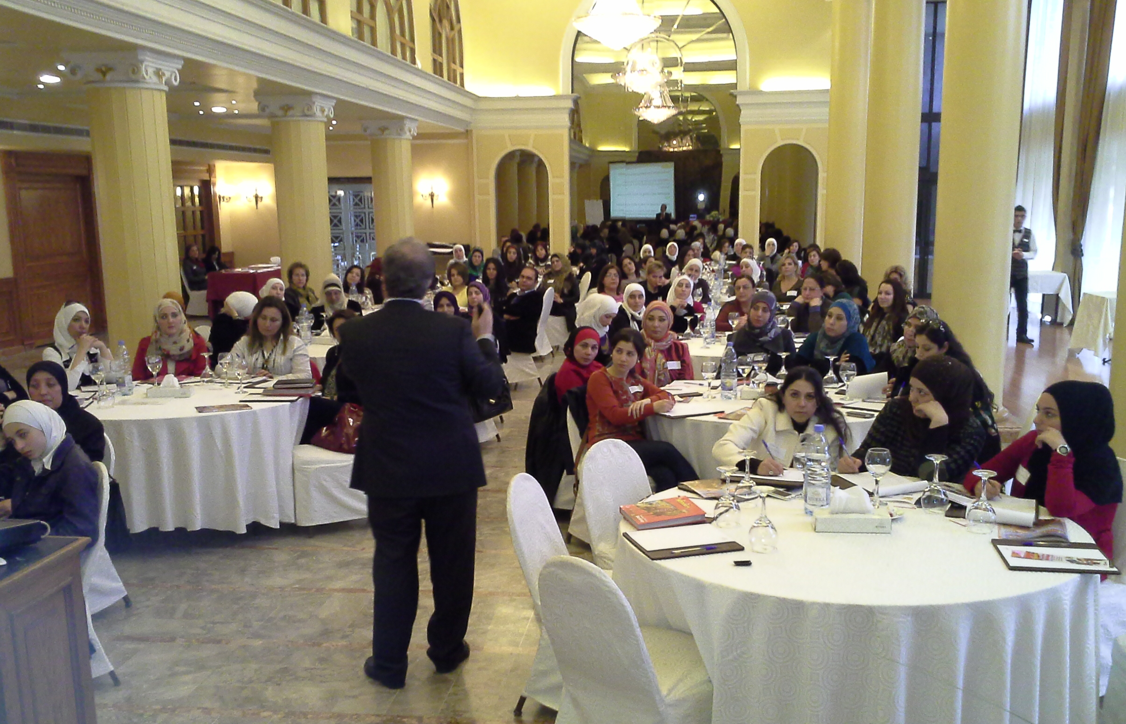
2/4
Instructions
4 Look at the picture and find details that answer WHO, WHAT, WHERE and WHEN. Write the details to continue the sentences
below.
1 I ______ ____________
2 ______ are ____________
3 We ______ ____________
4
5
6

Slide 47
Part 3
Sequence of time relative to the speaker or writer
In addition to connecting the details in a sentence, AM, IS or ARE also show the sequence of the information relative to the speaker or writer of the sentence.
In English, every sentence, that is spoken or written about something, is relative to the person who said it or wrote it. It tells if the details are true at the time, before the time, or after the time the speaker said or wrote them. In grammar, this is called the tense.
The next three slides will help you learn how.

Slide 48
3/1
Instructions:
1 Look at the image of the speaker and circle
BEFORE, NOW, and/or AFTER based on the questions below:
Is what he/she says true before speaking?
Is what he/she says true during speaking?
Is what he/she says true after speaking?
See the next slide for an example:

Slide 49

3/2
Example:
I am a doctor.
Before (he speaks) now (as he speaks) after(after he speaks)
Notes:
For example, the person in the picture speaks and says: I am a doctor. Now think this way: Is he a doctor when he speaks? Is he a doctor before he speaks? Is he still a doctor after he speaks? The answer is yes, he is a doctor as he speaks so we circle now. And yes he is a doctor before he speaks so we circle before. And yes he is a doctor after he speaks so we circle after.

Slide 50

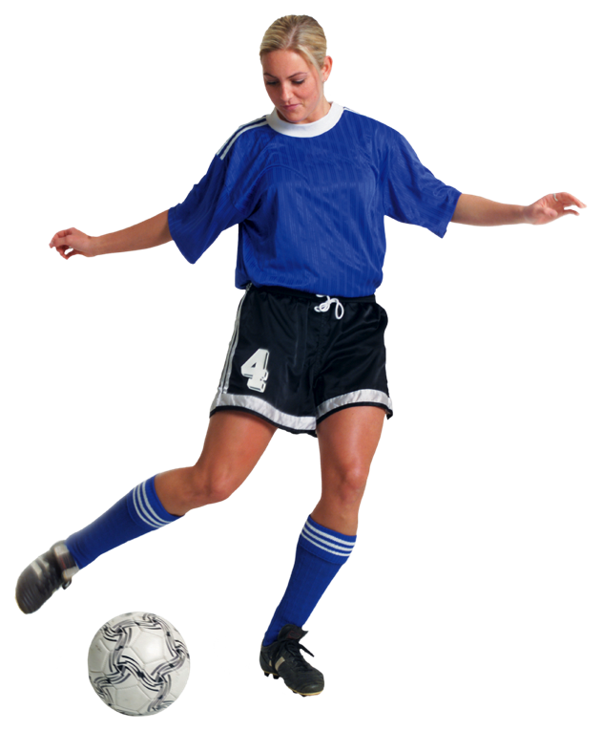
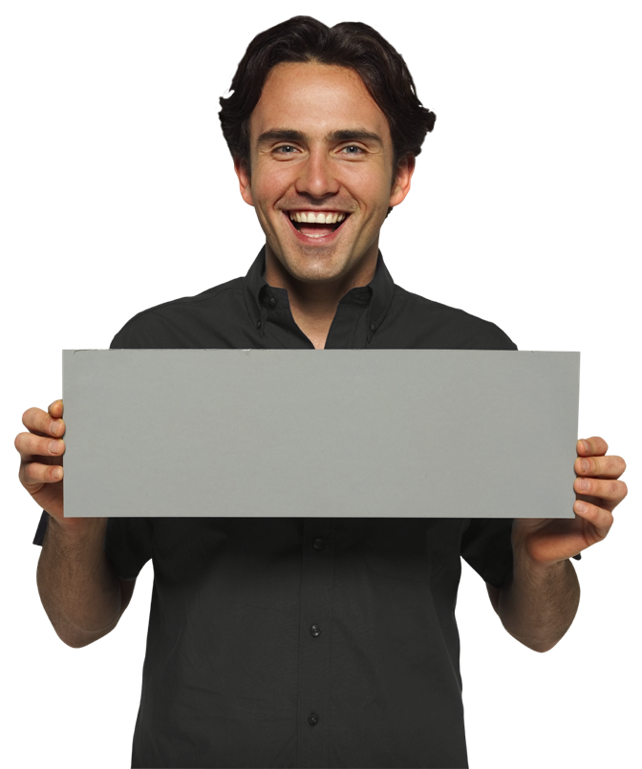
3/3
Instructions:
1 Look at the image of the speaker and circle
BEFORE, NOW, and/or AFTER based on the questions in the previous slide:
I am a doctor.
He is a footballer.
My name is Eli.
E l i
before (he speaks)
now (as he speaks)
after (after he speaks)
before (he speaks)
now (as he speaks)
after (after he speaks)
before (she speaks)
now (as she speaks)
after (after she speaks)

Slide 51
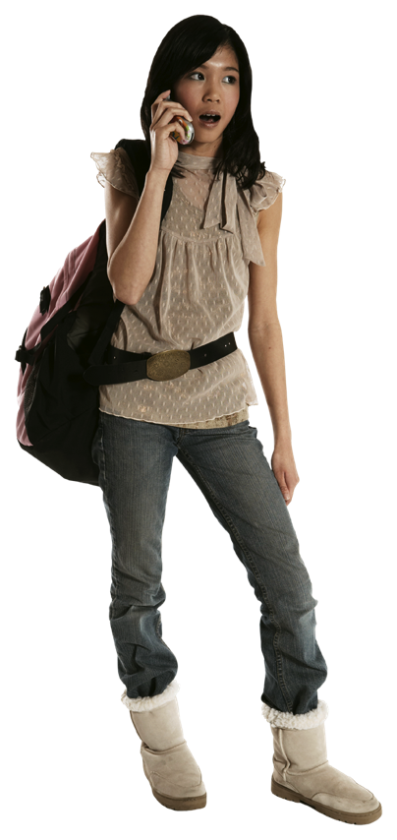

3/4
Instructions:
1 Look at the image of the speaker and circle
BEFORE, NOW, and/or AFTER based on the questions in the previous slide:
It is in the box.
She is on the phone.
before (she speaks)
now (as she speaks)
after (after she speaks)
before (she speaks)
now (as she speaks)
after (after she speaks)

Slide 52
You can’t teach grammar …
but you can help each learner develop a meaningful mental model of a language.
Notes:
You will learn 1, 2, and 3,

Slide 53
“Use grammar to develop meaning
and
the rule will take care of itself.”
Eli Ghazel
Notes:
You will learn 1, 2, and 3,

Slide 54
I would like to express my thanks to
Notes:
You will learn 1, 2, and 3,

Slide 55
I would like to express my thanks to
NileTESOL
Notes:
You will learn 1, 2, and 3,

Slide 56




eghazel@gmail.com
eghazel@21caf.org
eli@eupad.net
Notes:
You will learn 1, 2, and 3,

