Slide 1
One class period 40 (mins)
Fingers nose apple
4. I can see a printed word and tell which picture or object is for it
Fingers nose apple
5 I can hear a word and tell which printed word is for it.
Fingers nose apple
6 I can see a printed word and say it aloud.
Circle
time
Start lesson here
Opening/
Warm up
How?
nose, fingers, apple,
Say word
for pic tool
Say word
for pic when teacher says color tool
Say the words
for pics in order tool
nose, fingers, apple,
Yes/No tool
Hold up word card tool
Say color under pic tool
nose, fingers, apple,
Say word
for card tool
Say word
for printed word when teacher says color tool
Say the words for the printed words in order tool
Story/
Rhyme/
Song
Easy Tool …
For the teacher

Slide 3
Song:
1) If you’re happy and you know it say your name.
My name is _______
If you’re happy and you know it then your face will really show it. If you’re happy and you know it, say your name___________.
2) If you’re happy and you know it, say your age. I’m four.
3) If you’re a boy/girl and you know it, say I’m a boy/girl.
4) If you’re happy and you know it, touch your nose
5) if you are happy and you know it hold your finger up.
5) If you’re happy and you know it, say /Aa/ (sound)
6) If you’re happy and you know it, say apple/ant
7) If you’re happy and you know it, say arrow
8) If you are sad and you really want to show it touch your hair.
9) If you are sad and you really want to show it hold green square..
10) ) If you’re happy and you know it, say I am tall/short

Slide 4
Reading
4. I can see a printed word and tell which picture or object is for it.
For the teacher
Words
Fingers, nose, apple

Slide 5
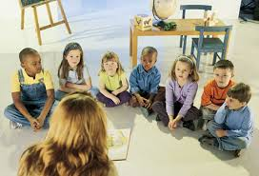
Reading
4. I can see a printed word and tell which picture or object is for it.
Words : nose, fingers ,apple
Reading
4. I can see a word and tell which colour it is for.
Words: fingers, nose, apple
YES / No TOOL
Teacher: Look at the picture. Look at the word. Say YES or NO.
Teacher: Shows picture/action for fingers, nose, and apple printed words
Children: YES

Slide 6
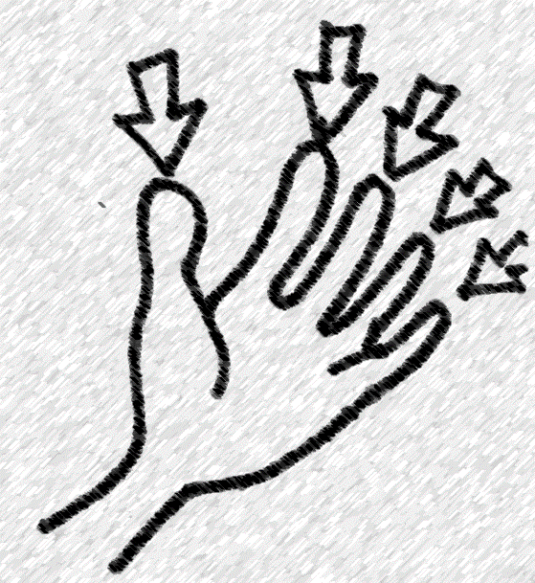
fingers
Teacher: Look at the picture. Look at the word. Say YES or NO.
Teacher: Shows action for fingers/ picture and printed word for fingers
Children: YES

Slide 7
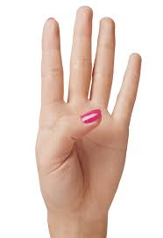
fingers
Teacher: Look at the picture. Look at the word. Say YES or NO.
Teacher: Shows picture/action and printed word for fingers
Children: YES

Slide 8
fingers
Teacher: Look at the picture. Look at the word. Say YES or NO.
Teacher: Shows action and printed word for fingers
Children: YES

Slide 9
fingers
Teacher: Look at the picture. Look at the word. Say YES or NO.
Children: NO

Slide 10
z
fingers
Teacher: Look at the picture. Look at the word. Say YES or NO.
Teacher: Shows color green and printed word .
Children: YES

Slide 11
Next word

Slide 12
nose
Teacher: Look at the picture. Look at the word. Say YES or NO.
Teacher: Shows color green and printed word for nose
Children: YES

Slide 13
nose
Teacher: Look at the picture. Look at the word. Say YES or NO.
Teacher: Shows picture and printed word for nose
Children: YES

Slide 14
nose
Teacher: Look at the picture. Look at the word. Say YES or NO.
Teacher: Shows picture and printed word for nose
Children: YES

Slide 15
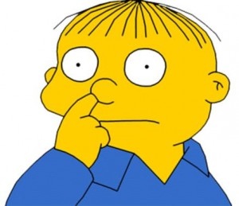
nose
Teacher: Look at the picture. Look at the word. Say YES or NO.
Teacher: Shows picture and printed word for nose
Children: YES

Slide 16
nose
Teacher: Look at the picture. Look at the word. Say YES or NO.
Teacher: Shows color green and printed word .
Children: NO

Slide 17
nose
Teacher: Look at the picture. Look at the word. Say YES or NO.
Teacher: Shows picture and printed word for nose
Children: YES

Slide 18
apple
Teacher: Look at the picture. Look at the word. Say YES or NO.
Teacher: Shows picture and printed word for apple
Children: YES

Slide 19
apple
Teacher: Look at the picture. Look at the word. Say YES or NO.
Teacher: Shows picture and printed word for apple
Children: YES

Slide 20
apple
Teacher: Look at the picture. Look at the word. Say YES or NO.
Teacher: Shows picture and printed word for apple
Children: YES

Slide 21
apple
Teacher: Look at the picture. Look at the word. Say YES or NO.
Teacher: Shows picture and printed word for apple
Children: YES

Slide 22
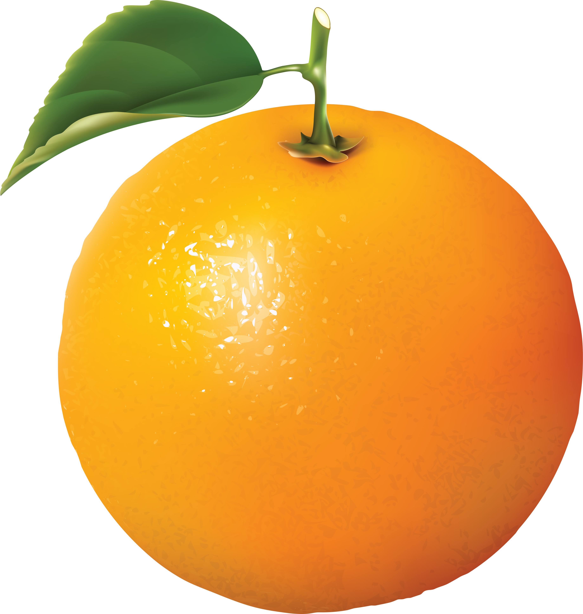
apple
Teacher: Look at the picture. Look at the word. Say YES or NO.
Teacher: Shows picture and printed word for apple
Children: no

Slide 23
Reading :
4. I can see a printed word and tell which picture or object it is
For the teacher
Words: fingers, nose, apple,
Hold up picture for the word tool
Teacher: Look at the word I show. Hold up the picture for the word.

Slide 24
Reading
4. I can see a printed word and tell which picture or object is for it.
Words : nose, fingers ,apple
NOTE: It’s better if we give the children the printed words instead of the of pictures because we want them to scan the word cards they for the picture they see on the slide.
For the students
nose
Teacher: Look at the word picture I show. Hold up the picture for the word card.
Teacher: shows word picture of nose.
Children: hold up picture word card .

Slide 25
For the students
fingers
Teacher: Look at the word I show. Hold up the picture for the word.
Teacher: shows word fingers
Children: hold up picture.

Slide 26
For the students
apple
Teacher: Look at the word I show. Hold up the picture for the word.
Teacher: shows word apple
Children: hold up picture.

Slide 27
1. Listen to the story. Hold up the correct picture when you hear the word in the story.
Teacher: Reads the story
2. Teacher: Listen to the story. Say the correct word for the picture I show you when I reach that word in the story.

Slide 28
Song:
1) If you’re happy and you know it say your name.
My name is _______
If you’re happy and you know it then your face will really show it. If you’re happy and you know it, say your name___________.
2) If you’re happy and you know it, say your age. I’m four.
3) If you’re a boy/girl and you know it, say I’m a boy/girl.
4) If you’re happy and you know it, touch your nose
5) if you are happy and you know it hold your finger up.
5) If you’re happy and you know it, say /Aa/ (sound)
6) If you’re happy and you know it, say apple/ant
7) If you’re happy and you know it, say arrow
8) If you are sad and you really want to show it touch your hair.
9) If you are sad and you really want to show it hold green square..
10) ) If you’re happy and you know it, say I am tall/short

Slide 29
5. I can hear a word and tell which printed word is for it.
Words : nose, fingers, apple

Slide 30
Reading
6. I can see a printed word and say it aloud (fingers, nose, apple)
Tool 1 voice mode
fingers
fingers
apple
apple
fingers
fingers
fingers
fingers
nose
nose
apple
apple
nose
apple
apple
nose
Teacher: Look at the word I show. Say the word in a low voice.
Teacher: Show words one by one
Children: nose etc
Notes:
Show the children the pairs of pictures or objects.
A Wait for them to say the pairs to each other in a low voice

Slide 31
nose
apple
Reading
6. I can see a printed word and say it aloud (fingers, nose, apple )
Tool 2 – missing word
fingers
nose
apple
apple
nose
apple
fingers
nose
eraser
fingers
fingers
apple
fingers
apple
fingers
nose
Teacher: Look at the words I show.
Teacher: Show slide one by one, which word is missing
Children: apple etc
Notes:
Show the children the pairs of pictures or objects.
A Wait for them to say the pairs to each other in a low voice

Slide 32
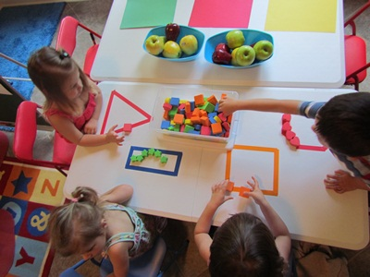
Switch tables until you do all the tables
Reading (hold up tool)
CENTER TOOLS
CENTER TOOLS
TEACHER LED TABLE 1
Teacher: Listen to the word I say. Hold up
the correct word
Teacher: nose, fingers, apple
Children: Children hold up the correct
Word from the series the teacher had
already given them.

Slide 33
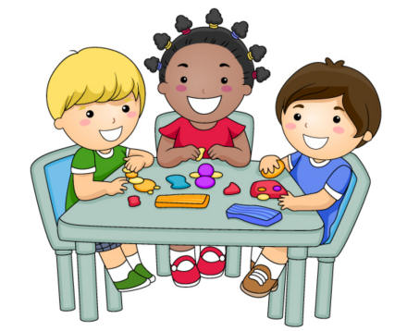
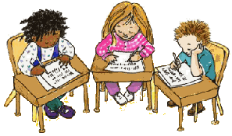
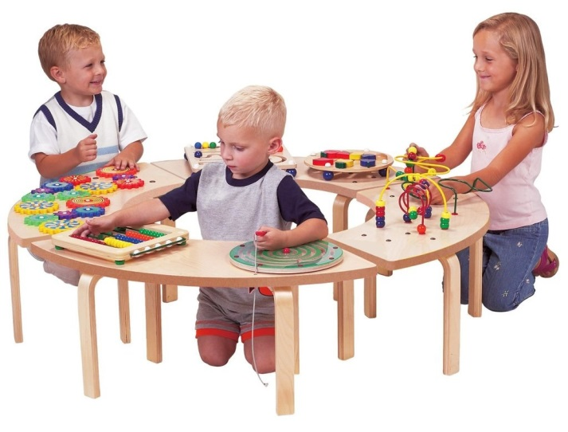
TABLE 3
Fun Table
TABLE 5
Writing Table.
TABLE 4
Activity Table

