Slide 1
Listening
I can hear a word or a color and tell which picture or object it is.
YES / TOOL

Slide 2
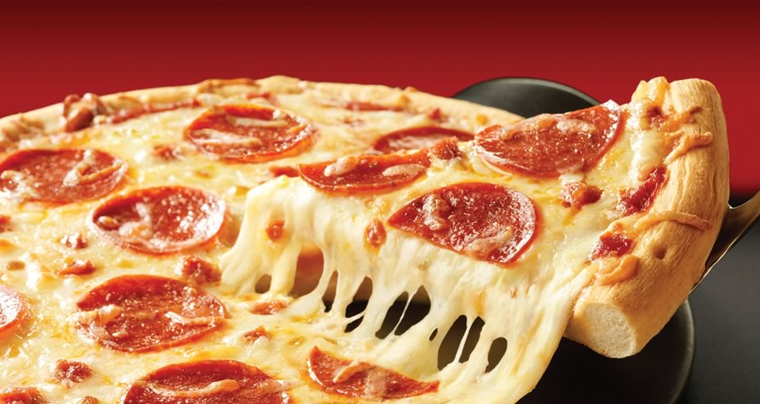
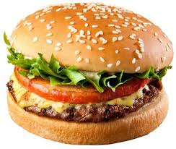
Teacher: Listen to what I say. Say YES or NO.
Teacher: Pizza
Children: YES/NO
Notes:
Show the children the picture or the object.
A Say the word for the item 2 to 4 times.
B Put the item behind your back. Bring it out to the front again. (or make it disappear from the screen and then appear again)
C Say the correct word for the item. Have the students nod their heads for YES*.
D Put the item behind your back. Bring it out to the front again. Say the INCORRECT word
for the item. Have the students shake their heads for NO*.
E Put the item behind your back. Bring out A DIFFERENT picture or object to the front. Say
the word for the previous item. Have the students shake their heads for NO*.
F Bring out the first item again and say the word for the item. Have the students nod their
heads for YES*.
G Continue with this until the children can nod YES* or shake their heads for NO* for
CRAYON, PENCIL, GREEN and RED.
H Do the story exposure task on the next page. If there is enough time, I strongly suggest you do the
memory enhancement tasks.
* You can ask the students to wag their fingers, give thumbs up, hold up smiley/frowny face instead of YES/NO

Slide 3
Teacher: Listen to what I say. Say YES or NO.
Teacher: Burger
Children: YES
Notes:
Show the children the picture or the object.
A Say the word for the item 2 to 4 times.
B Put the item behind your back. Bring it out to the front again. (or make it disappear from the screen and then appear again)
C Say the correct word for the item. Have the students nod their heads for YES*.
D Put the item behind your back. Bring it out to the front again. Say the INCORRECT word
for the item. Have the students shake their heads for NO*.
E Put the item behind your back. Bring out A DIFFERENT picture or object to the front. Say
the word for the previous item. Have the students shake their heads for NO*.
F Bring out the first item again and say the word for the item. Have the students nod their
heads for YES*.
G Continue with this until the children can nod YES* or shake their heads for NO* for
CRAYON, PENCIL, GREEN and RED.
H Do the story exposure task on the next page. If there is enough time, I strongly suggest you do the
memory enhancement tasks.
* You can ask the students to wag their fingers, give thumbs up, hold up smiley/frowny face instead of YES/NO

Slide 4
Listening
I can hear a word or a color and tell which picture or object it is.
Hold picture up TOOL

Slide 5
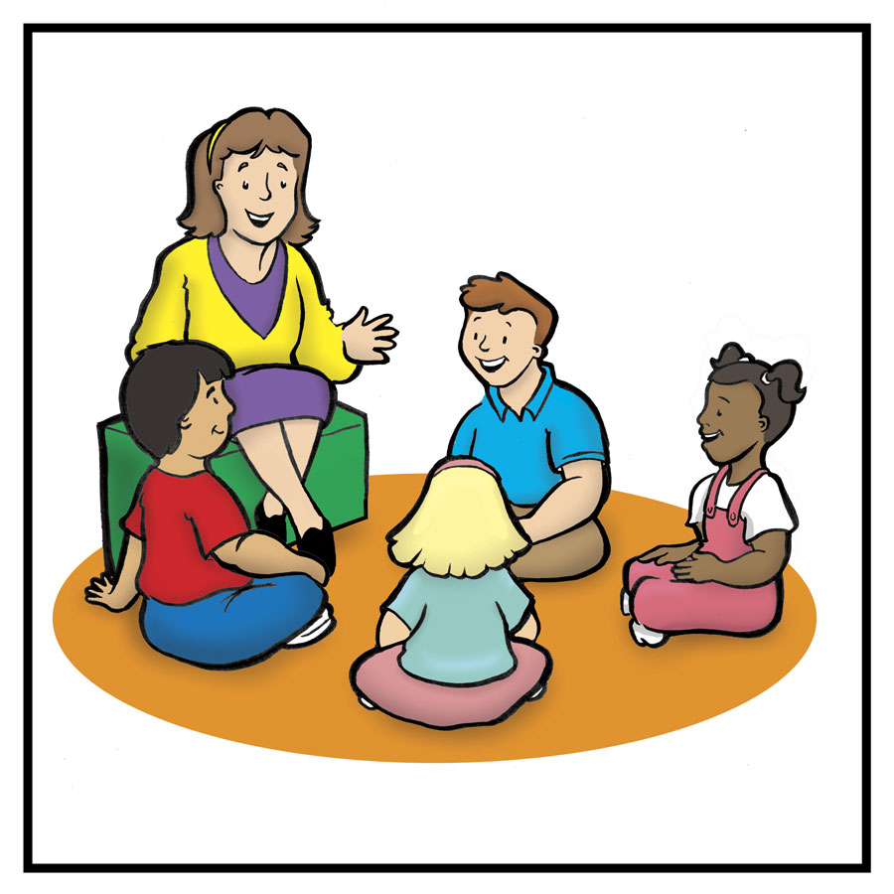
Teacher: Listen to the word I say. Hold up the correct picture.
Teacher: Burger
Children: Children hold up the correct picture from the series the teacher had already given them.

Slide 6
Listening
I can hear a word or a color and tell which picture or object it is.
Point TOOL

Slide 7
Teacher: Listen to the word I say. Point to the correct picture.
Teacher: Burger
Children: Children point to the correct picture from the series the teacher had already given them.

Slide 8
Listening
I can hear a word or a color and tell which picture or object it is.
Story TOOL

Slide 9
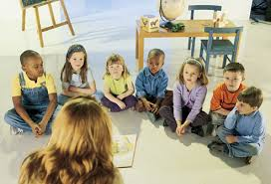
Teacher: Listen to the story. Point to the correct picture when you hear the word in the story, or
Listen to the story. Hold up the correct picture when you hear the word in the story.
Teacher: Reads the story

Slide 10
Listening
I can hear a word or a color and tell which picture or object it is.
www.munjez.com
Eli Ghazel

Slide 11
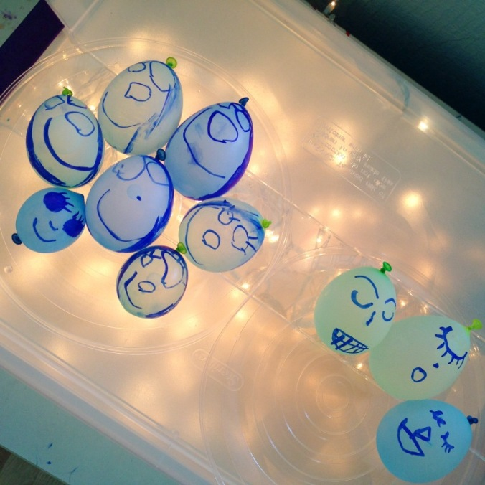
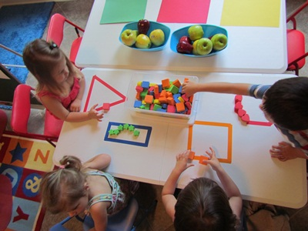
Listening
I can hear a word or a color and tell which picture or object it is.
CENTER TOOLS
FUN TABLES
TEACHER LED TABLE
Teacher: Listen to the word I say. Hold up the correct picture.
Teacher: Burger
Children: Children hold up the correct picture from the series the teacher had already given them.

Slide 12
Listening
I can hear a word or a color and tell which picture or object it is.
CENTER TOOLS
FUN TABLES
TEACHER LED TABLE
Teacher: Listen to the word I say. Hold up the correct picture.
Teacher: Burger
Children: Children hold up the correct picture from the series the teacher had already given them.

